Slide 1
My Maths

Slide 2
What is My Maths?
'MyMaths' is a whole-school interactive resource for use in the classroom and at home that is easy to use alongside any other maths resources to consolidate learning.

Slide 3
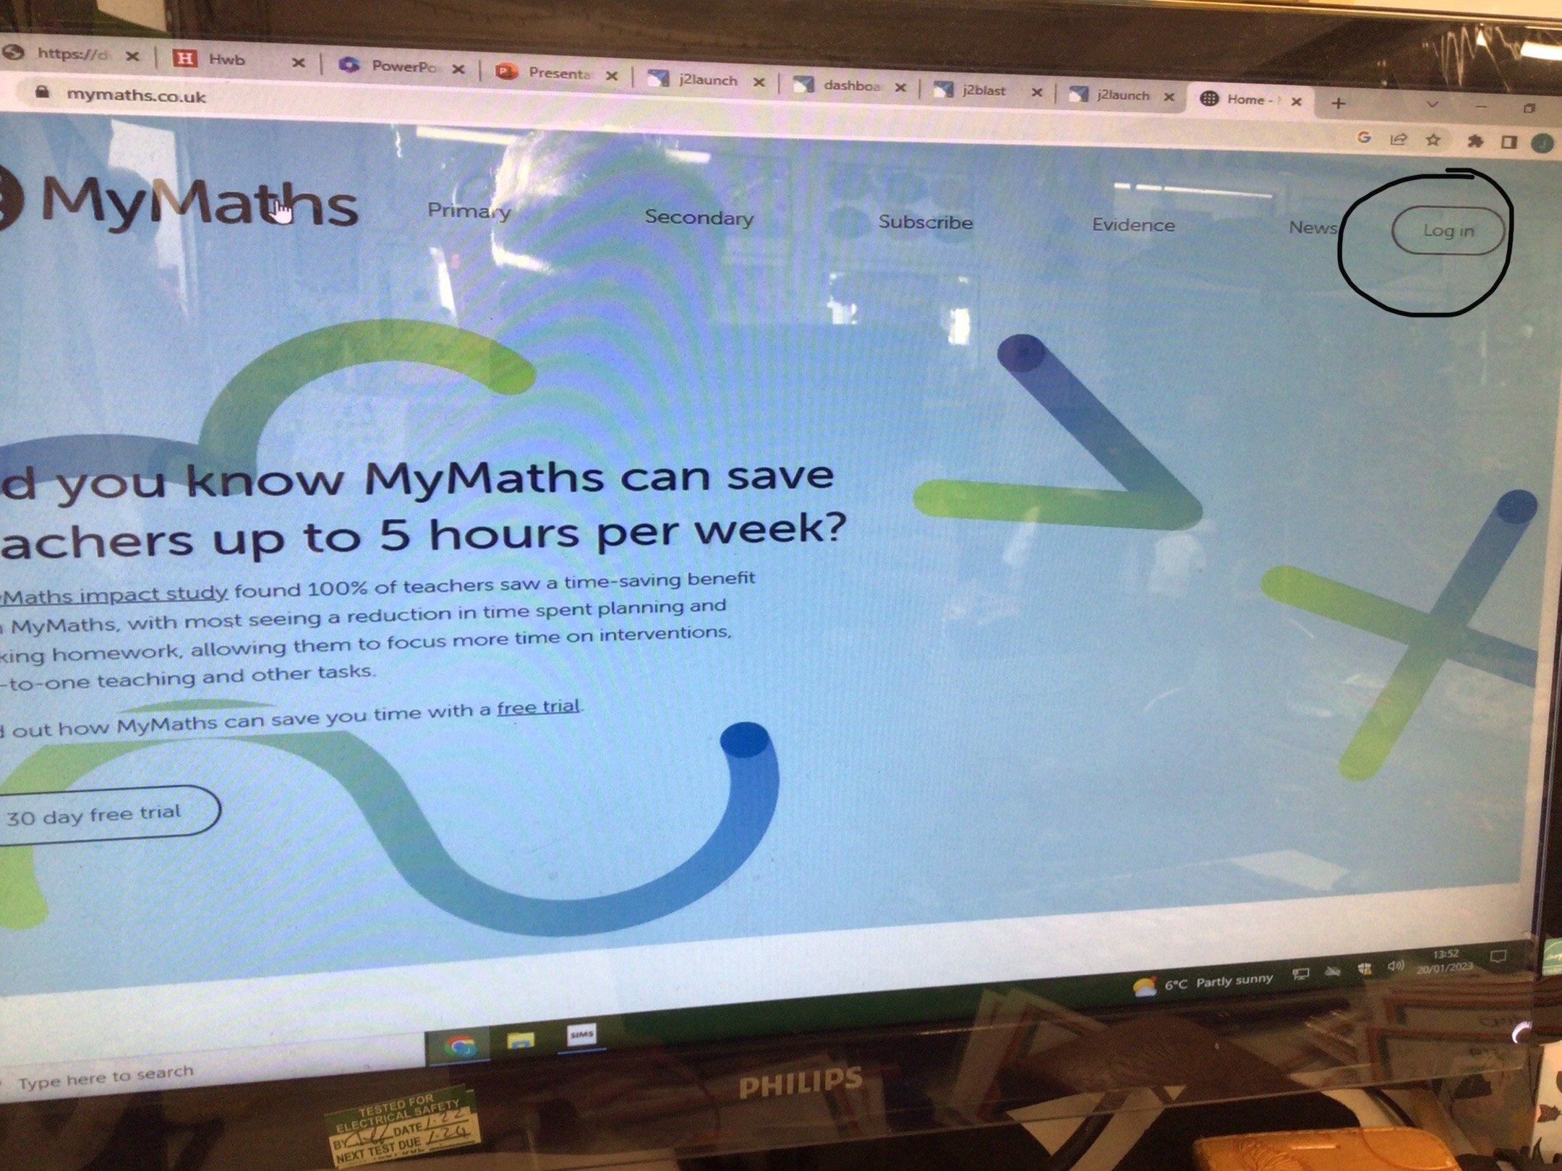
First click login
How to log onto 'My Maths'

Slide 4
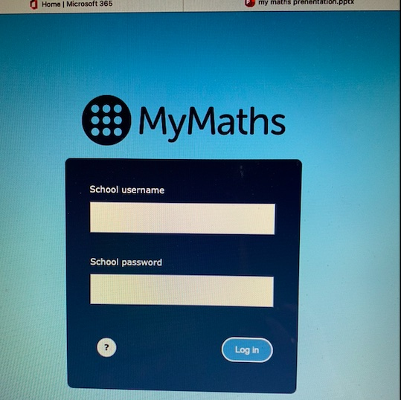
Next input the school details. These were handed out for homework.

Slide 5
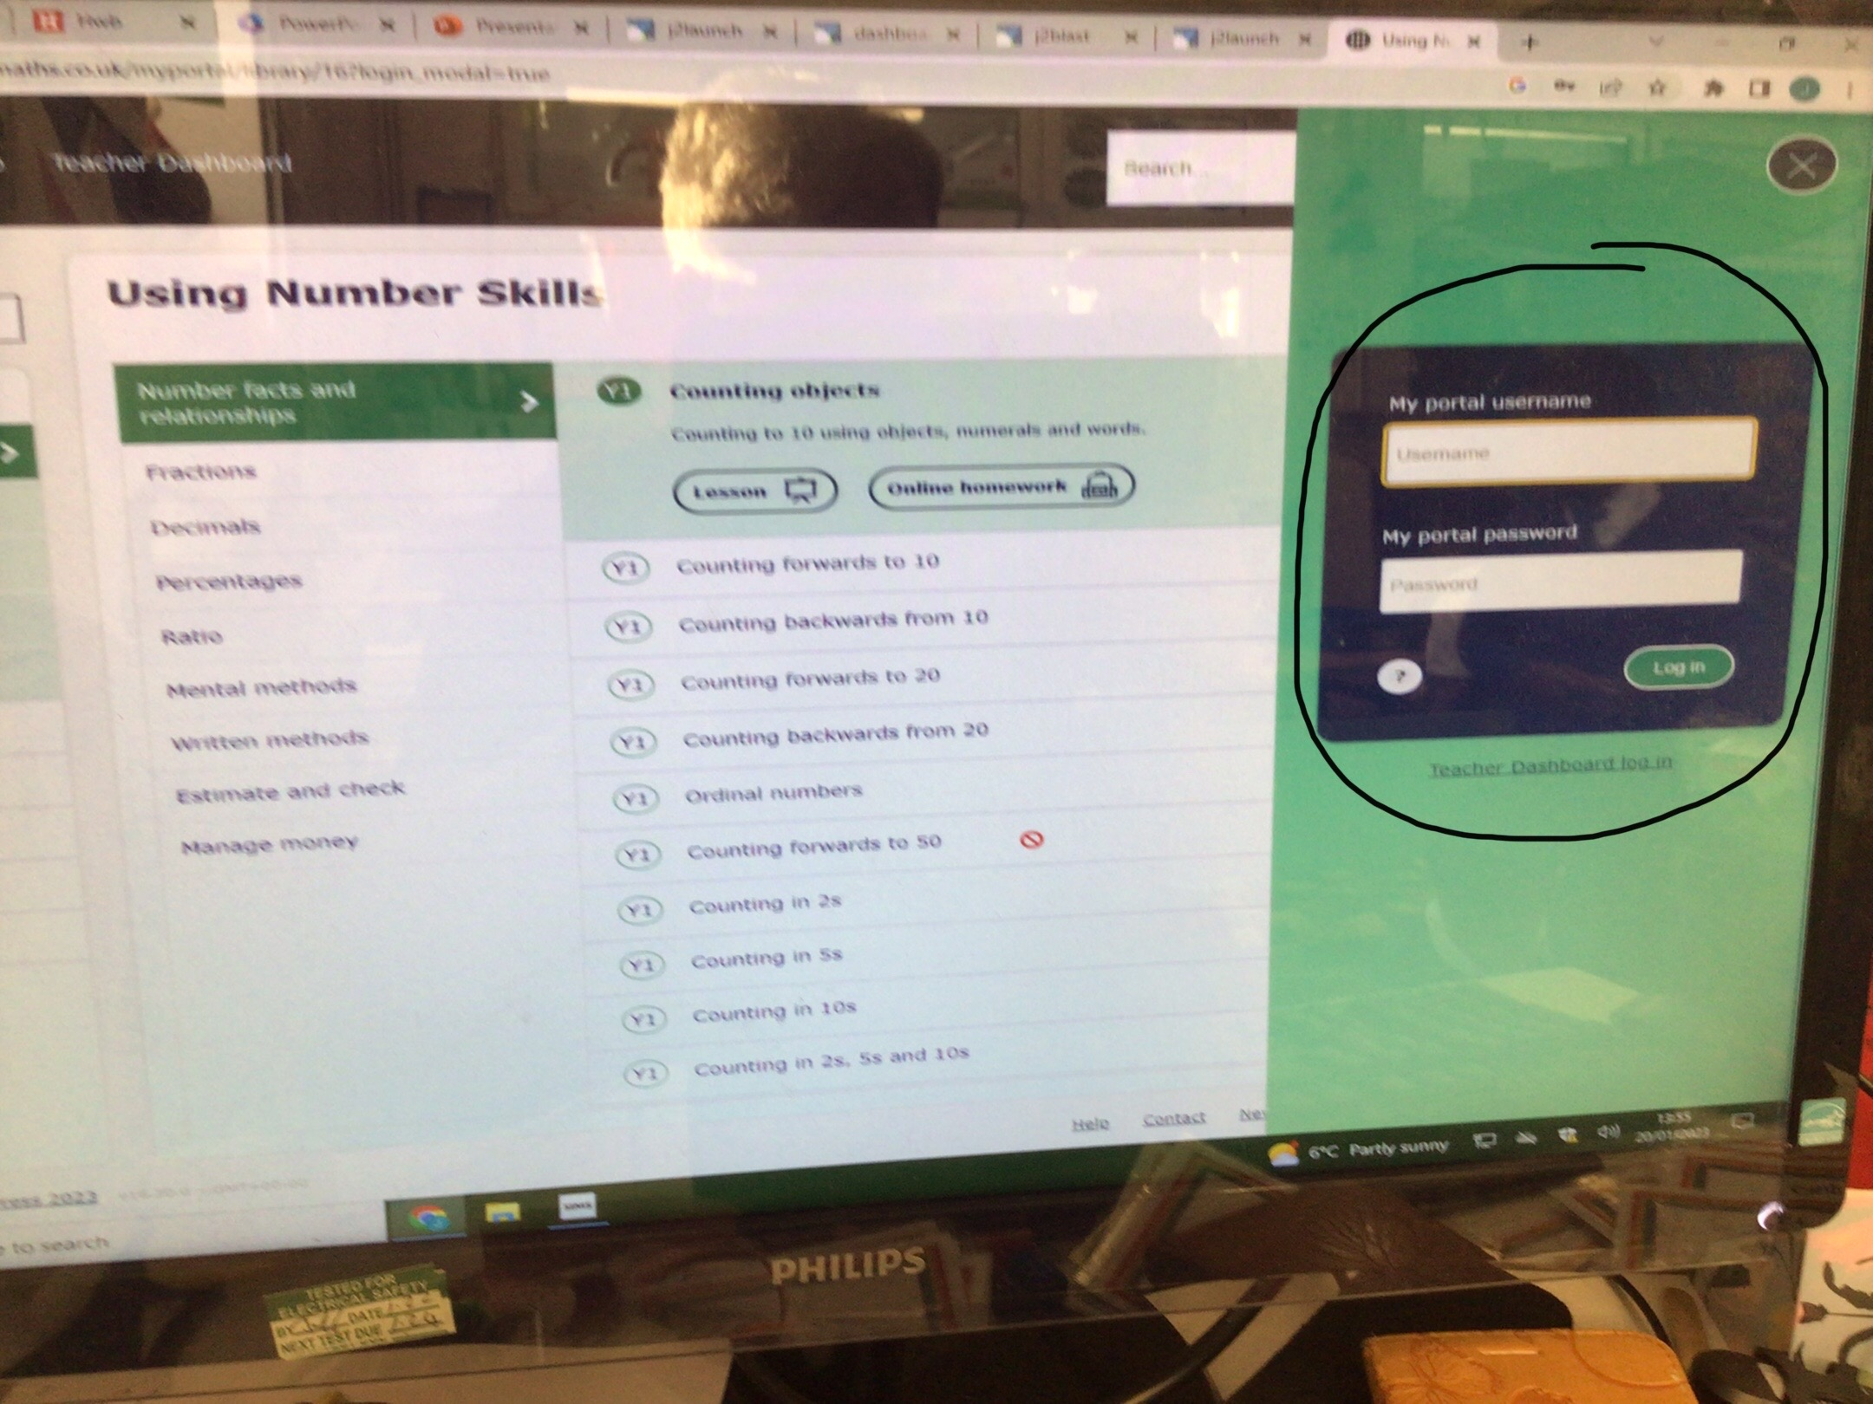
Then input your childs username and password.

Slide 6
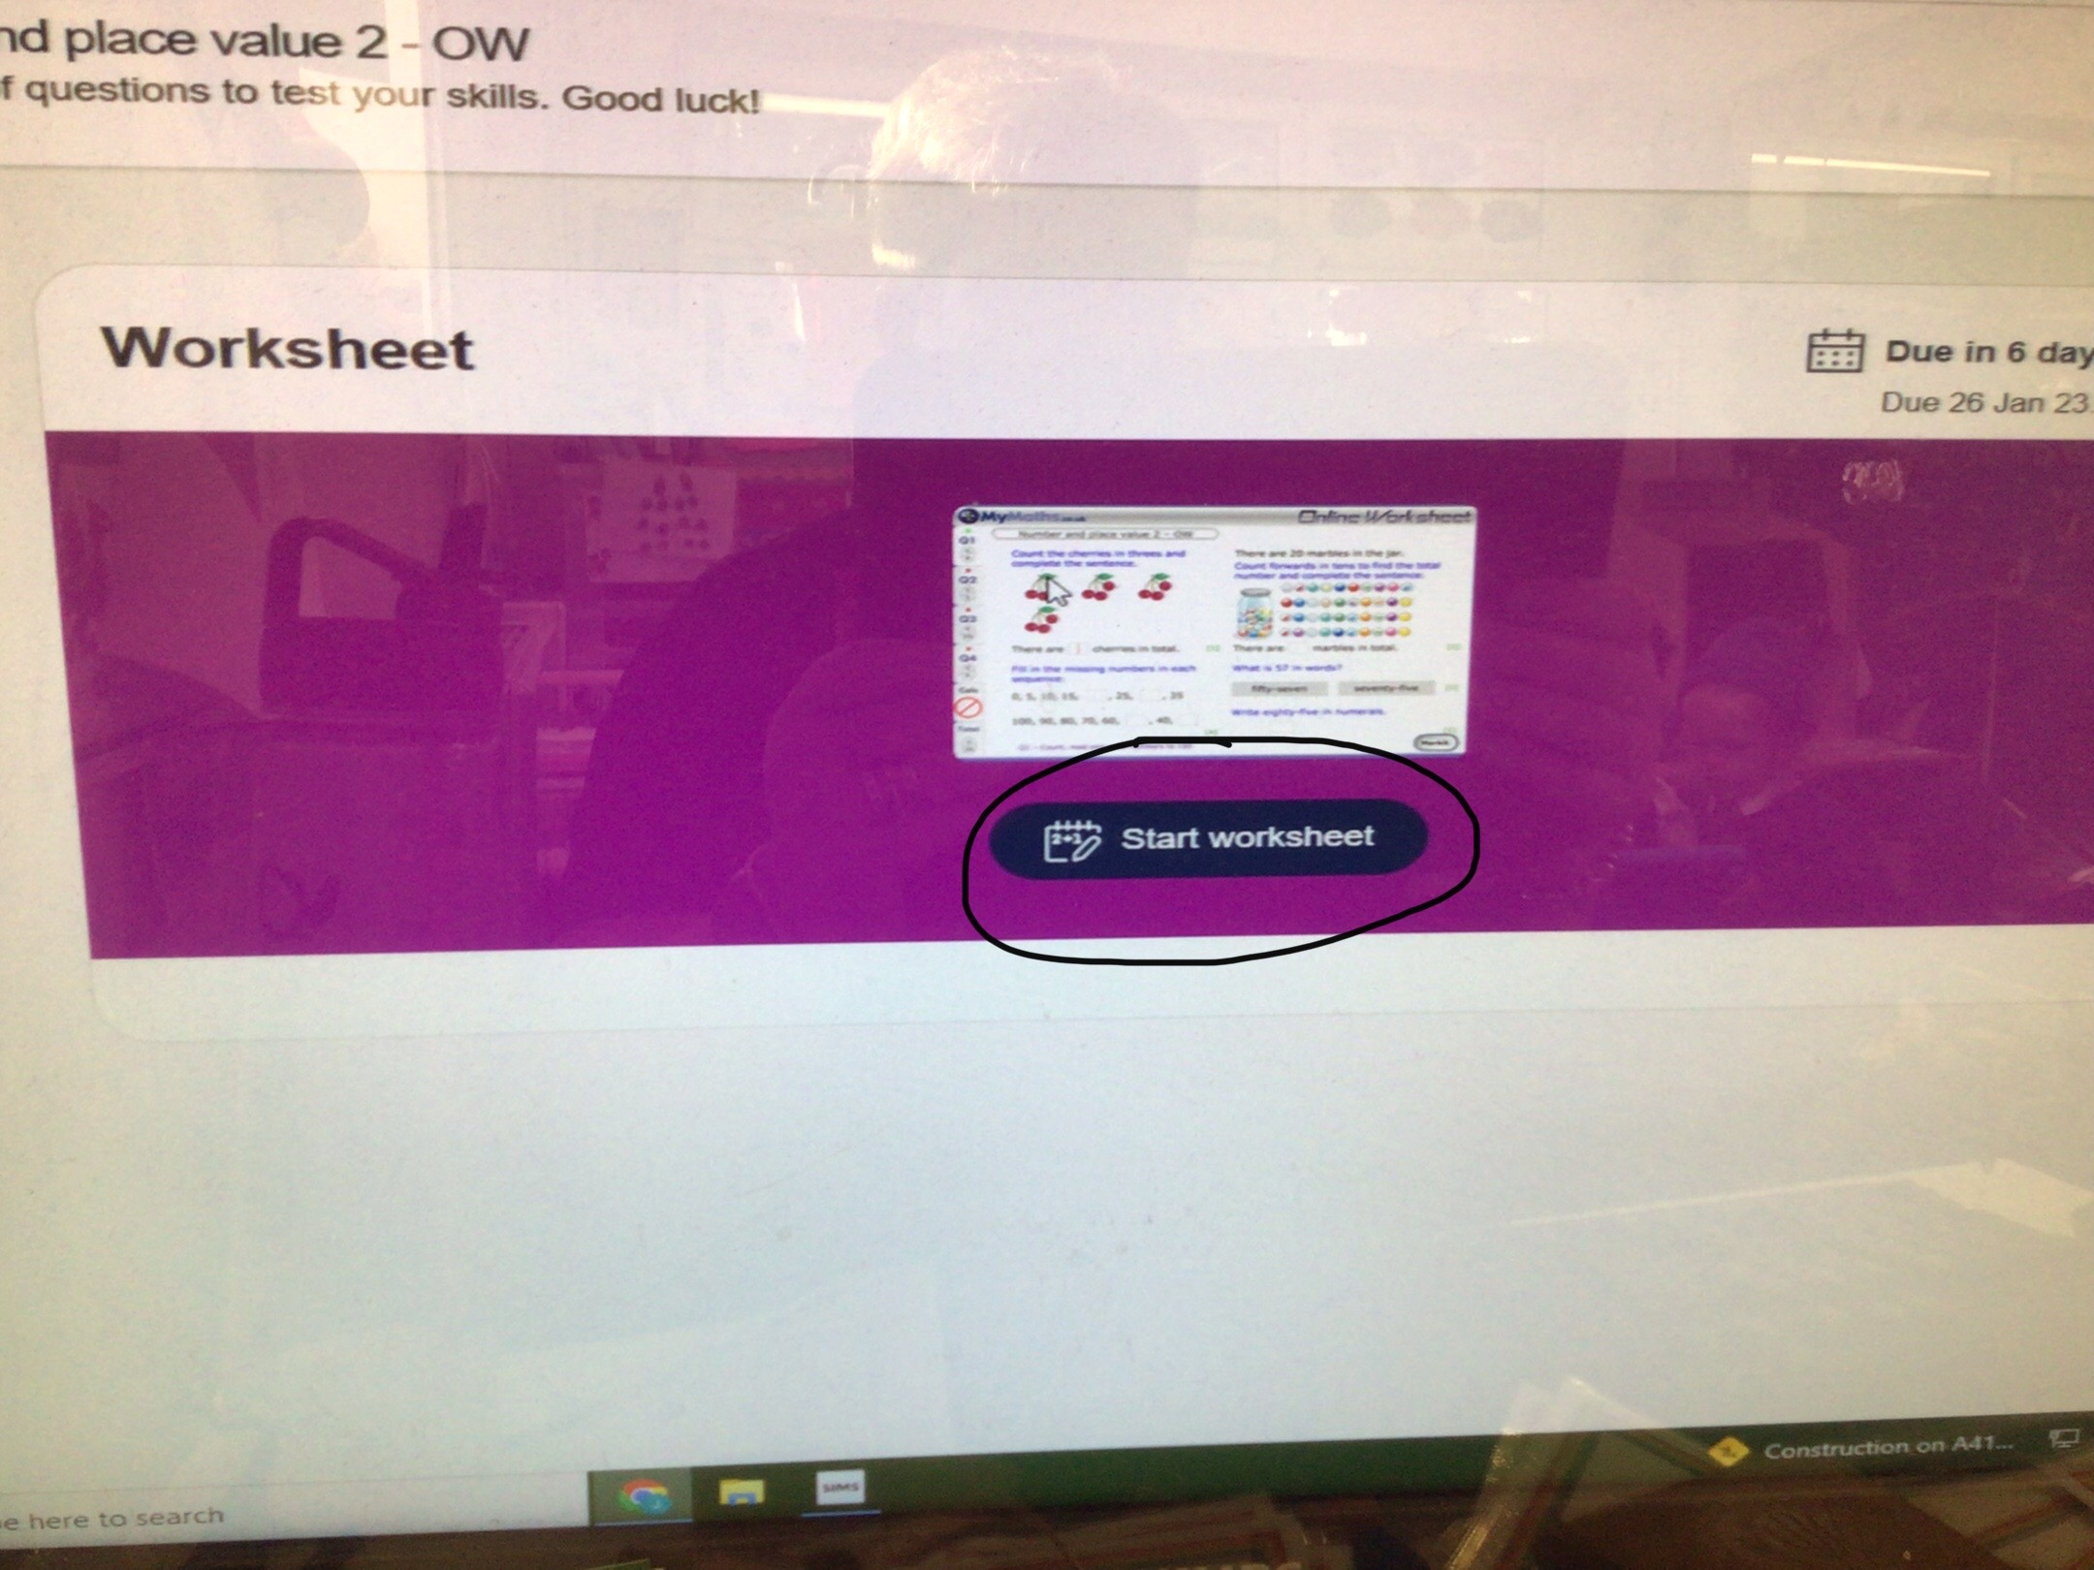
You will then see the work that has been allocated for homework.

Slide 7
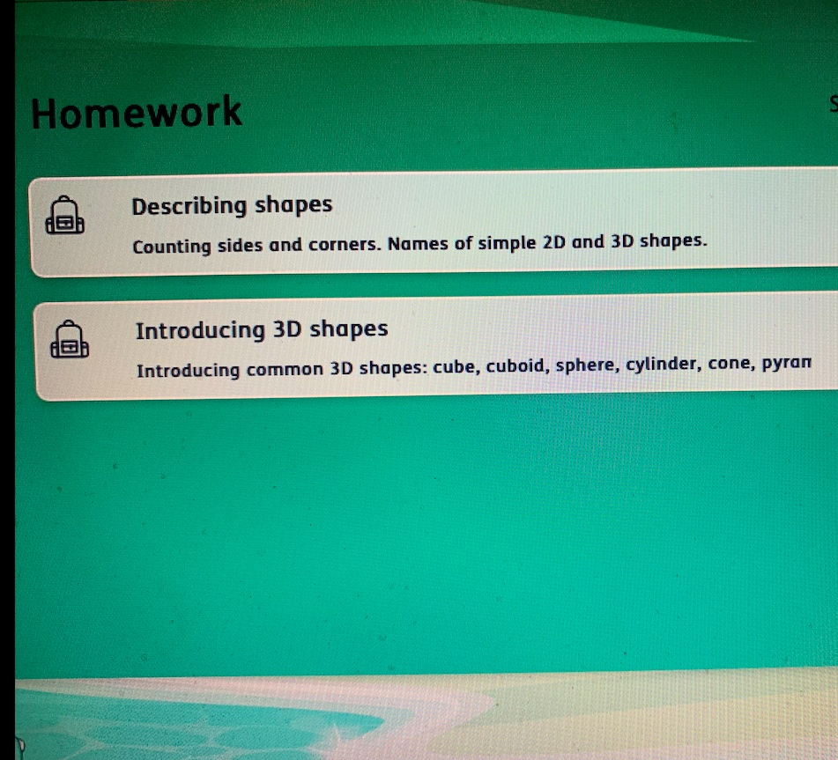
Click on a homework to complete.

Slide 8
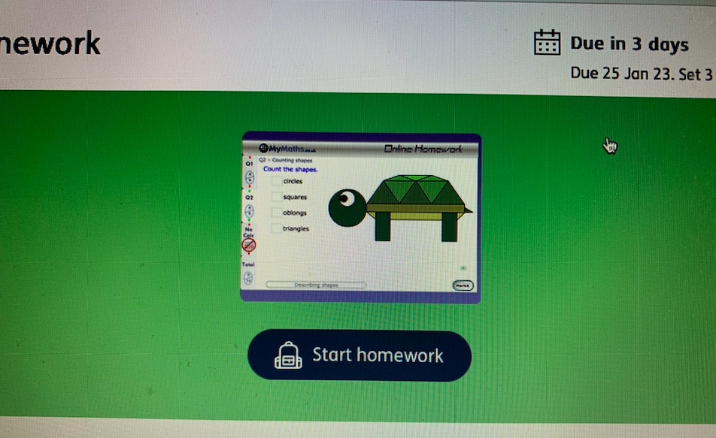
Press start worksheet.

Slide 9
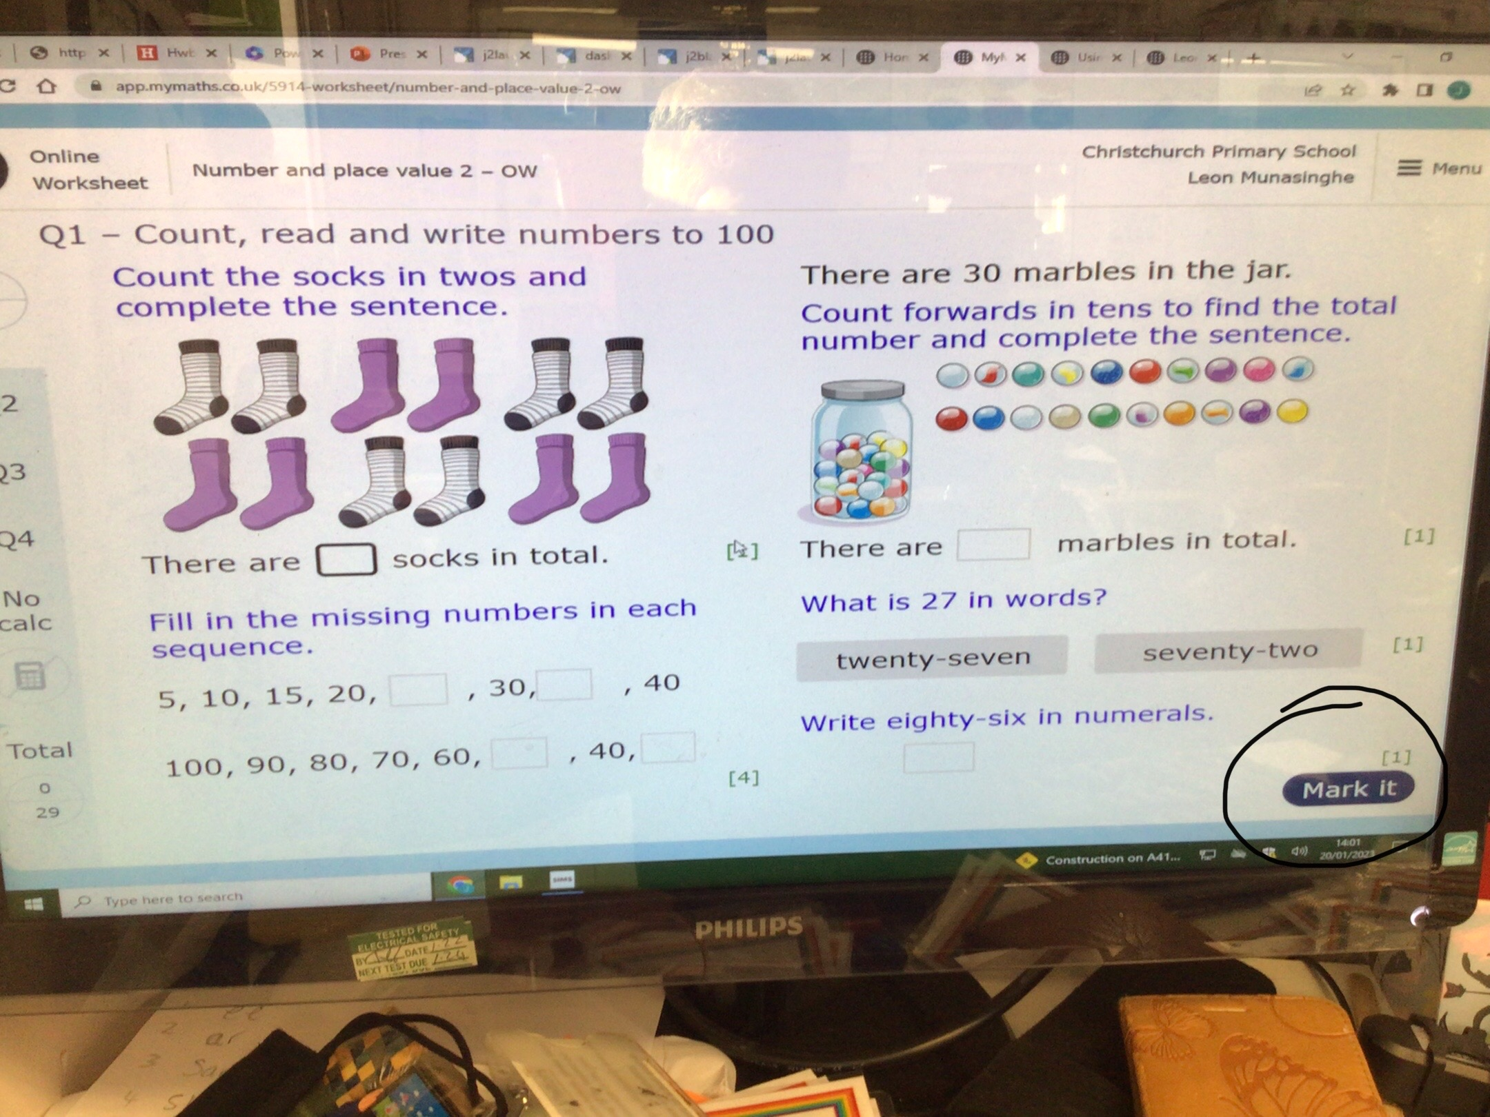
You will see the questions that children are to answer. Your child will need to complete all parts to each question before pressing mark it.

Slide 10
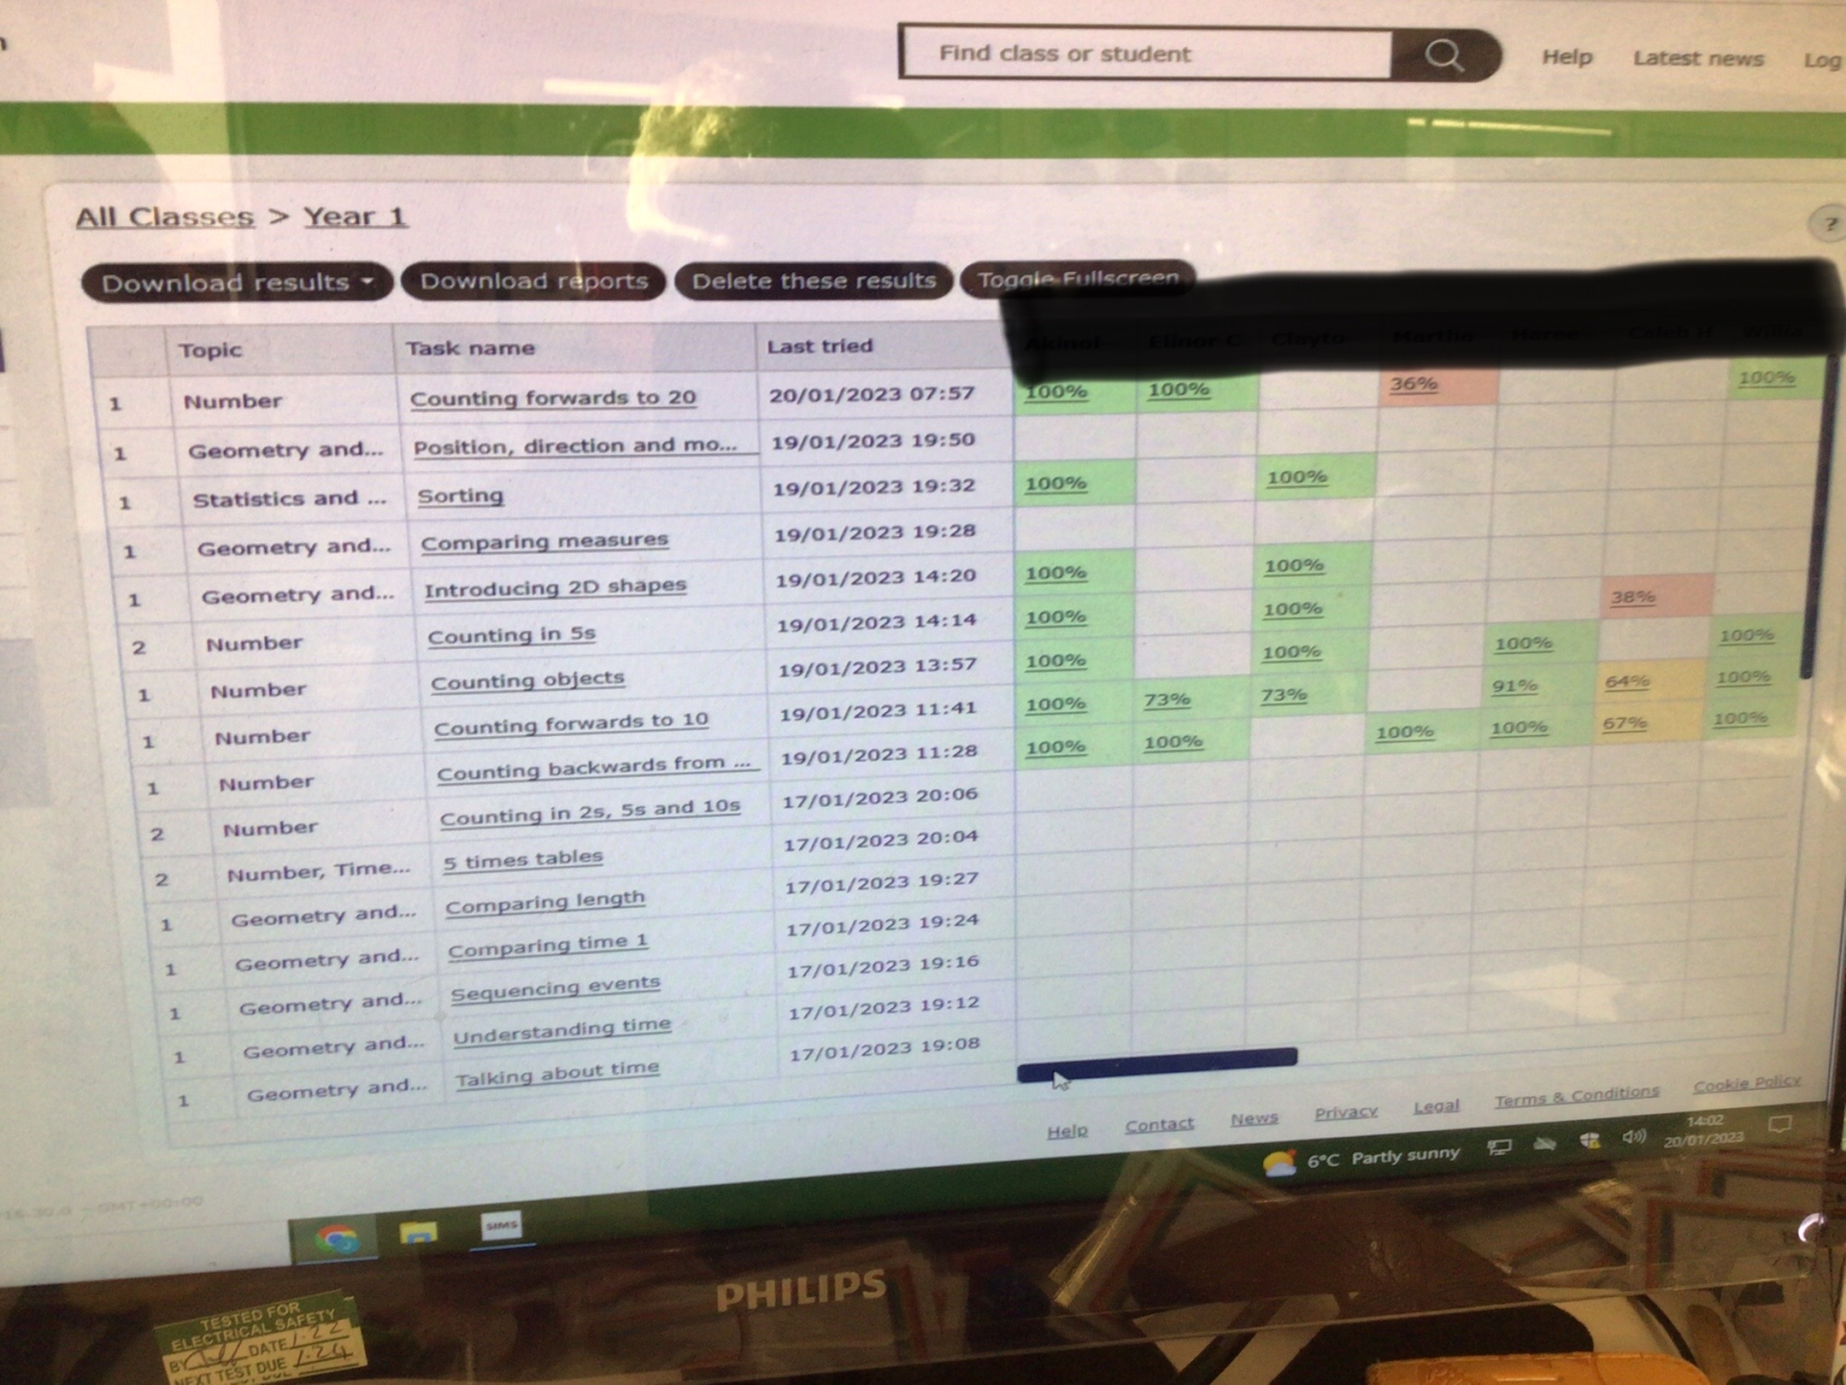
Your child's teacher will be able to see when they have completed the homework. They will also see what your child is still finding tricky.

