Slide 1
What is Spell Blast and why use it?
Spell Blast is a program on HWB. Hwb is a platform that is used for all primary schools in Swansea.
All the children have individual login details to access HWB and have used it many times in FP2.
Children can use Spell Blast to access their weekly spelling words. Spell Blast is a fun and an exciting way for children to learn how to spell.
Children in FP2 will take part in a weekly spelling quiz on the words they have been practising in Spell Blast.
New words will be allocated every Friday. ☺

Slide 2
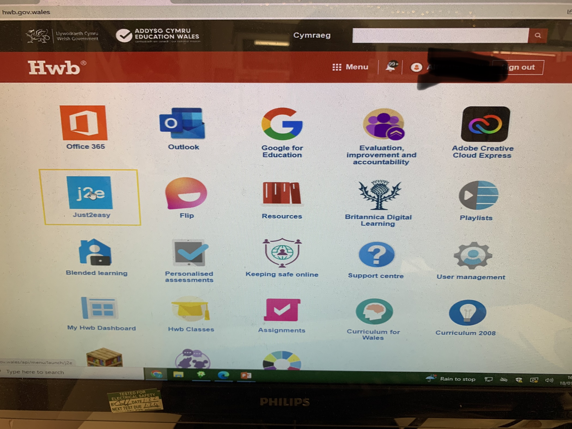
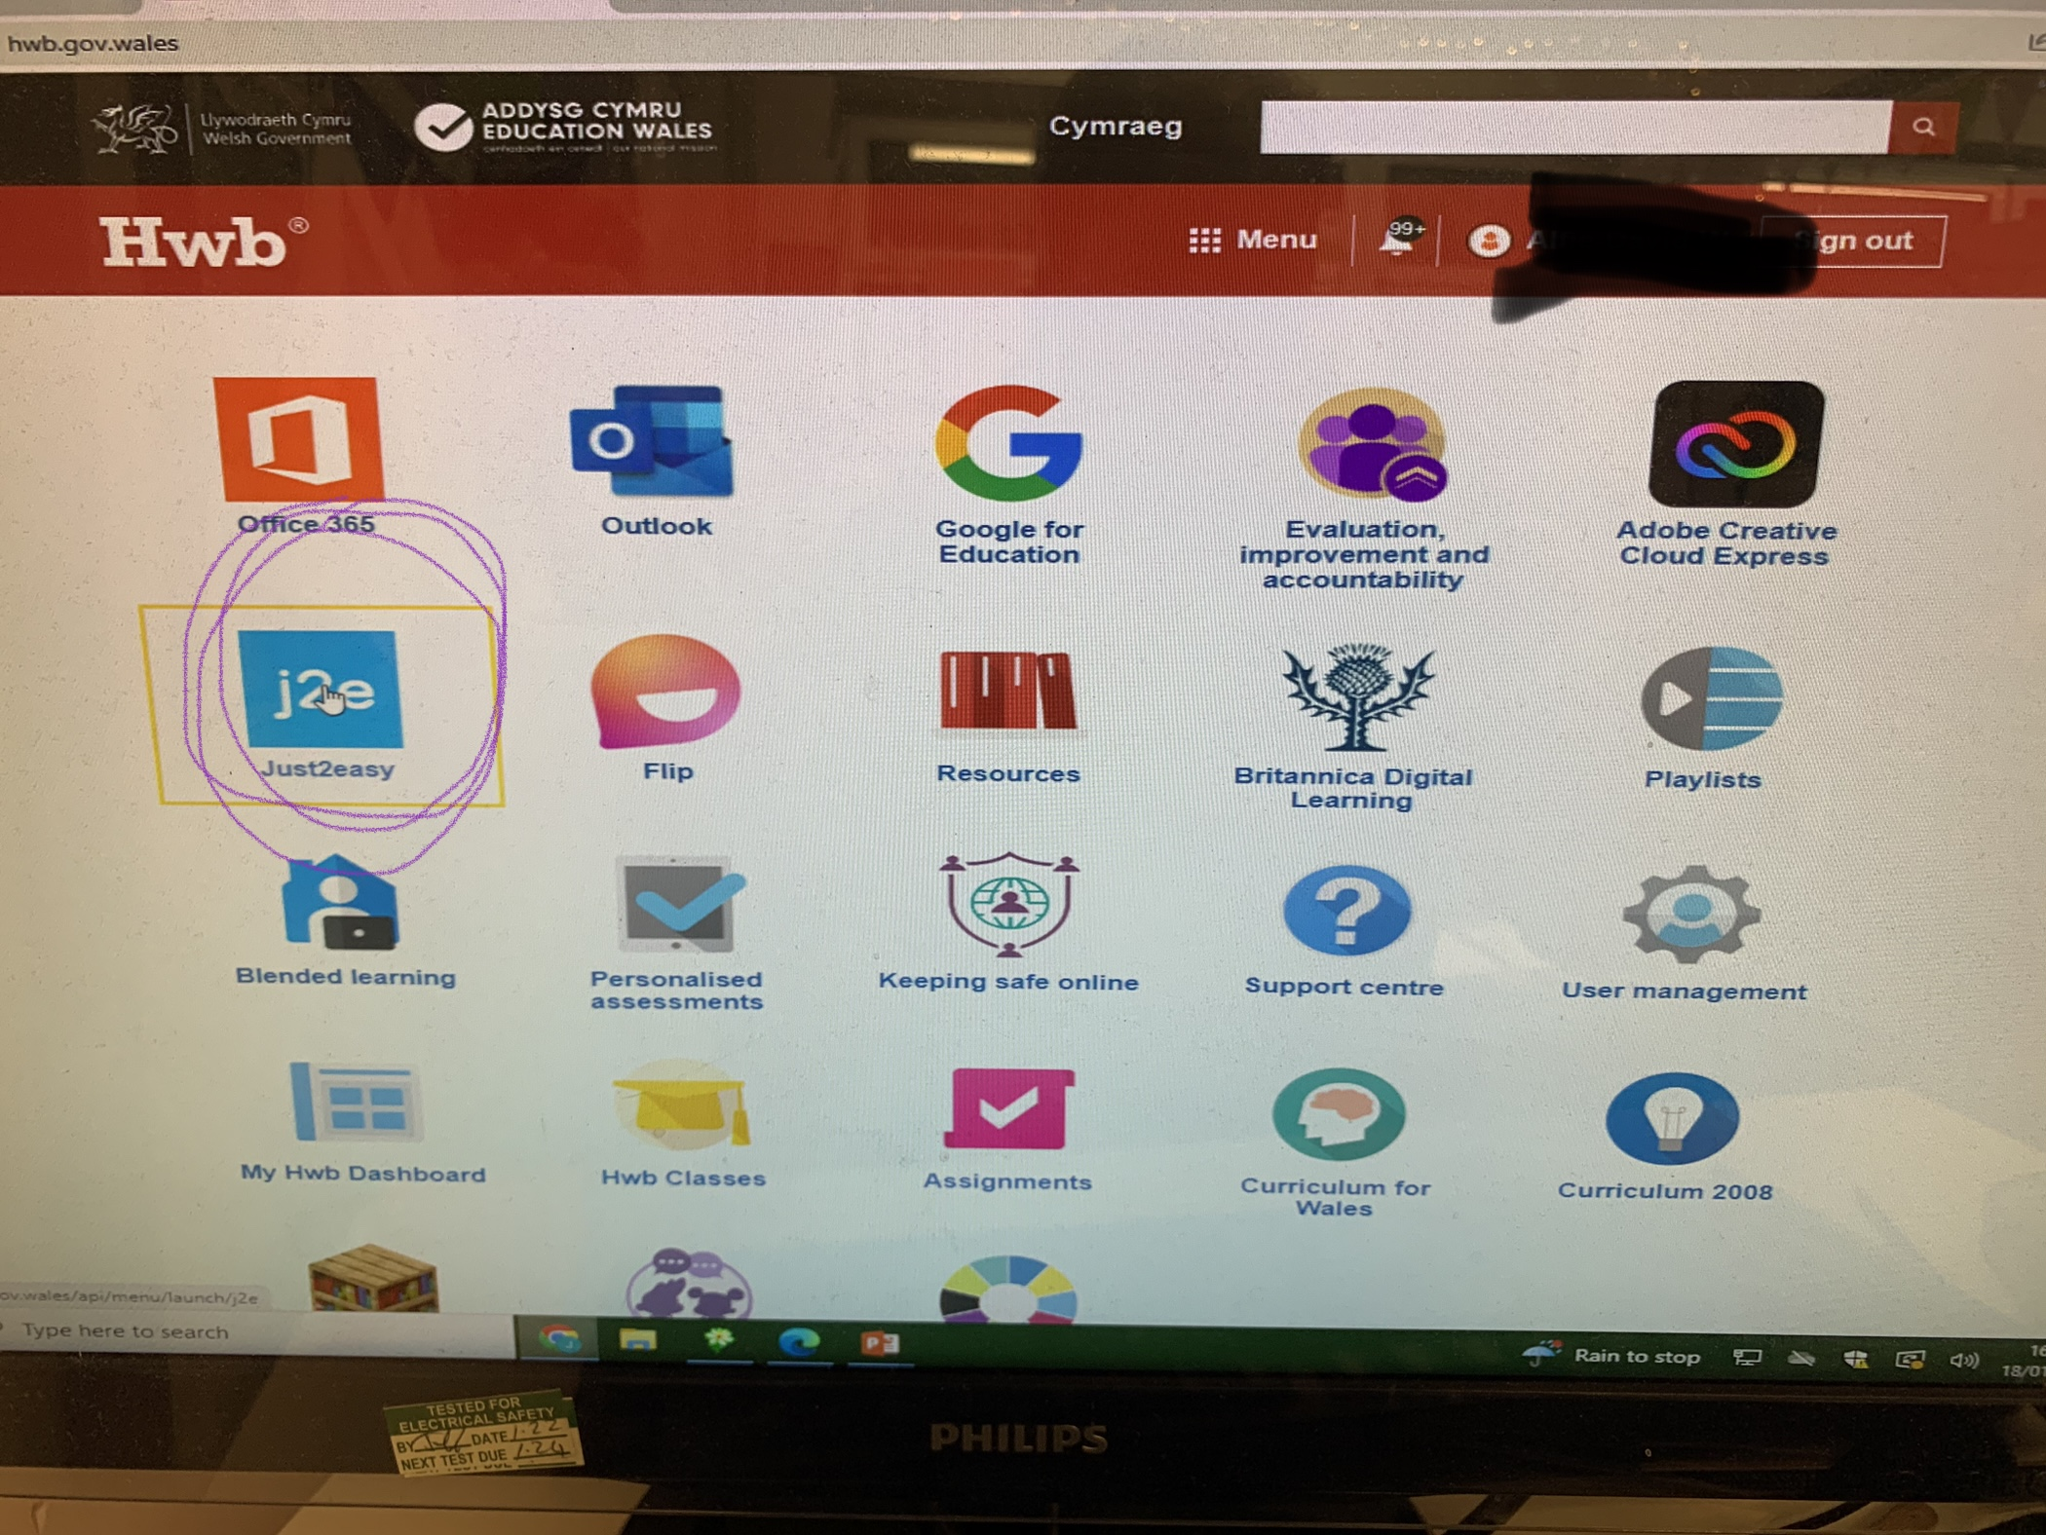
How to Access Spell Blast
First log into your child’s HWB account, using the login details which have been stuck into their homework books.
Next press the J2e tile.

Slide 3
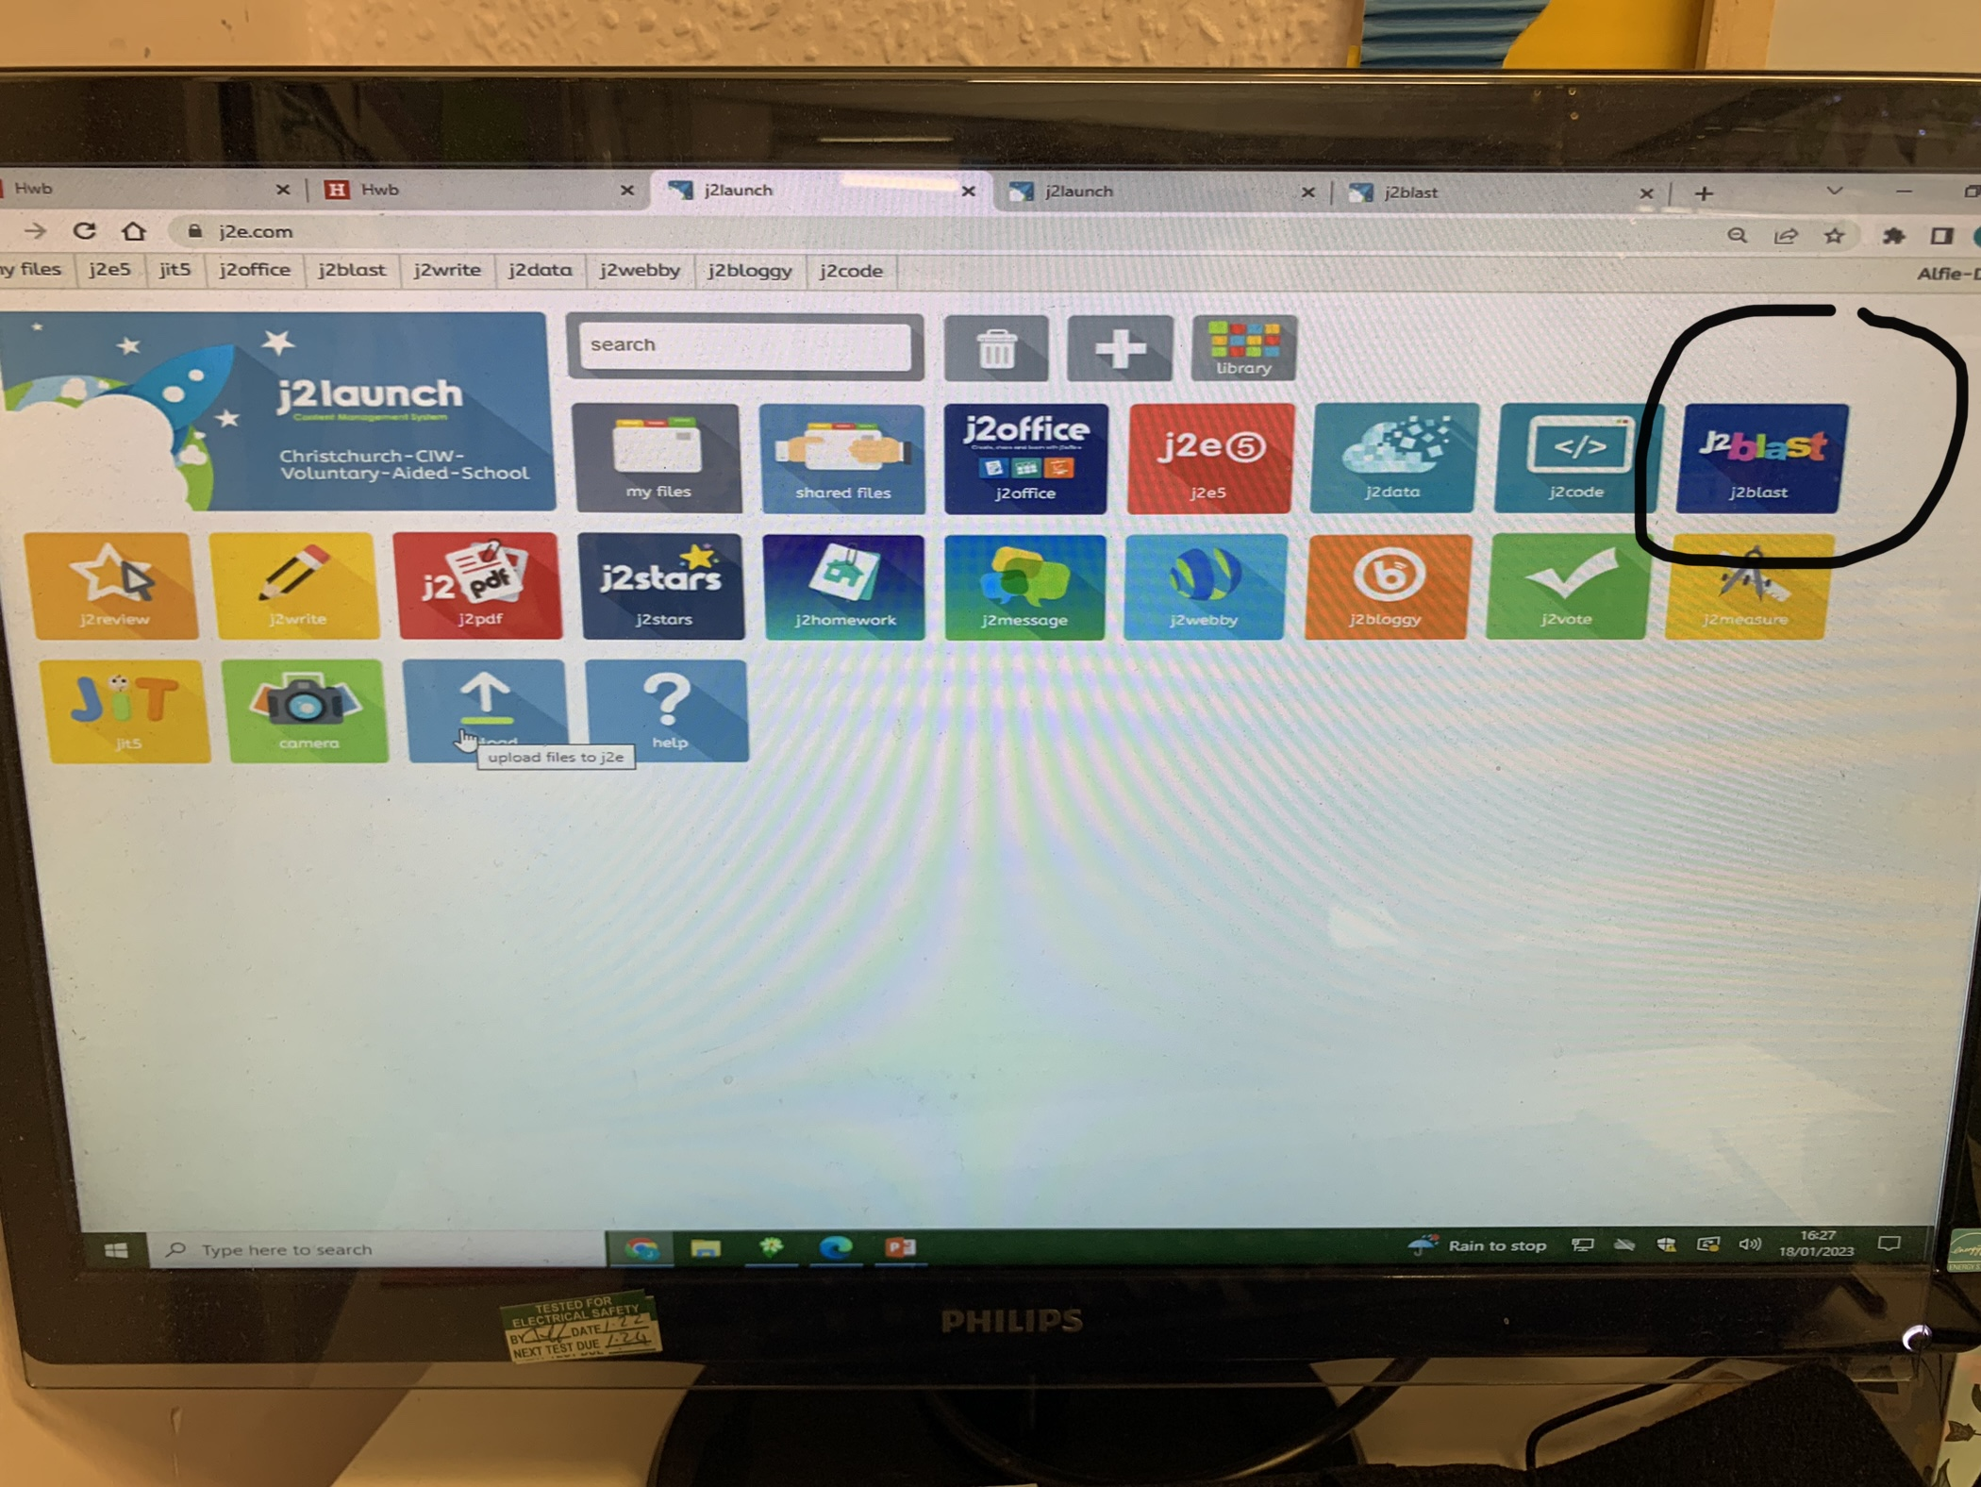
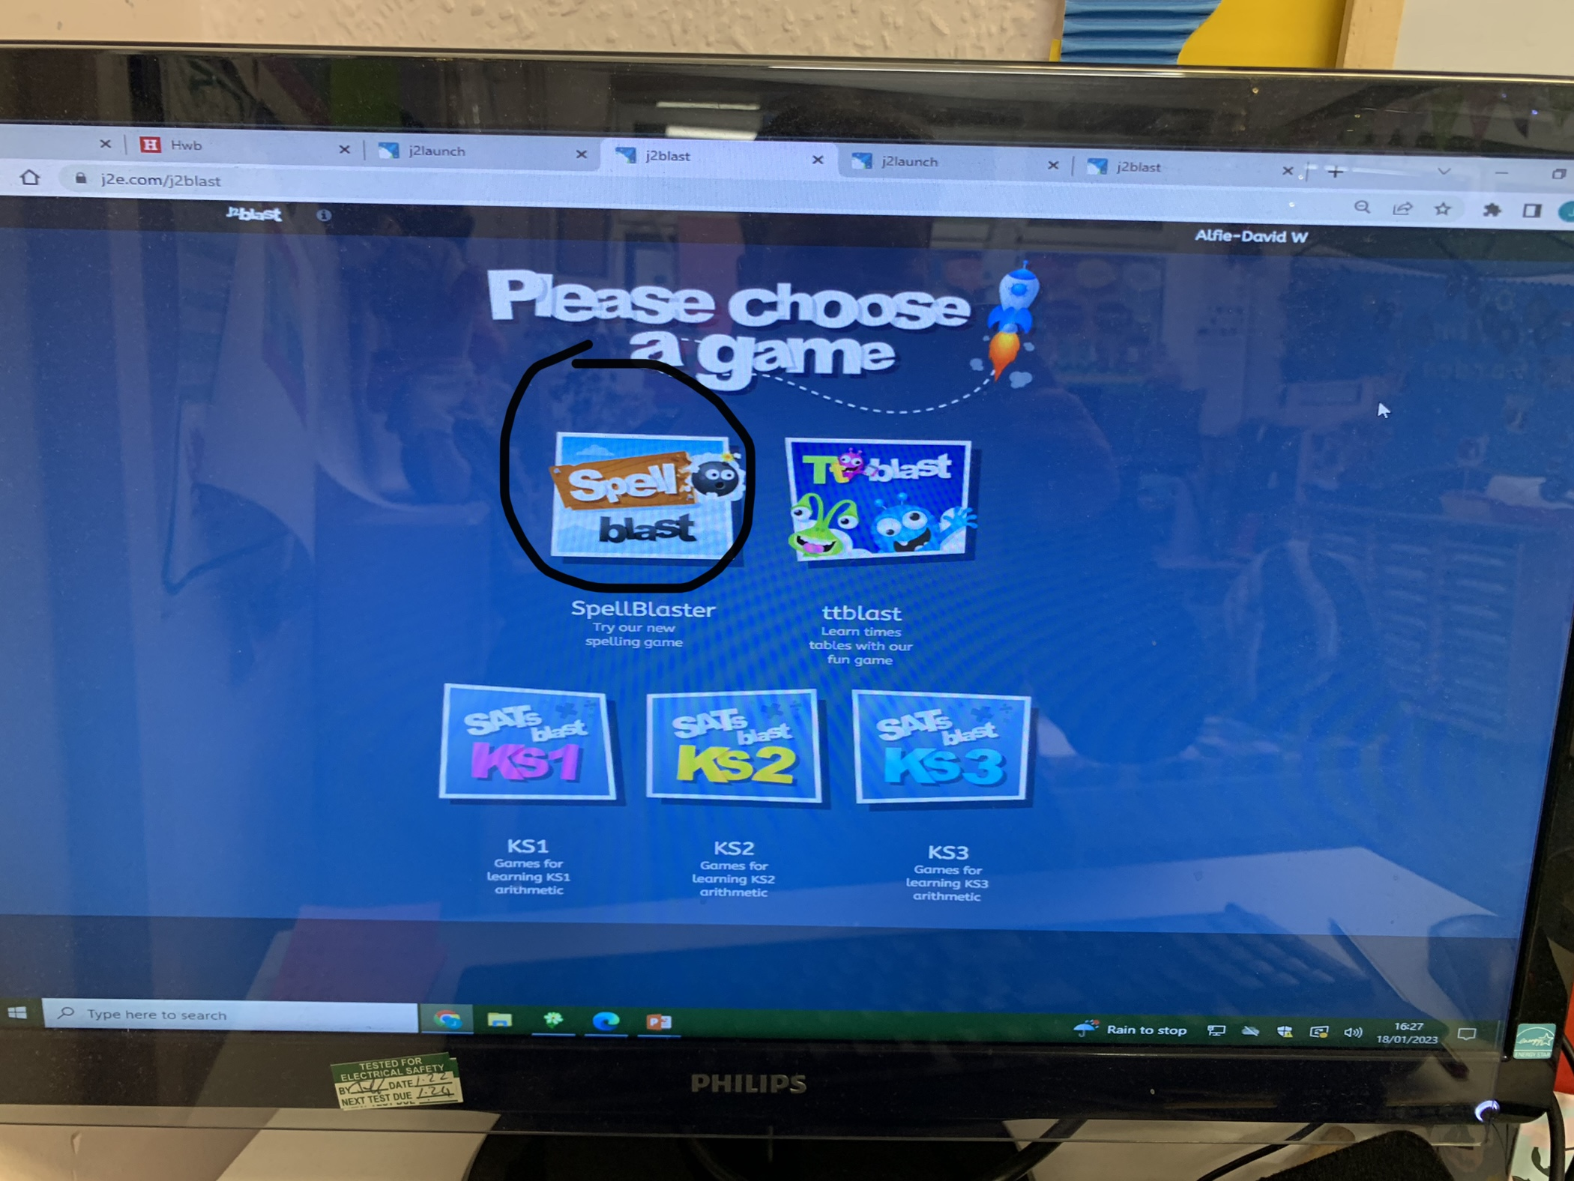
Then click onto J2 Blast
Then press Spell Blast

Slide 4
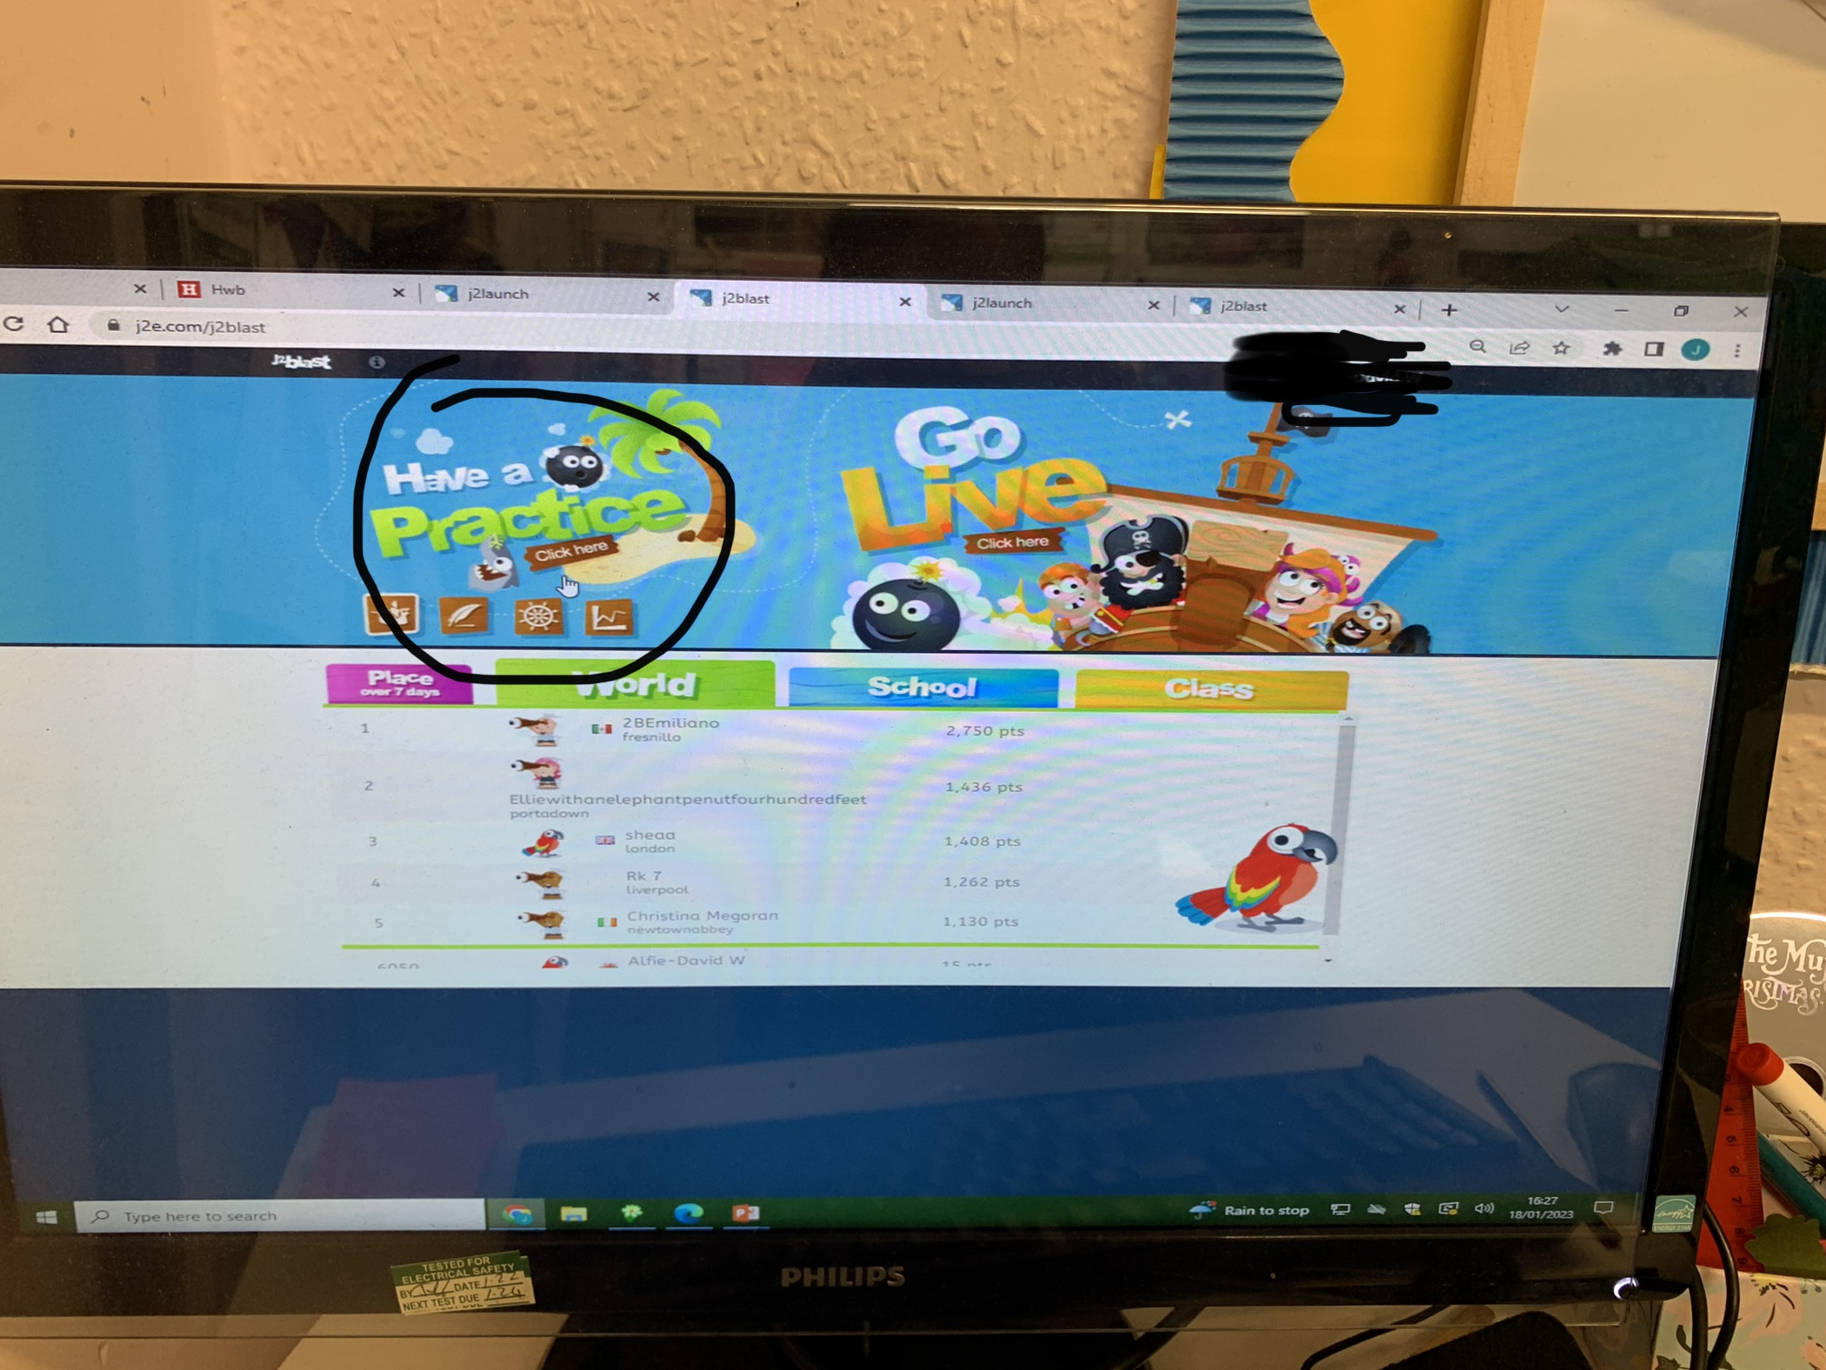
After that press have a practise, press here.

Slide 5
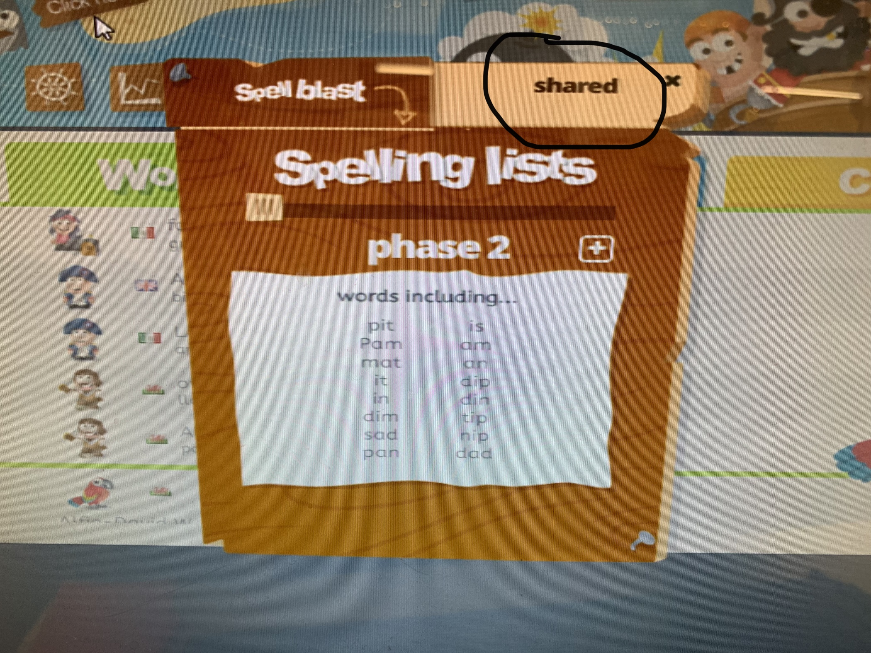
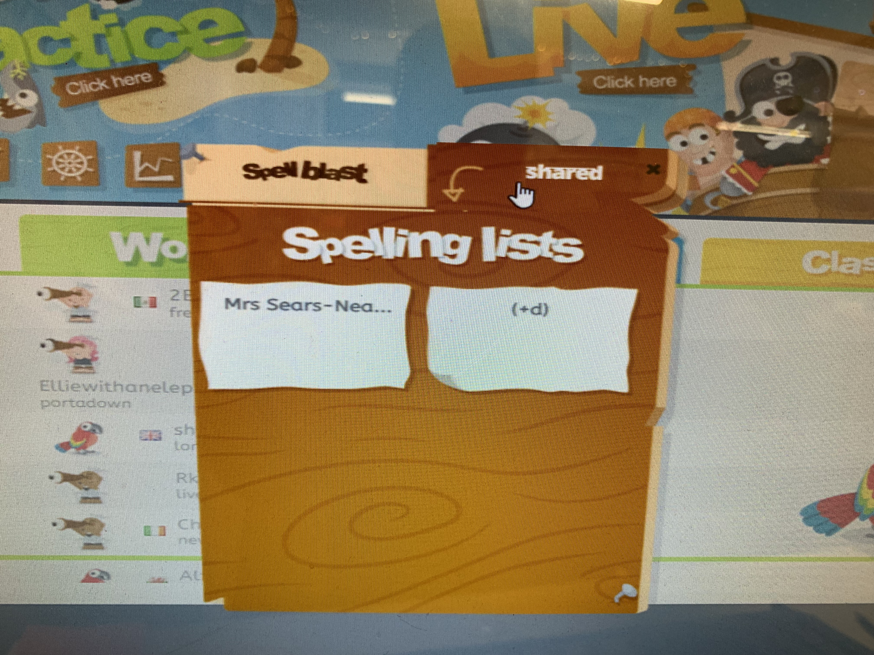
Then, click on shared.
Then, teacher name

Slide 6
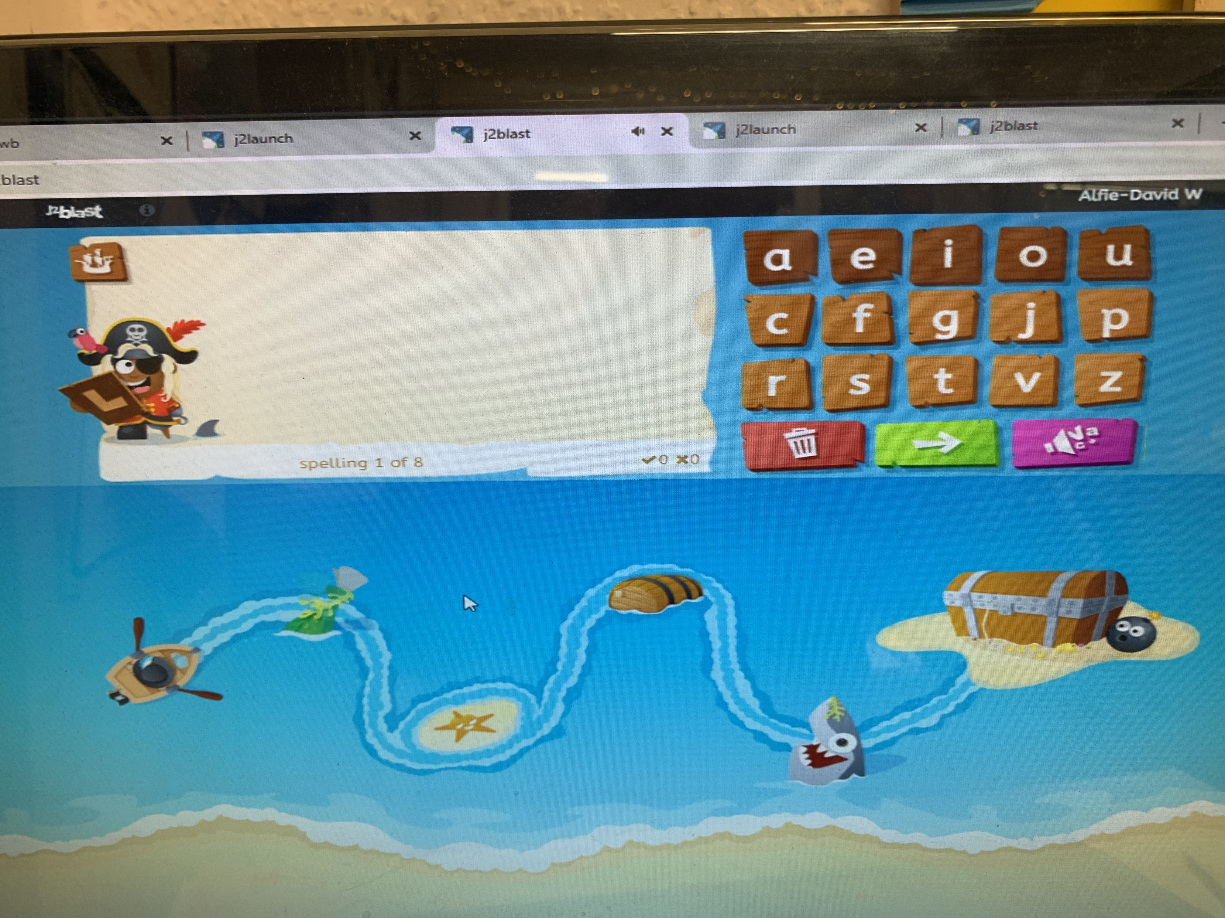
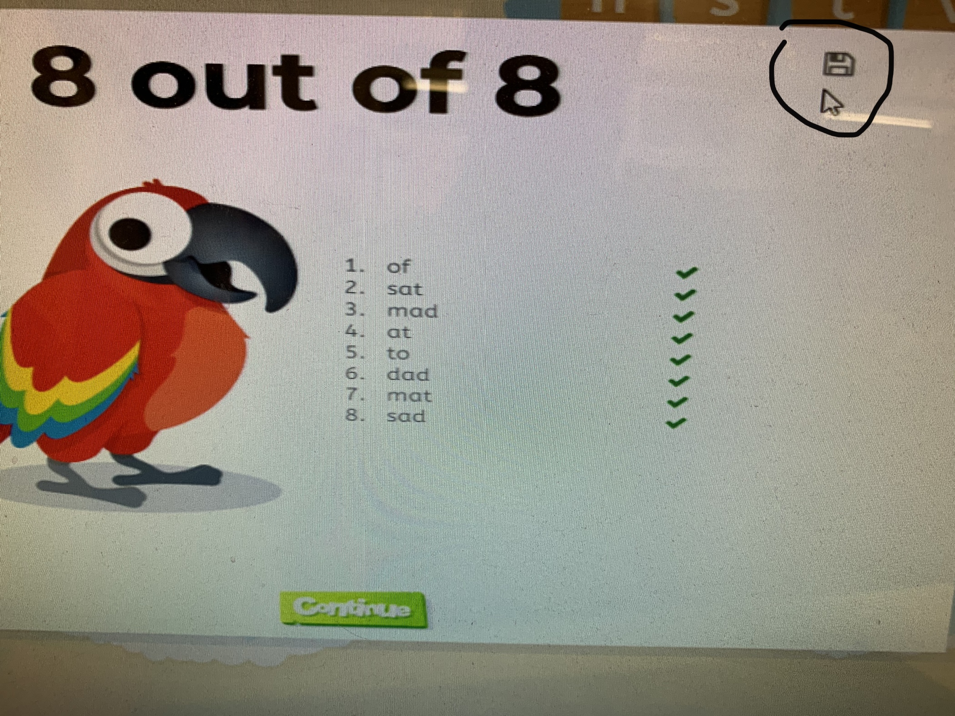
You should now have access to the spelling game with the words that are going to be included in your child’s spelling quiz on a Friday.
The game will sound out the word for your child to use the keypad to spell the word.
Your child will be told if the word is correct or not.
At the end of the practise, a list of the words will be displayed.
Your child can practise these words as many times as possible.
When your child has finished the game, if they press the save button, then the teacher can see the results from their HWB account.

Slide 7
I hope your child enjoys learning to spell with Spell Blast ☺
Your child can also practise their spelling in their homework book, by writing a sentence with their words included.

