Slide 1

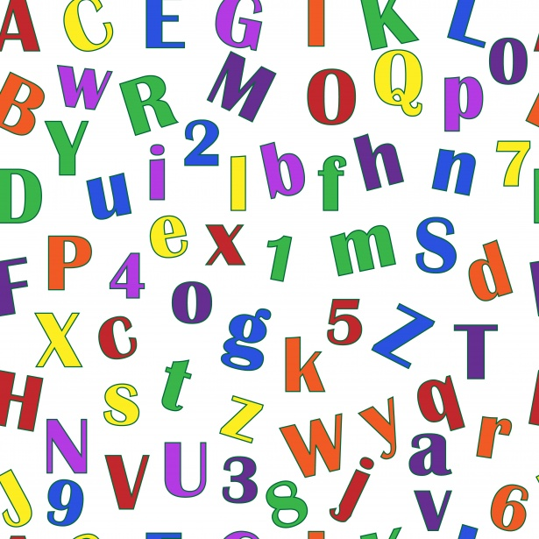
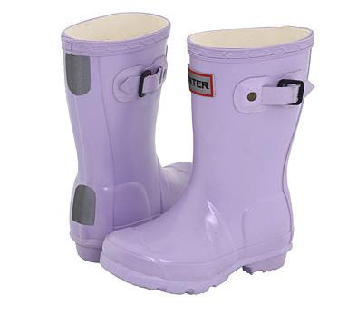
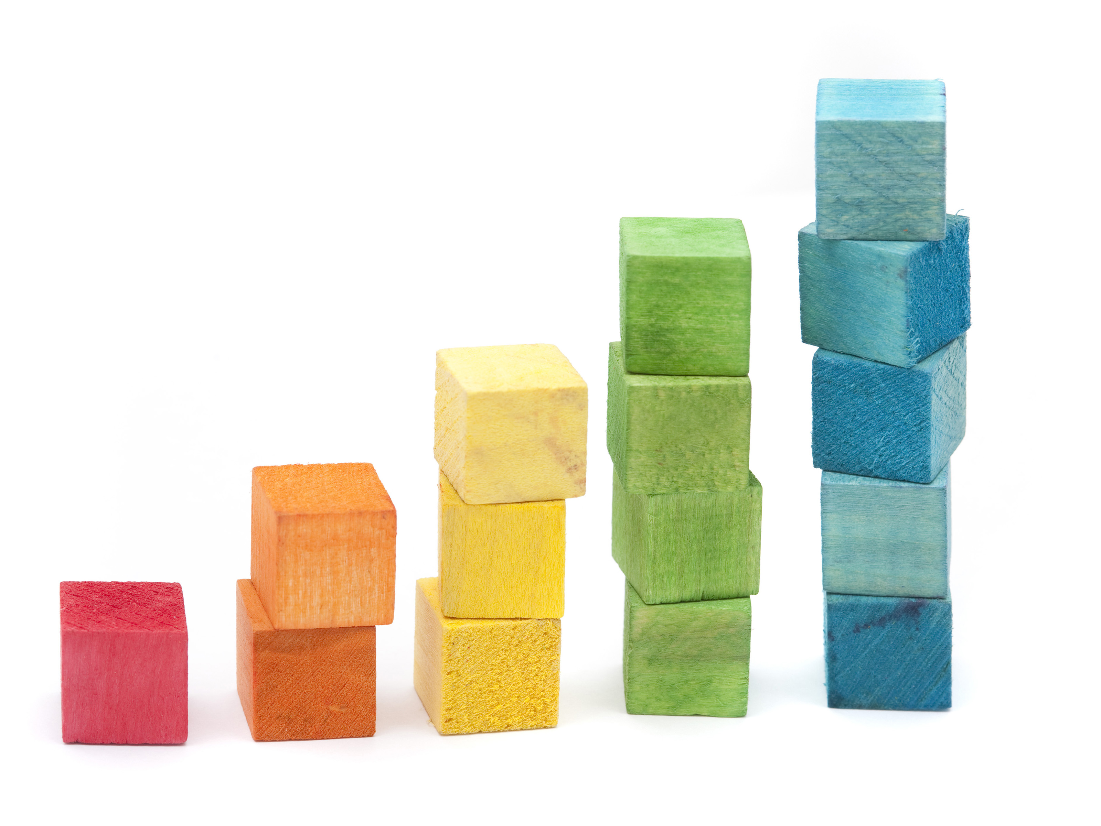
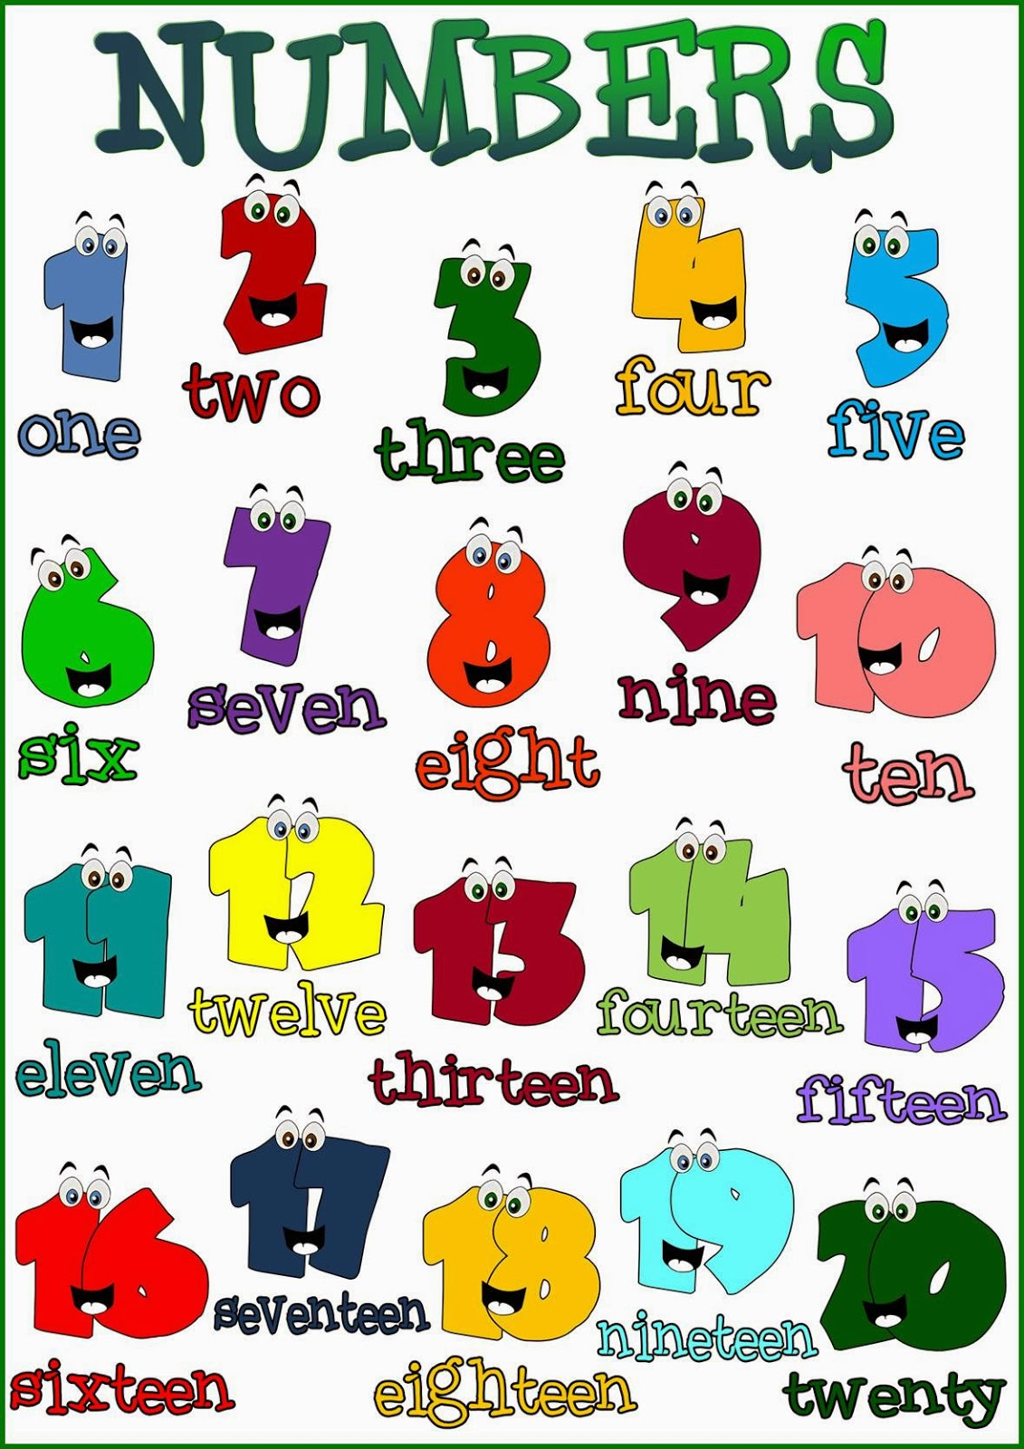
WelcomE
To nursery and reception

Slide 2
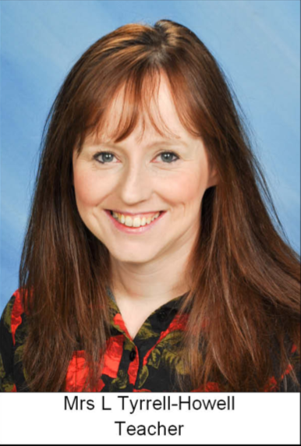
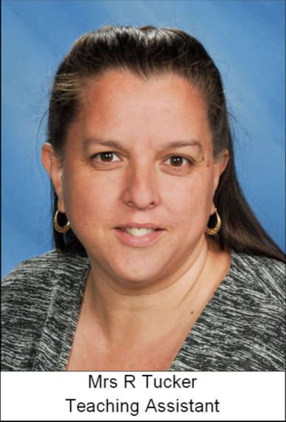
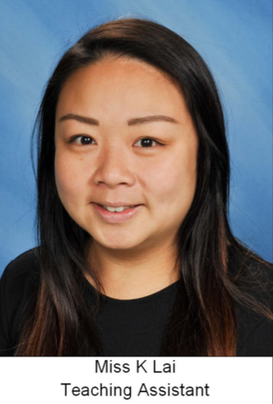
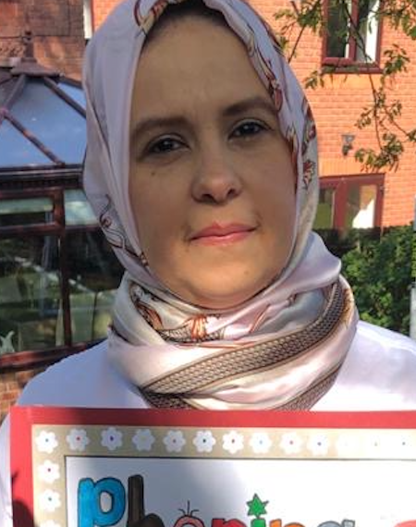
nursery and reception Bubble
We are in the Nursery and Reception bubble. We learn together, play together, have fun together and we even have lunch in our classroom.
In our classroom we have four members of staff.
Mrs S Elsenki
Teaching Assistant

Slide 3
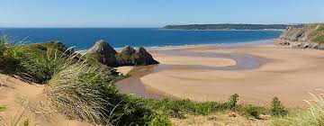
Our topic this term is…
Glorious Gower
We will be focusing on Pirates and the gorgeous beaches of Gower.

Slide 4
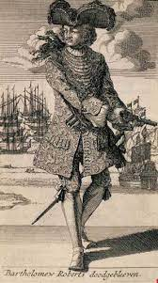
Literacy
This term we will continue with our special letter each week. We will have a strong focus on speaking and listening skills.
We will be learning about famous Welsh pirates.
We will be making messages in a bottle and re-writing the ending of the story – Ten Little Pirates.
We will have a pirates’ day.
We will be writing postcards and instructions on how to make a sandcastle.
We will have a pirate ship and beach themed role play area.

Slide 5
numeracy
We will be focusing on number recognition, counting objects and number formation this term.
We will also look at 2D shapes and patterns, go on number hunts, order things by size (smallest to largest), weigh objects and do simple problem-solving activities.
We will be using the Jit programme on Hwb to do data collection.

Slide 6
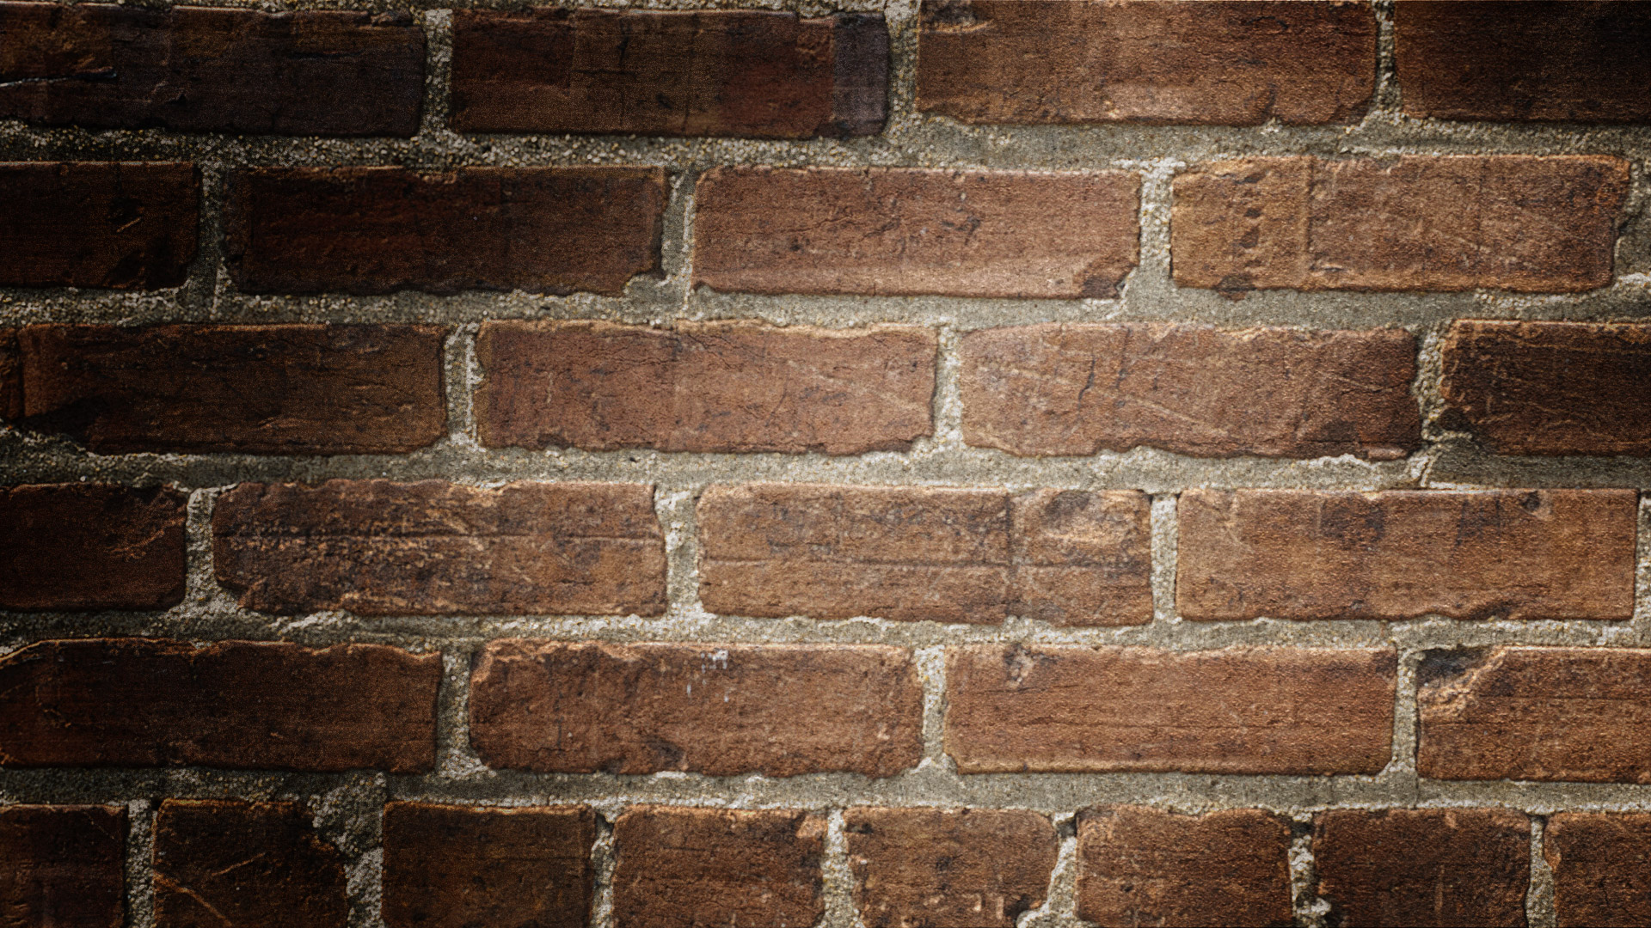
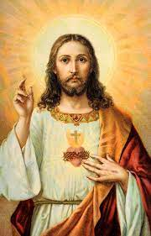
Religious education
We will be talking about good news.
We will be looking at the good news that Jesus brought.
We will be looking at friendship, forgiveness, peace in our lives, peace inside and peace between people.

Slide 7
Humanities
We will be creating our own treasure maps.
We will look at the history of Black Bart and the places he visited.
We will look at recycling and how we can help the environment.
We will be looking at some of the jobs that people had in Gower in the past and comparing them to the jobs around today.

Slide 8
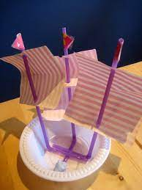
Science, Technology and DCF
We will make 3D junk model pirate ships.
We will be looking at floating and sinking.
We will be Researching animals that live in rockpools.

Slide 9
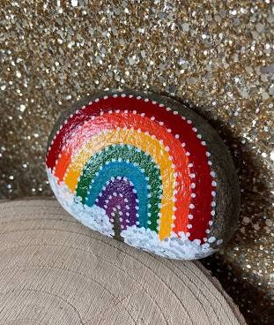
Expressive arts
We will create our own pirate hats, flags and treasure chests.
We will create art work inspired by Gower artists.
We will make sand sculptures and paint pebbles.
We will listen to the sounds of the sea and learn sea shanties.

Slide 10
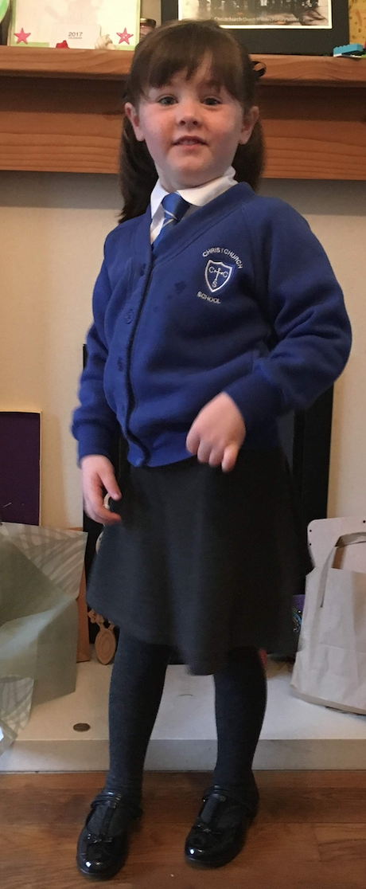
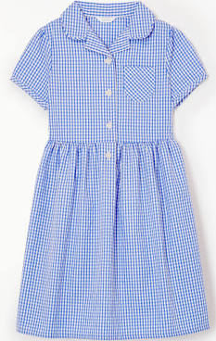
Other important information
Fruit money £4.50 per term – please put in an envelope with your child’s name on.
No PE kits needed at the moment.
Homework will be given out on a Friday and needs to be returned the following Thursday.
Nursery and Reception – Please bring your school reading books in every day.
Bring a filled water bottle labelled with your child’s name.
Our school uniform is a white shirt, blue school jumper or cardigan and grey trousers, shorts, skirt or dress with plain black shoes. In the summer blue school summer dresses can also be worn. Reception children also need to wear a school tie (Nursery can also wear one if they want to.) Jumpers, cardigans and ties can be purchased from the office.

Slide 11
KEEP IN TOuch
Mrs Tyrrell-Howell – Tyrr-howeL@hwbcymru.net
Mrs Tucker – TuckerR46@hwbcymru.net
Miss Lai – LaiK1@hwbcymru.net
Or telephone the school

