Slide 2
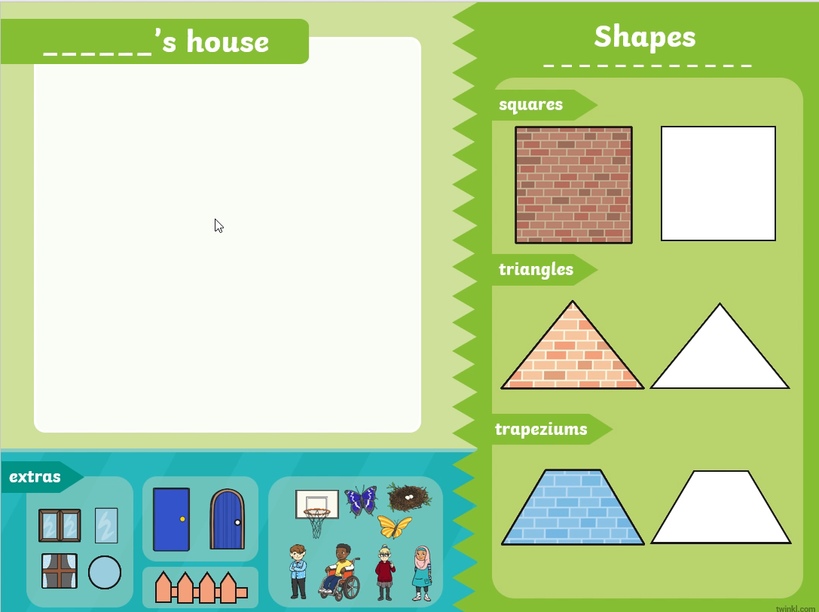

Build a House Using Shapes
Instructions
!
This PowerPoint will not
work in presentation mode.
Demonstration
Please view this PowerPoint in edit mode to ensure that the interactive elements work.
On slide 3, you can use your mouse pointer or interactive whiteboard pen to drag and drop shapes onto the house creation area.
You can change the fill colour of the white shapes to any colours that you like.
Roll over the video above
and press play to watch a
short demonstration.

Slide 3
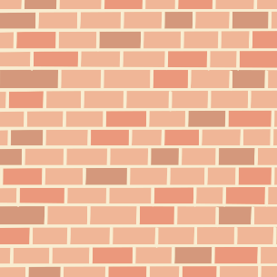
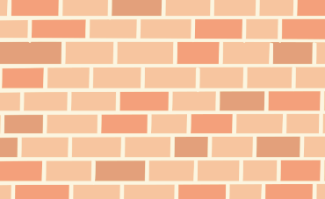
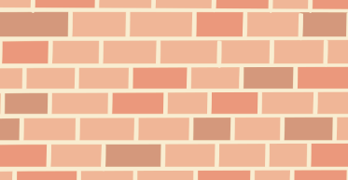


______’s house

