Slide 1

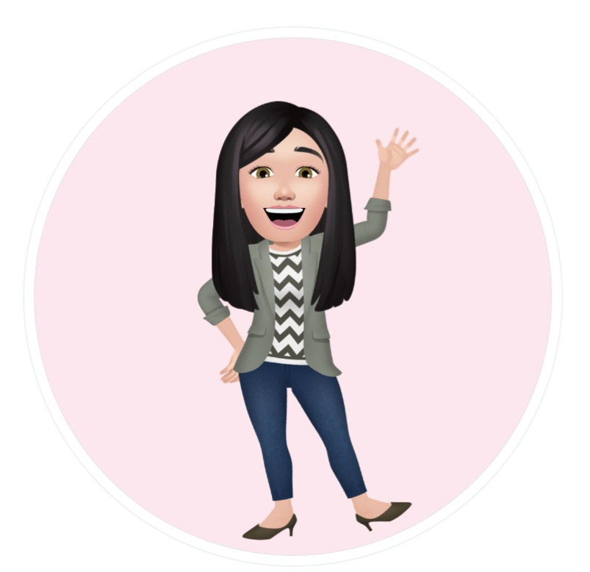
Summer Term 2021 FP2
Information for parents

Slide 2

Welcome back!
Due to the Covid restrictions, we are currently teaching in two separate year groups.
Miss Herbert, Mrs Lang and Ms Logue in Year 2
Email: HerbertS5@hwbcymru.net
Mrs Sears-Neale and Miss O'Reilly in Year 1
Email: sears-nealej5@hwbcymru.net
The following slides will briefly explain our Summer Term topic. If you have any questions or if you have any suitable resources we could borrow, please get in touch!

Slide 3
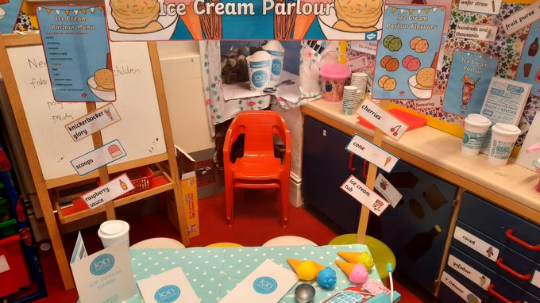
LLC – Literacy and Welsh
Children will continue to follow the RWI scheme and learn different spelling rules and strategies. Spelling quizzes will take place weekly.
Please listen to your child read frequently and make a comment in their diary.
This term we have an interactive Ice Cream shop and a beach hut role play area.
Your child will be learning how to write instructions, explanations, stories and poems. We will have fun with Disco Dough, drama activities and EPIC challenges to support our whole school topic ‘Gorgeous Gower’.

Slide 4

Numeracy
Children will be:
-Using TT Rockstars to practise their times tables.
-Taking part in a weekly times table quiz.
-Revising their addition and subtraction skills.
-New topics which we will be exploring during the term are;
Division
Tens and units
Fractions
Symmetry
Money

Slide 5

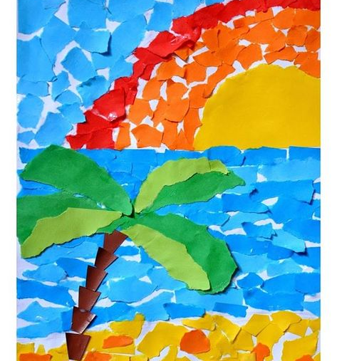
Expressive Arts
Children will:
Make sand art, paint beach scenes, sketch observational drawings of shells, act out dramas as pirates, perform sea shanties and take part in many more creative opportunities.
We are very lucky to be part of a nationwide creative project with the Arts Council of Wales. A wonderful storyteller will come and work with Year 2 to take part in an exciting art opportunity to develop our skills as ethically informed citizens, working with Black and Ethnic Minority artists.

Slide 6
Humanities
This term we are going to be planting sunflower seeds so that we can measure growth weekly and record our findings into a histogram on j2e.
Looking at maps identifying key information around the Gower to support our topic.
Researching information about clams and cockles.
Looking at our environment and how we can preserve it.

Slide 7


PE/ PSD
All children in FP2 will have PE outside every Friday. Please ensure your child has their PE kit in school. Please label every item of clothing. Please encourage your child to tie their hair back and wear no jewellery on a Friday.
Year 2 children will take part in the annual Road Safety eight - week workshop with the Swansea Council.
All children take part in a daily offering of milk and fruit. Due to Covid restrictions we have had to suspend the toothbrushing project until further notice.

Slide 8
RE and DCF
In Religious Education this term, we are learning about the Gospel and how Jesus would like us to behave.
We will be learning about how we can help sustain our environment and we will take part in many eco based projects.
We have been given more chrome books to support our computer skills. We use HWB frequently and this term we will be learning key board skills and how to communicate safety over the Internet.

Slide 9

The weather is getting warmer!
With the weather getting warmer we hope to use our outdoor spaces as much as we can. So please ensure your child has a coat as the weather can change in an instant.
Children are encouraged to drink water to stay hydrated. If you would like to provide your child with their own bottle, please make sure their name is written clearly on the bottle.
Sun hats are encouraged to be worn.

Slide 10

Thank you!
This is the last term of the school year and my goodness, what a strange year we have all had. May we take this opportunity to say how immensely proud we all are of the children in our care. They make us smile every day. They are resilient and a credit to you all.
We wish Year 2 the best as they start their junior transition into Key Stage 2 in September.
If you need any help, support, or you would like to share good news; please email the class teachers. Please look at our school website and Twitter, as we work very hard to upload and share our adventures.
Many Thanks from Miss Herbert, Mrs Sears-Neale and all of the FP2 team.

