Slide 1
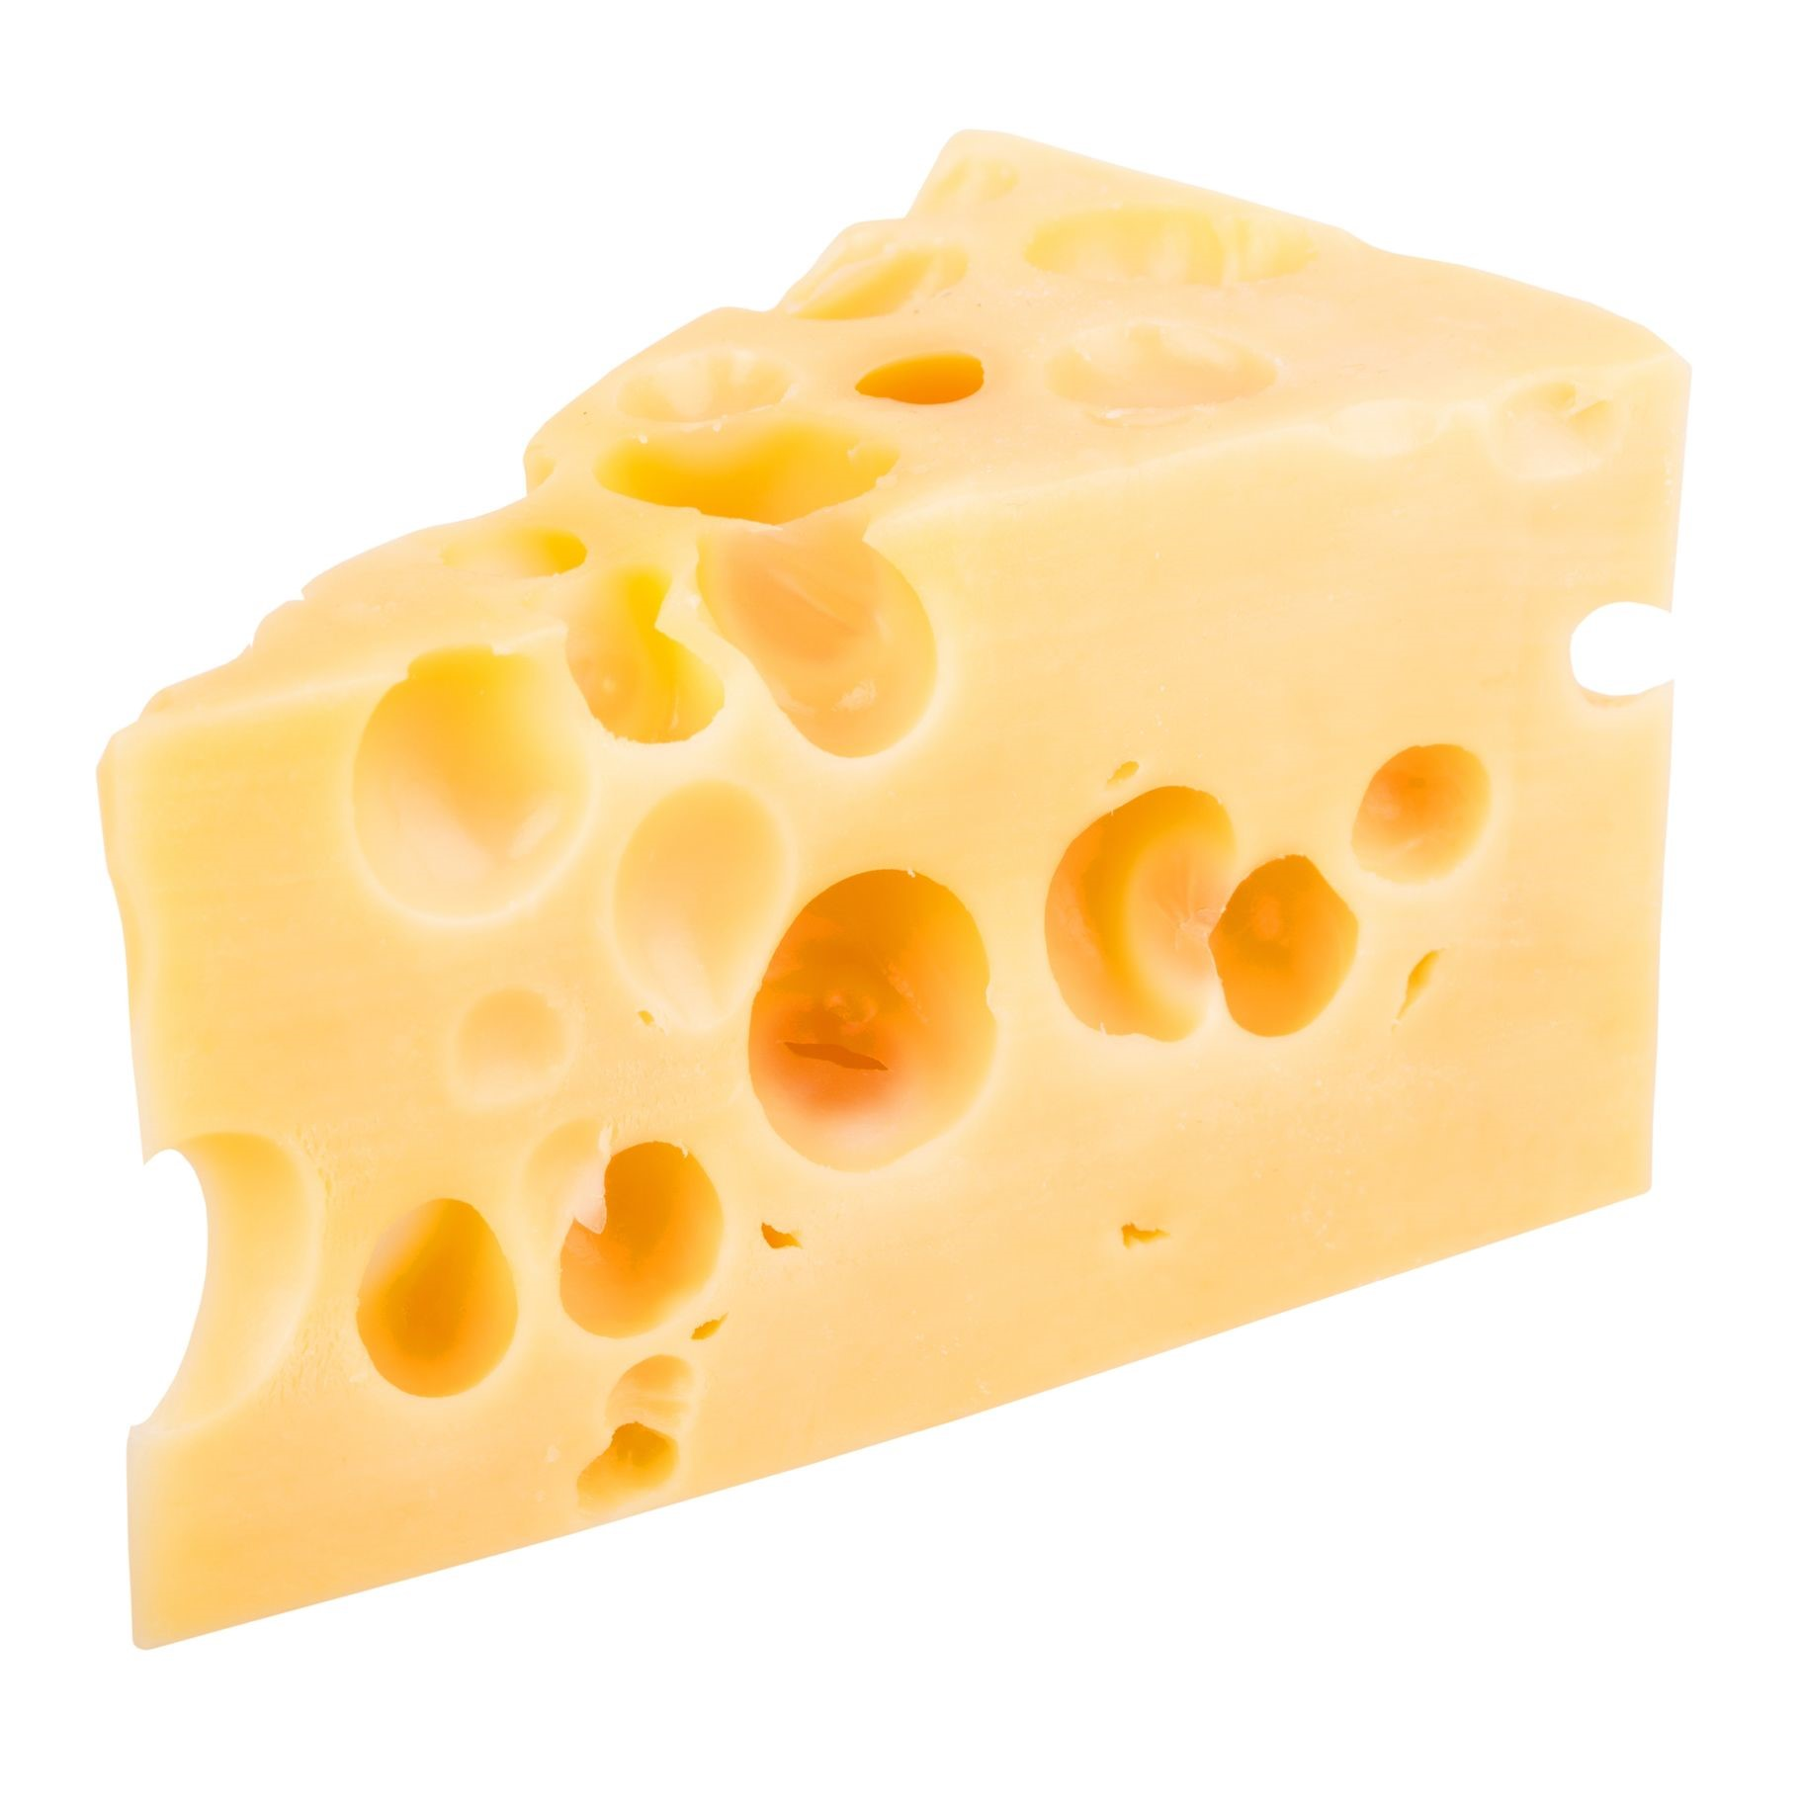
Monday 11th January
Miss Herbert’s joke:
What do you call cheese that doesn’t belong to you?

Slide 2
Nacho cheese!

Slide 4
feel

Slide 5
queen

Slide 6
week

Slide 7
cheek

Slide 8
teeth

Slide 9
free

Slide 10
feet

Slide 11
reef

Slide 12
weep

Slide 13
Tasks:
Play our 1 minute game – pick a tricky ‘ee’ word and see how many times you can spell it correctly.
Write ‘ee’ words in paint, foam, mud or in rainbow writing.
Can you put each ‘ee’ word into a sentence. Check your full stop and capital letters!

