Slide 2
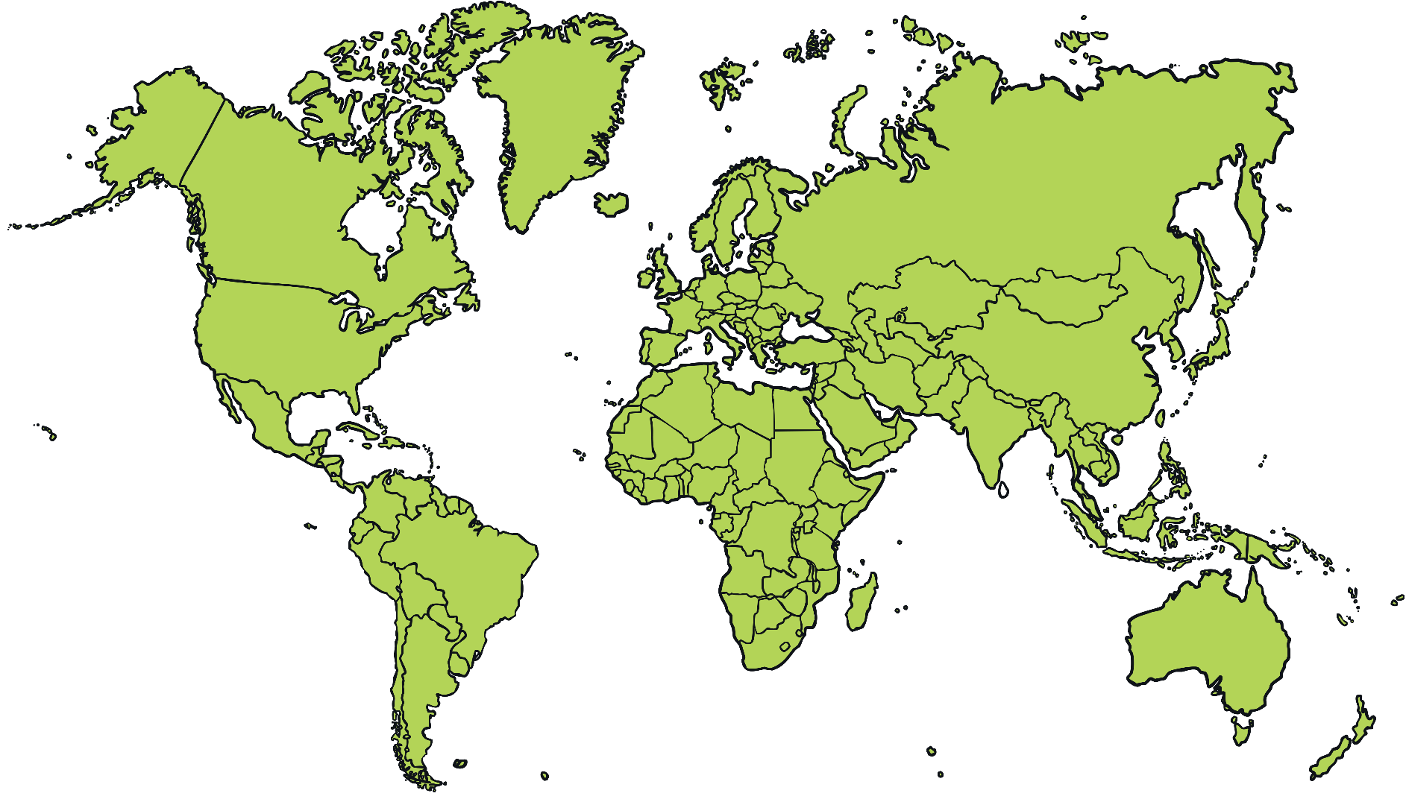
Christmas Around the World

Slide 3
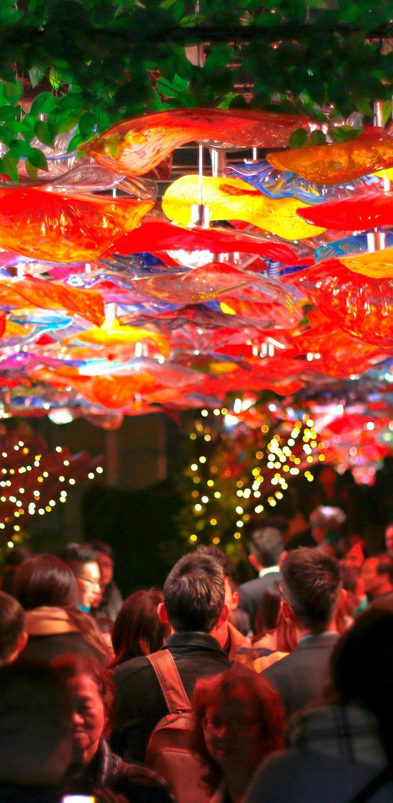

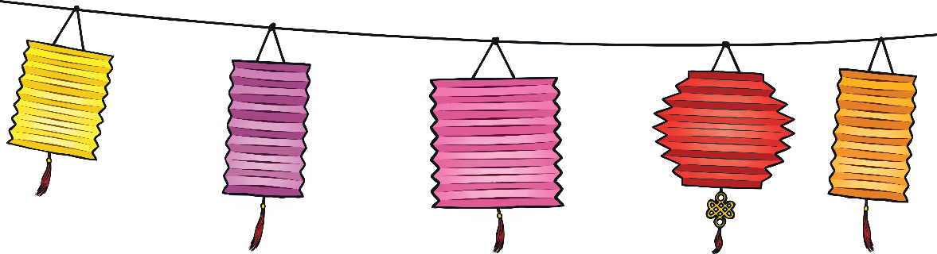
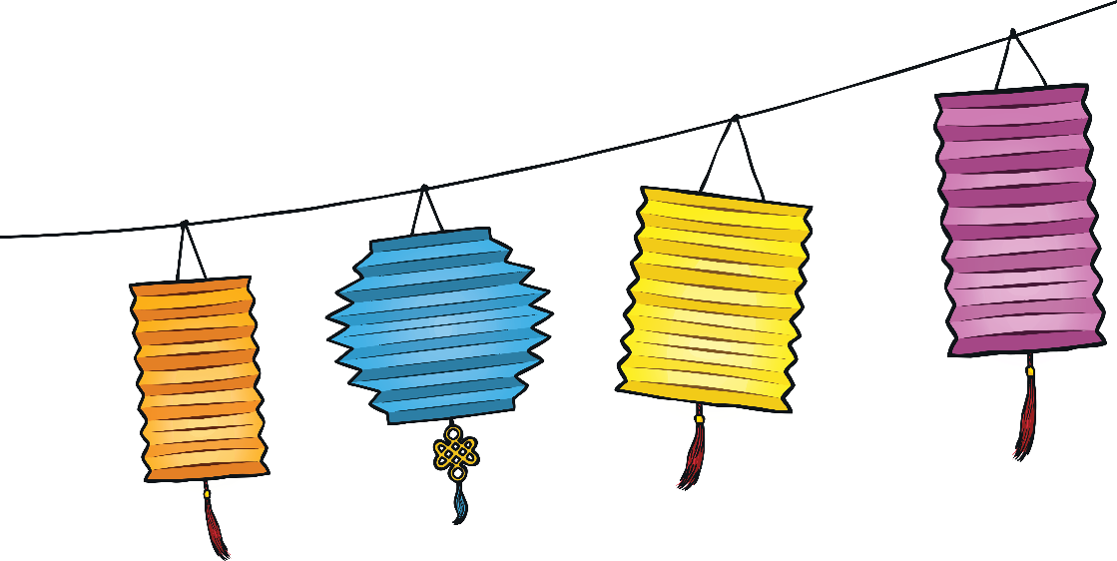
Christmas Around the World
China
Christians in China often celebrate by lighting their houses with paper lanterns.
Christmas trees are called ‘trees of light’ and are decorated with paper chains, paper flowers and paper lanterns.
Lots of people in China do not celebrate Christmas. The main winter festival is called Chinese New Year and takes place in February. Many Chinese people worship their ancestors during Chinese New Year.

Slide 4
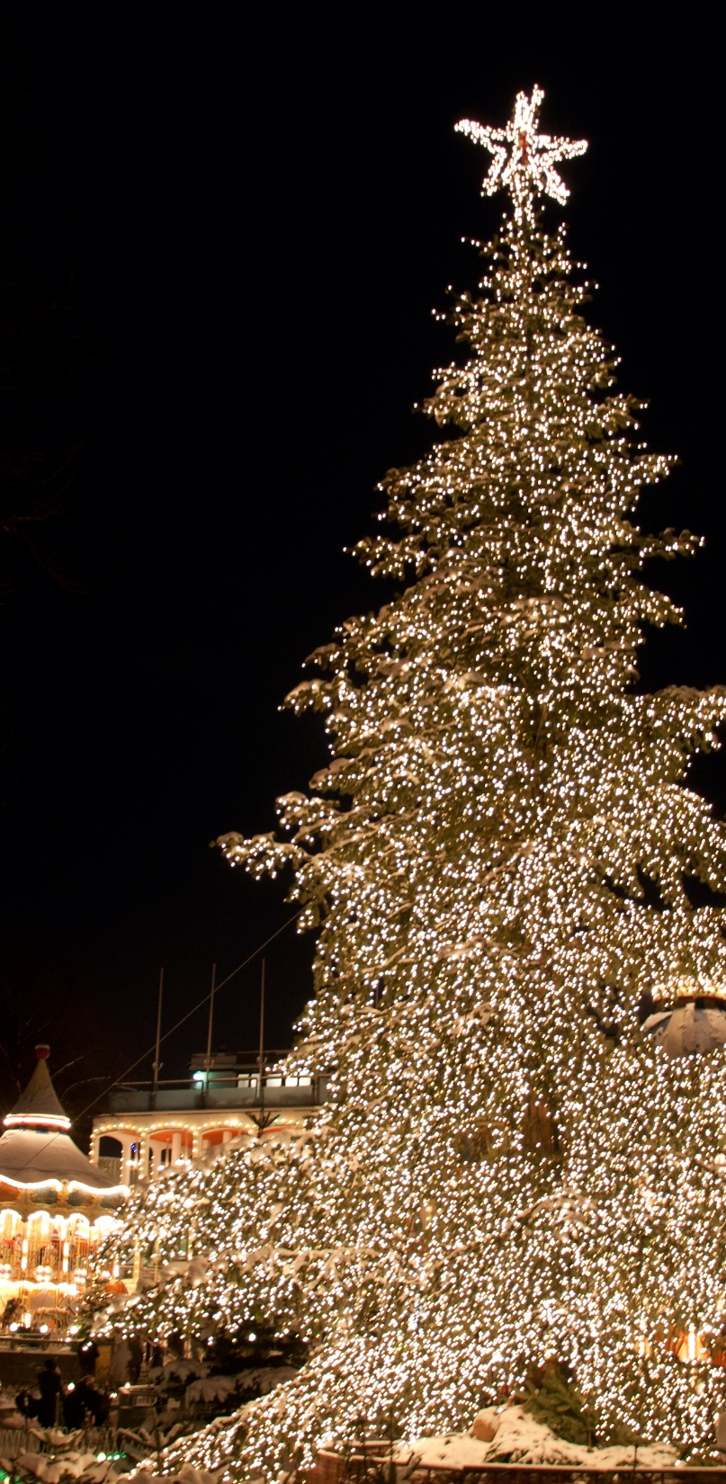
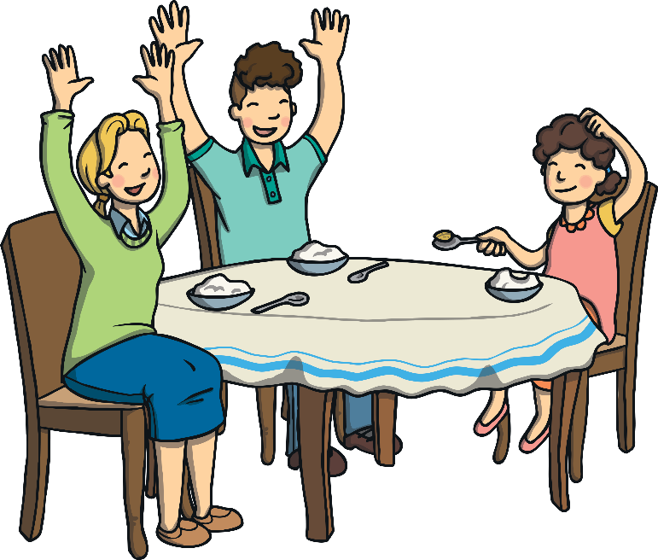
Christmas Around the World
Denmark
The Christmas feast in Denmark is usually celebrated at midnight on Christmas Eve.
It is common to have special rice pudding dessert in which a single almond is hidden. Whoever finds the almond will have good luck for a whole year.
Instead of Santa Claus, the bringer of gifts in Denmark is known as Julemanden.
Julemanden arrives in a sleigh drawn by reindeer and a sack over his back.
Julemanden has lots of elf helpers, named Juul Nisse, who are said to live in attics.
“Christmas Tree” by Kristian Mollenborg is licensed under CC BY 2.0

Slide 5
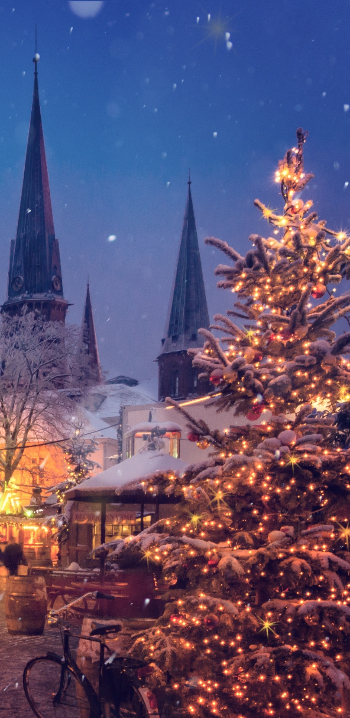
Christmas Around the World
Germany
According to legend, on Christmas Eve in Germany, rivers turn to wine, animals speak to each other, tree blossoms bear fruit, mountains open up to reveal precious gems and church bells can be heard ringing in the bottom of the sea. Only the pure of heart can witness the Christmas magic.
In many homes, children will be distracted while a Christmas tree is brought out and decorated on Christmas Eve. Presents are then put underneath. Traditionally, plates are laid out for each member of the family with fruit, nuts, chocolate and biscuits. Often, carols are then sung, sparklers are lit, the Christmas story is read and then the gifts are opened.

Slide 6
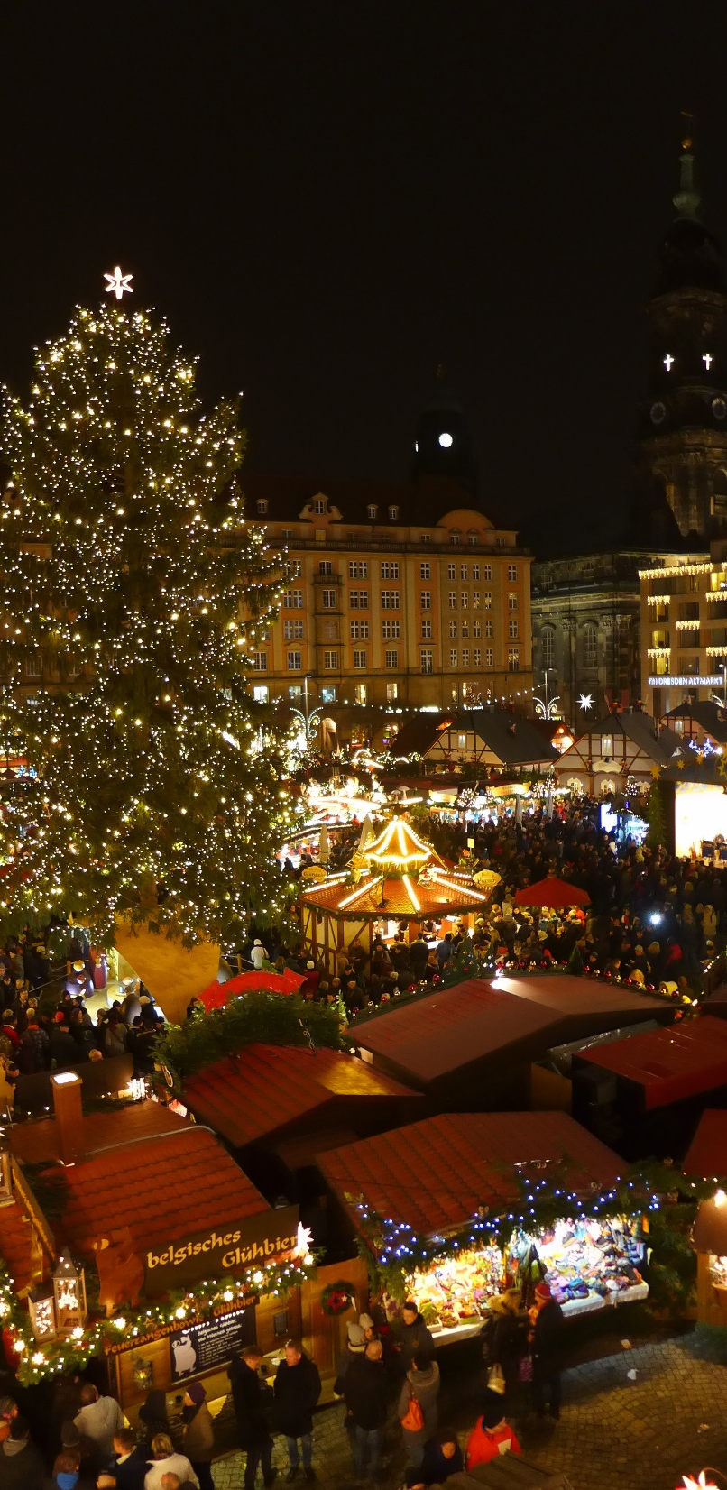
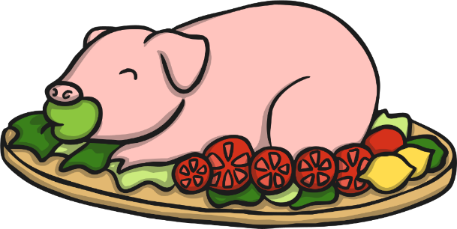
Christmas Around the World
Germany
On Christmas Day, many families enjoy a banquet of roast goose, breads and marzipan.
There are lots of huge Christmas fairs in Germany which are very beautiful.
After the presentation of the tree, there is a huge feast of dishes like suckling pig, white sausage, macaroni salad and many more.

Slide 7
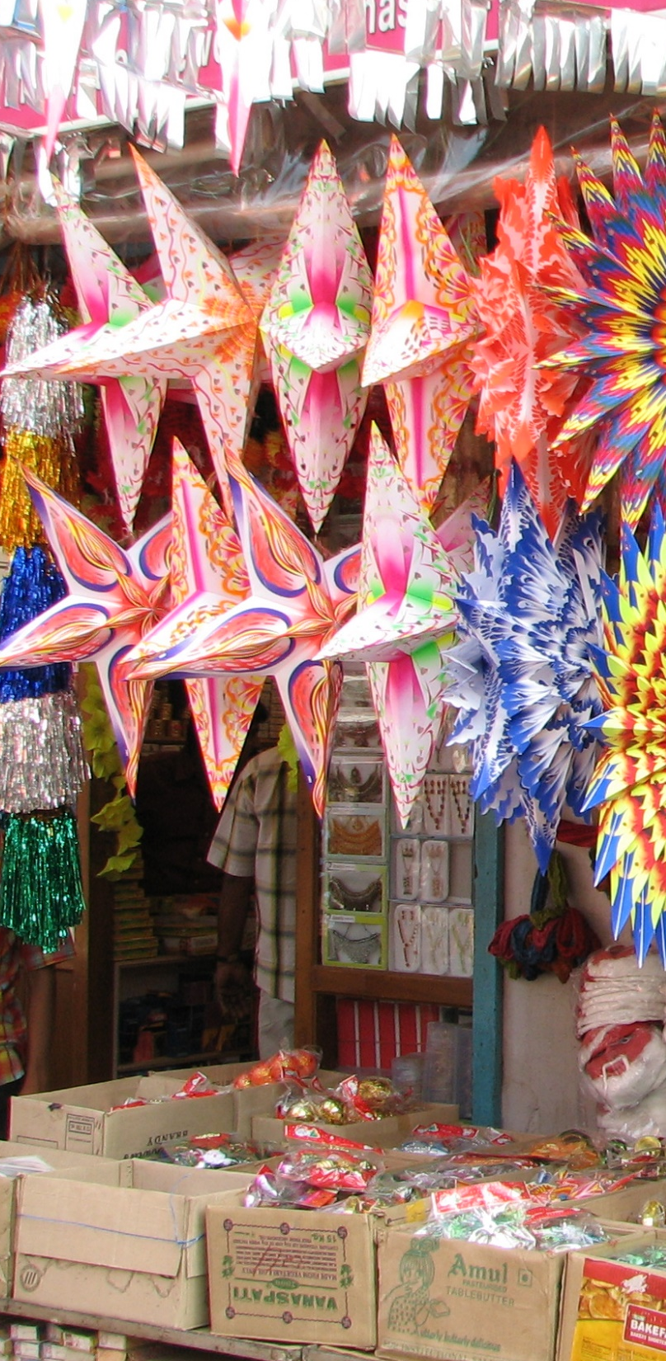
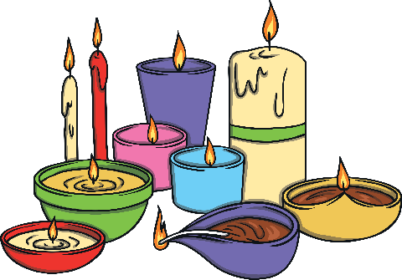
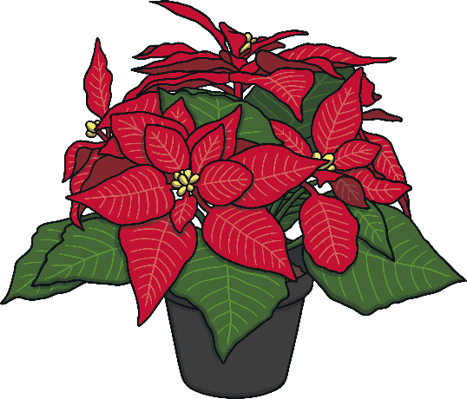
Christmas Around the World
India
Many Christians in India choose to decorate mango and banana trees at Christmas time.
Decorations are colourful and bright.
In some parts of India, small clay oil-burning lamps are used as Christmas decorations. They are placed on the edges of roofs and on the tops of walls.
Churches are decorated with poinsettias (red Christmas flowers) and candles for the Christmas Evening service.
“India – Kerala” by McKay Savage is licensed under CC BY 2.0

Slide 8
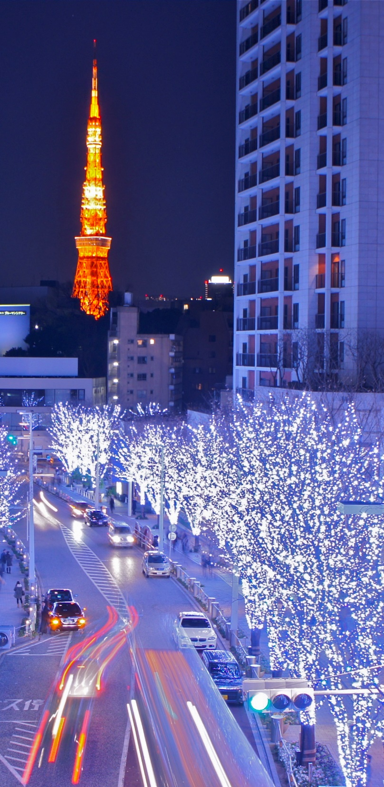

Christmas Around the World
Japan
Lots of people in Japan celebrate Christmas, although only 1% of the population is Christian.
Lots of homes are decorated with Christmas trees and mistletoe.
Lots of people in Japan enjoy exchanging gifts at Christmas.
“Tokyo Tower and Roppongi Christmas illumination” by Manish Prabhune is licensed under CC BY 2.0

Slide 9
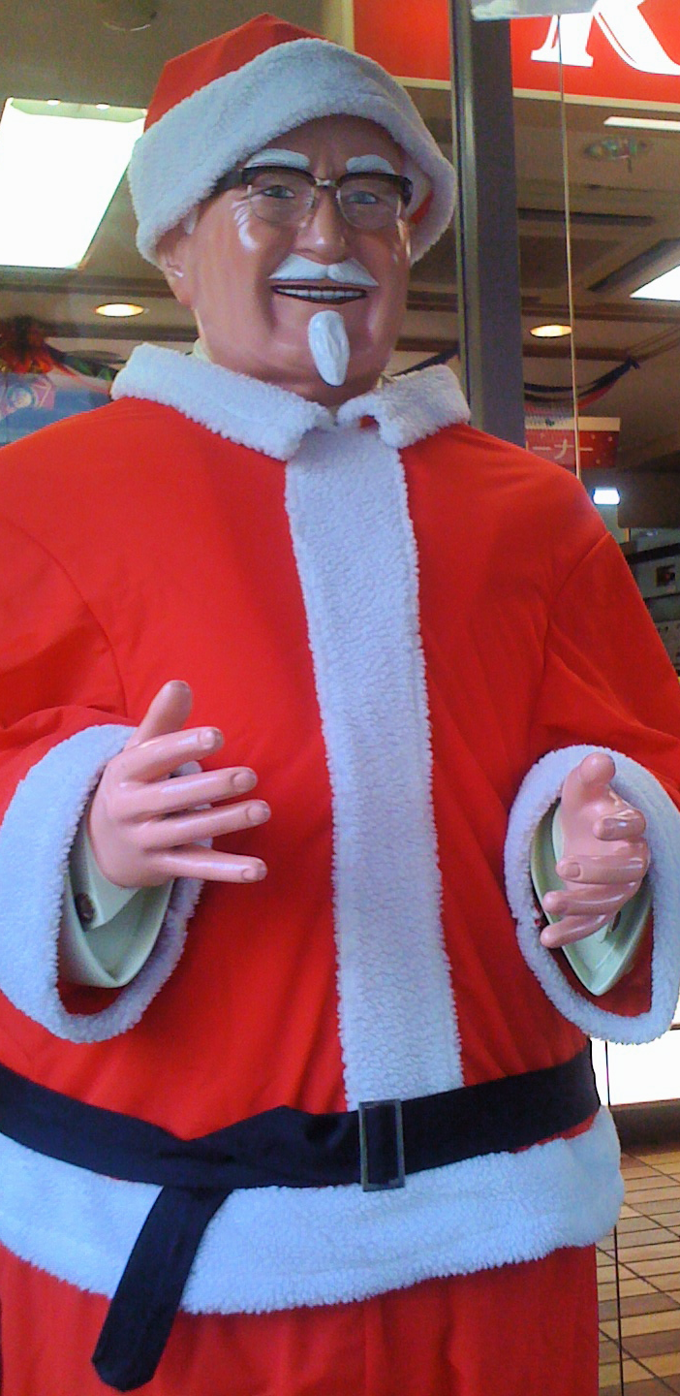
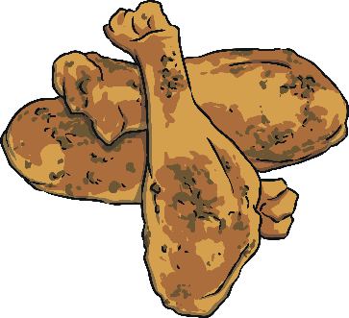
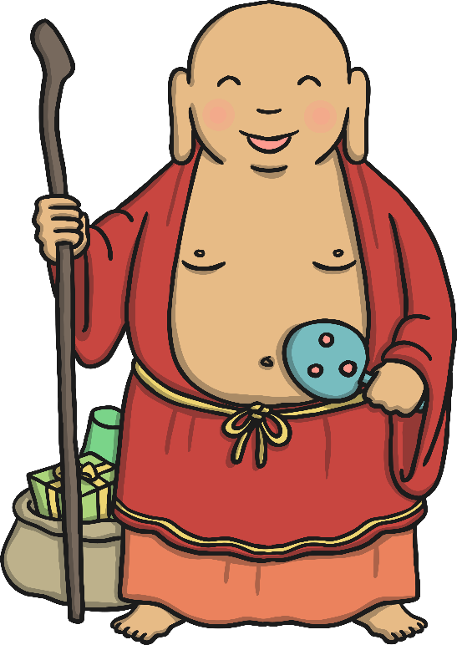
Christmas Around the World
Japan
On Christmas Day, many people in Japan eat fried chicken for dinner! Local fast food restaurants can be fully booked months in advance.
A Buddhist monk named Hotei-osho acts like Santa Claus. He brings presents to each house for children. Some think he has eyes in the back of his head so that children behave when he is nearby.
“Colonel Sanders Santa” is licensed under CC BY 2.0

Slide 10

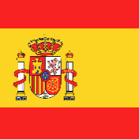
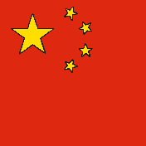
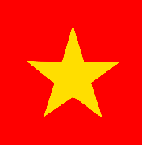

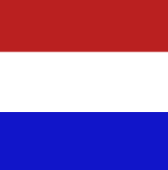



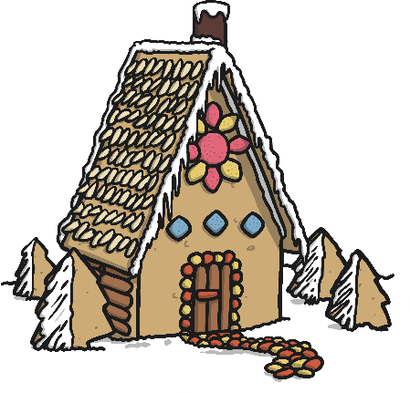
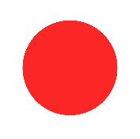

Christmas Around the World
English
Spanish
Mandarin
Merry Christmas
Feliz Navidad
Shèng dàn kuài lè
Vietnam
French
Dutch
Giáng sinh vui vẻ
Joyeux Noel
Vrolijk Kerstfeest
Italian
German
Buon Natale
Fröhliche Weihnachten
Japanese
Merii Kurisumasu

