Slide 1
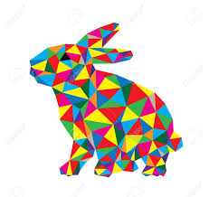
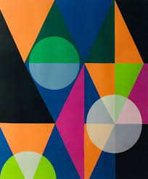
Geometric Art
So, geometric art is inspired from geometry. It is designed and created with lines, circles, square and rectangles perfect or not.

Slide 2
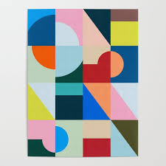
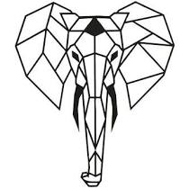
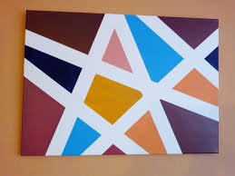
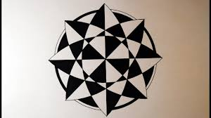
What shapes can you see?
What colours can you see?
What do you think?

Slide 3
Your turn- Pick a technique:
Use a ruler to draw lines in different directions.
Draw around different shapes.
Use masking tape to make lines and paint/colour over the tape. (Make sure you put tape on a material that can be easily removed)
Use the computer to help you draw lines and shapes.

Slide 4
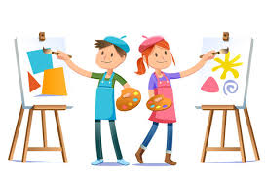
Have fun!
Email me your wonderful artwork!

