Slide 1
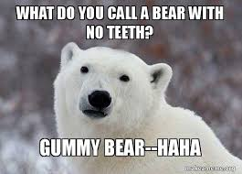
Joke: What do you call a bear without any teeth?

Slide 2
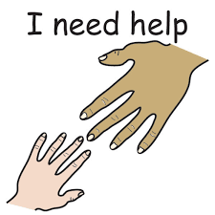
Instructions Part 2
ASK AN ADULT TO HELP!

Slide 3

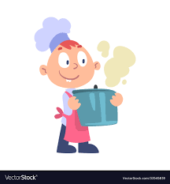
It’s time to cook!
ALWAYS work with an ADULT for safety!

Slide 4
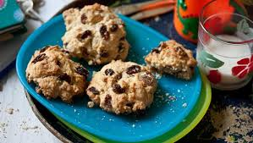
Today, Fflic and Fflac are going to make ROCK CAKES

Slide 5
What you need:
200g self raising flour
100g block margarine
75g caster sugar
100g currants
1 medium egg
I have used the recipe from http://allrecipes.co.uk/recipe/32843/simple-rock-cakes.aspx
Your parents might know an easier recipe ☺

Slide 6
What to do:
Preheat oven to 200 C / Fan 180 C / Gas 6. Line baking tray with greaseproof paper.
Sieve flour (and spice) into mixing bowl. Cut the margarine into smaller pieces. Rub it into the flour using fingertips only until it looks like breadcrumbs.
Stir in the sugar and currants. Beat the egg in a small bowl and add to the mixture. Press firmly with a fork until a stiff rocky consistency is formed. Place the mixture on the baking tray in 12 rocky heaps.
Bake for 10 to 12 minutes until they are golden brown and firm to touch. Allow rock cakes to cool before eating. ADULT HELP!

Slide 7

Take a photograph and show me how yours turns out!

