Slide 1

A joke:
Why do fish live in salt water?
Because pepper makes them sneeze!

Slide 3


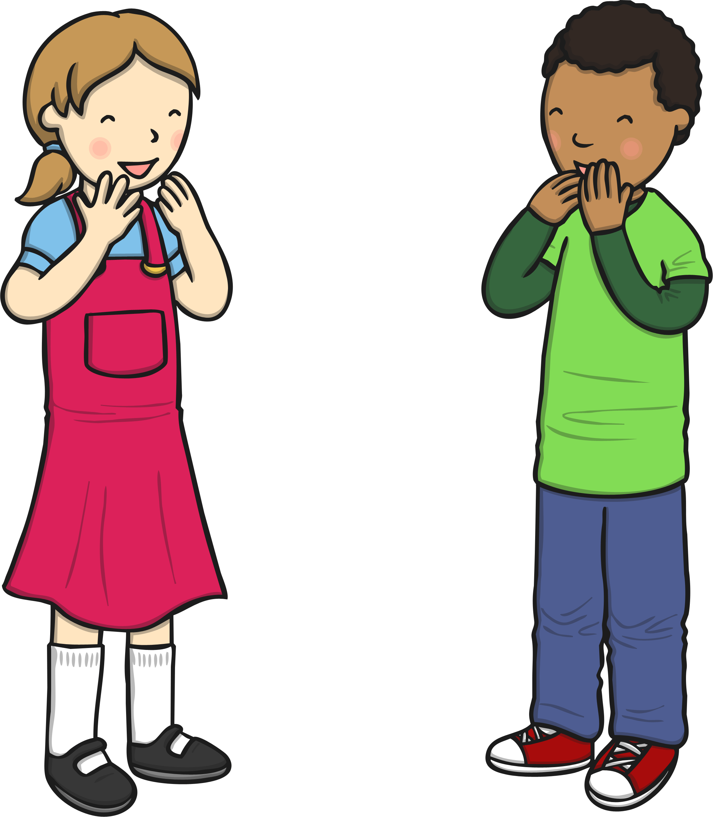

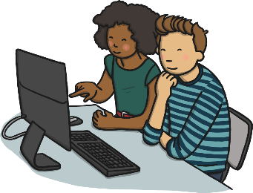
What Is Communication?
Using words, sounds, signs or behaviours to exchange information.
Expressing your ideas, thoughts or feelings.
Exchanging of information.
Speaking, writing, or drawing to give a message.
Sending or receiving information.

Slide 4
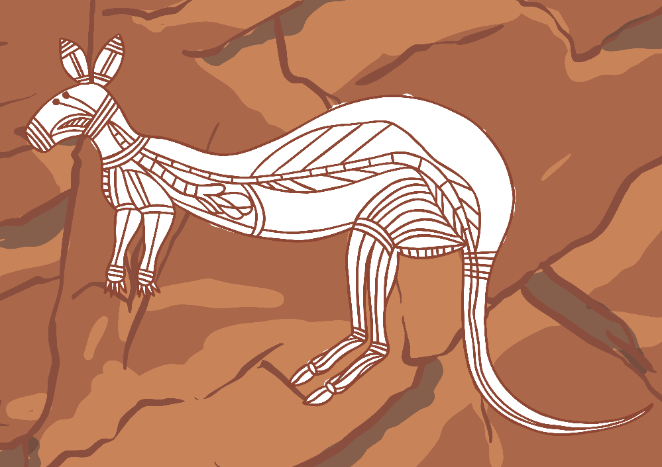
Very Early Types of Communication
Cave Paintings
A very long time ago, cave paintings were used by many cultures, such as Australian Aborigines, to communicate with other tribes who visited their site. They used rocks and dirt mixed with water to make the paint and used their fingers or sticks to draw with. People think the drawing may have been part of a religious ceremony.

Slide 5
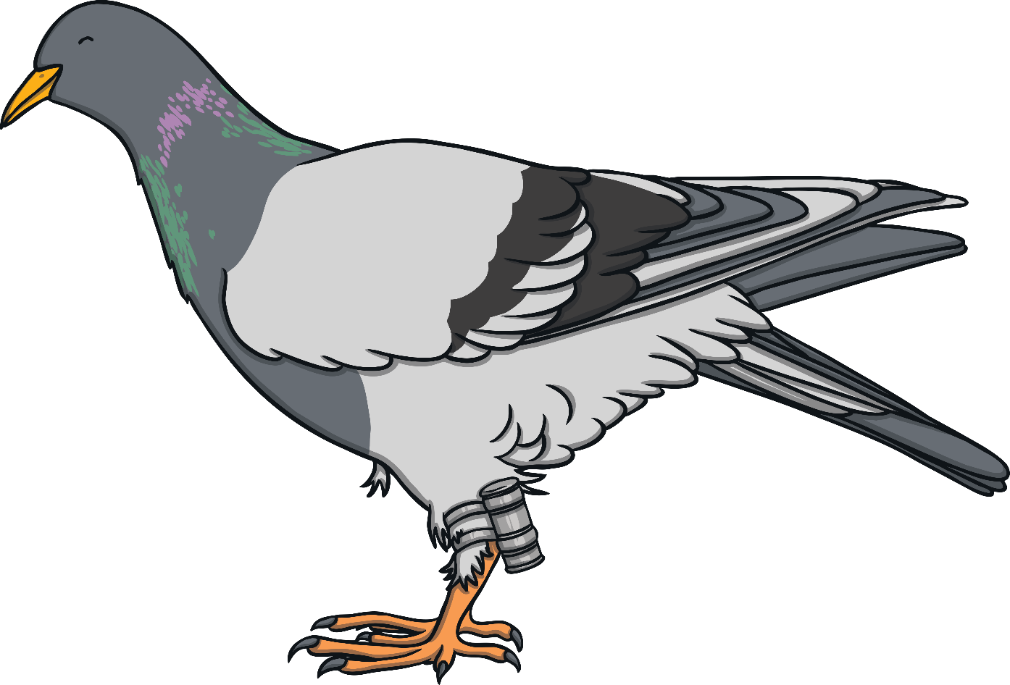
Very Early Types of Communication
Carrier Pigeons
A carrier pigeon is a pigeon that has been trained to carry messages from one point to its home. A message is attached to the pigeon’s foot. Carrier pigeons were used in the First World War so that people were not at risk delivering important messages through war zones.

Slide 6
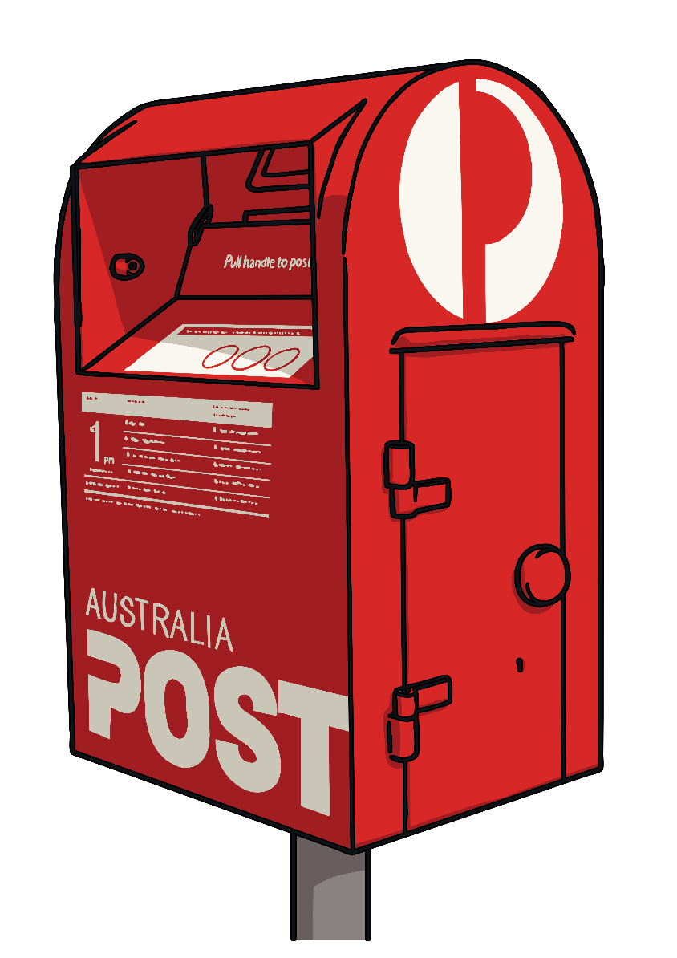
Early Communication
Mail or Post System
People used pen and paper to write letters and this was a very popular way of communicating. In the 1800s, official postal systems were set up all over the world, to deliver letters and parcels. However, sometimes the system was unreliable because it took a long time for a letter to reach its destination and sometimes letters could be lost and never arrived at their destination.

Slide 7
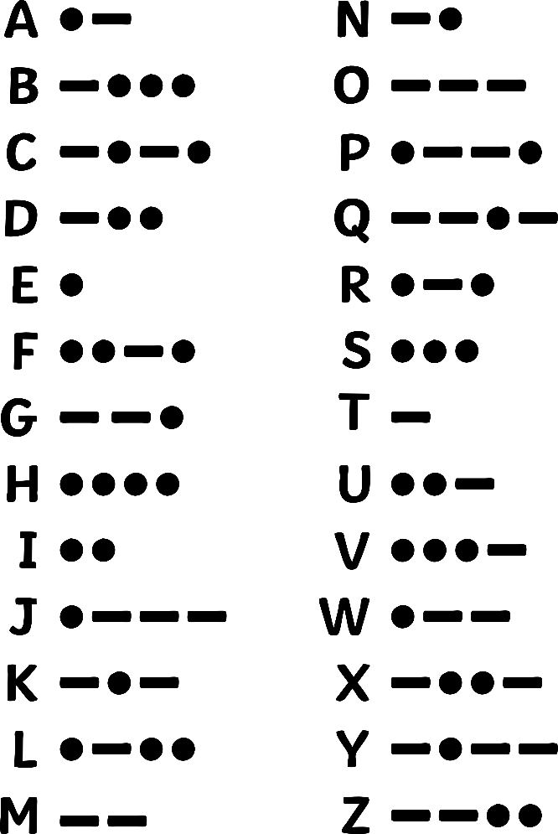
Early Communication with Machines
Electrical Telegraph
In the 1800s, telegraphic communication was invented which involved sending electric signals through a wire. A well-known version of the electrical telegraph is Morse code. Morse’s code used dots and dashes, which were short and long pulses, sent through the wire to match letters and numbers.
This type of communication allowed for instant communication across very long distances, which was something that had never been done before.

Slide 8
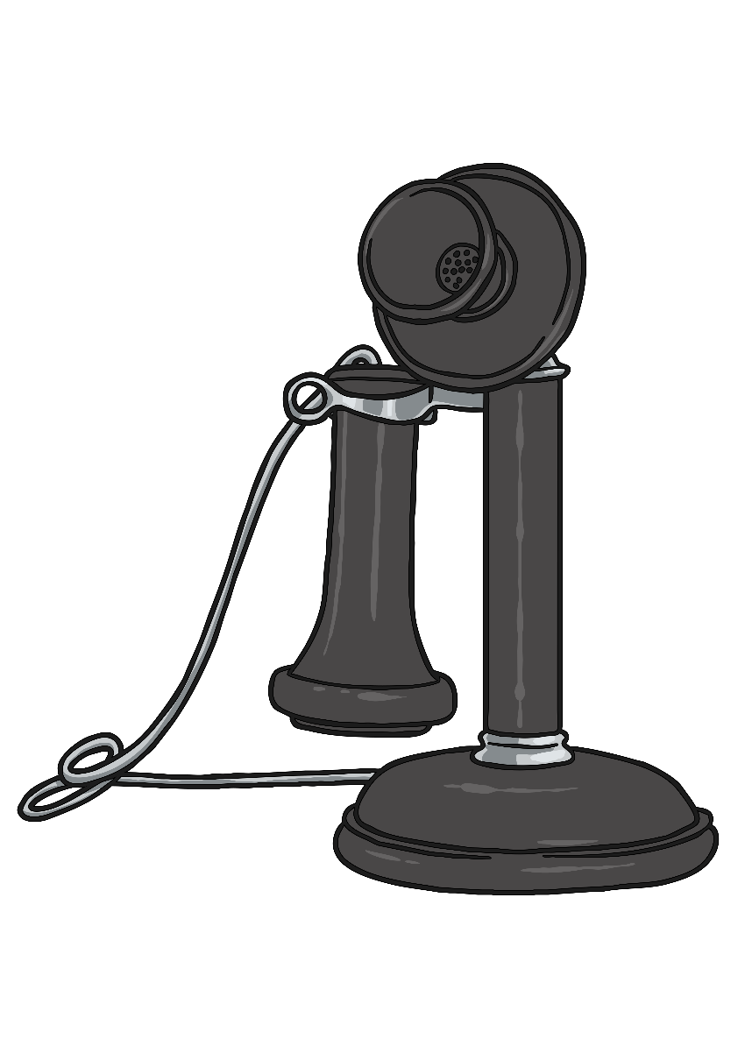
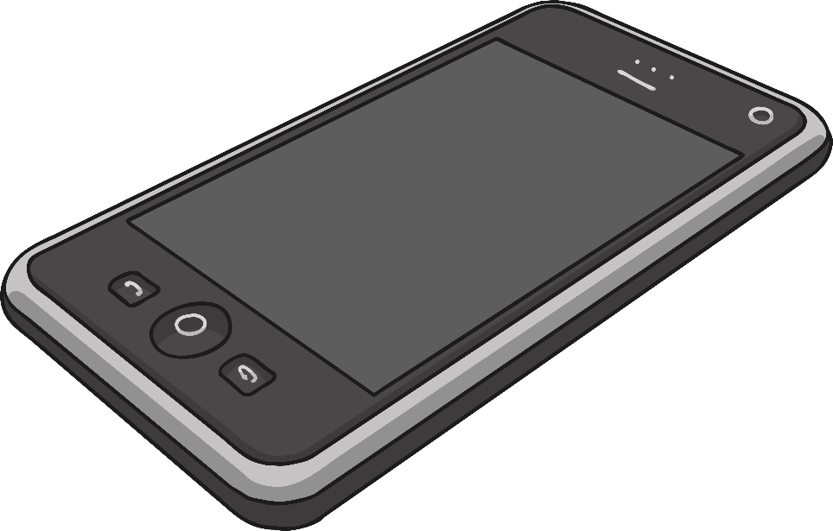
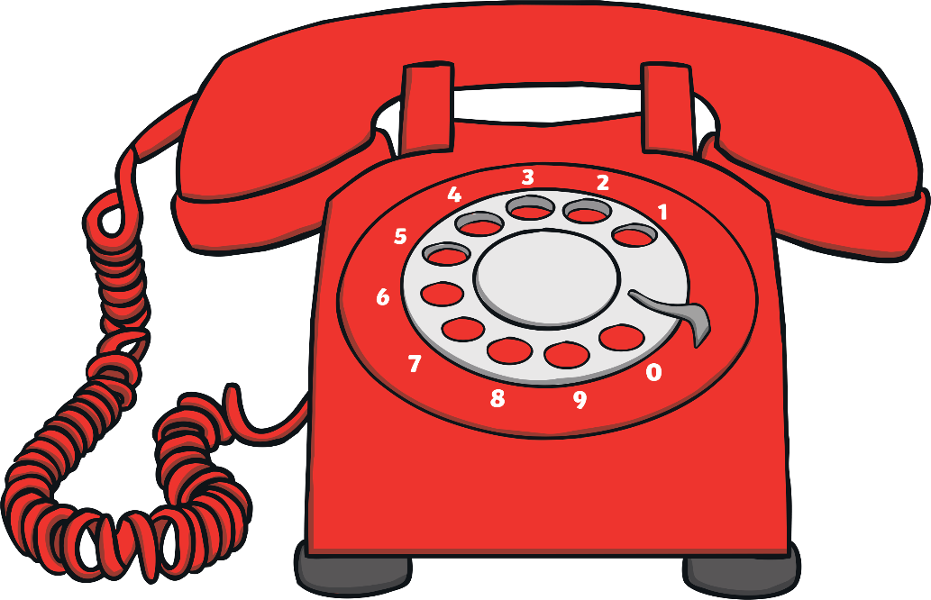
Modern Communication with Machines
Telephones
In the late 1800s, a man named Alexander Graham Bell invented the first telephone using wire to transmit voices over long distances.
Early phones needed to be fixed with wires but with modern technology, telephone calls can be sent through radio waves or satellites, which makes them cordless.
Modern mobile phones can not only make phone calls but they can be used for text messaging, taking photos, playing games and accessing the Internet. Over the years, phones have also become smaller and
lighter to carry. These days, people can not only hear each other talking, but they have a small screen that allows people to see each other as well.

Slide 9
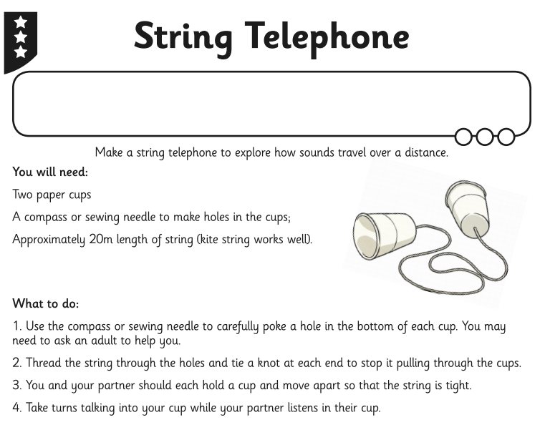
TASK: Make and use a string telephone with an adult.

