Slide 1

Anti-Racism
By Agents Of Change and Super Ambassadors.

Slide 2
What is racism?
Racial discrimination or racism is when someone is treated differently because of their race, ethnicity, nationality or colour.

Slide 3
A form of racism is; Harassment
Making a child, young person, or adult feel humiliated, offended or degraded
Harassment can happen in the form of:
spoken or written words.
offensive emails.
comments online.
facial expressions.
social media posts.
jokes.

Slide 4
Types of racism and racial discrimination
Racism, racial discrimination and racial bullying can take many forms. Children and young people might experience more than one type of racism.
For example, a young person experiencing racial bullying in school could also be sent abusive comments online and face racial discrimination at their workplace.
Racism can also happen alongside other forms of discrimination or abuse.

Slide 5

Racism
Racism affects children's mental health. It makes you feel alone and cry. We are all the same

Slide 6

Racism is NOT okay.
We do not tolerate ANY type of bullying in Christchurch. We Respect and treat others how we want to be treated. Racism is Nasty unkind and not appreciated it is mean and nobody wants to be shamed because of what their body type is no matter what skin color we are all human and we have feelings. Treat others how you want to be treated.

Slide 7

How racism makes us feel:
Sad
Lonely
Upset
Annoyed
angry

Slide 8
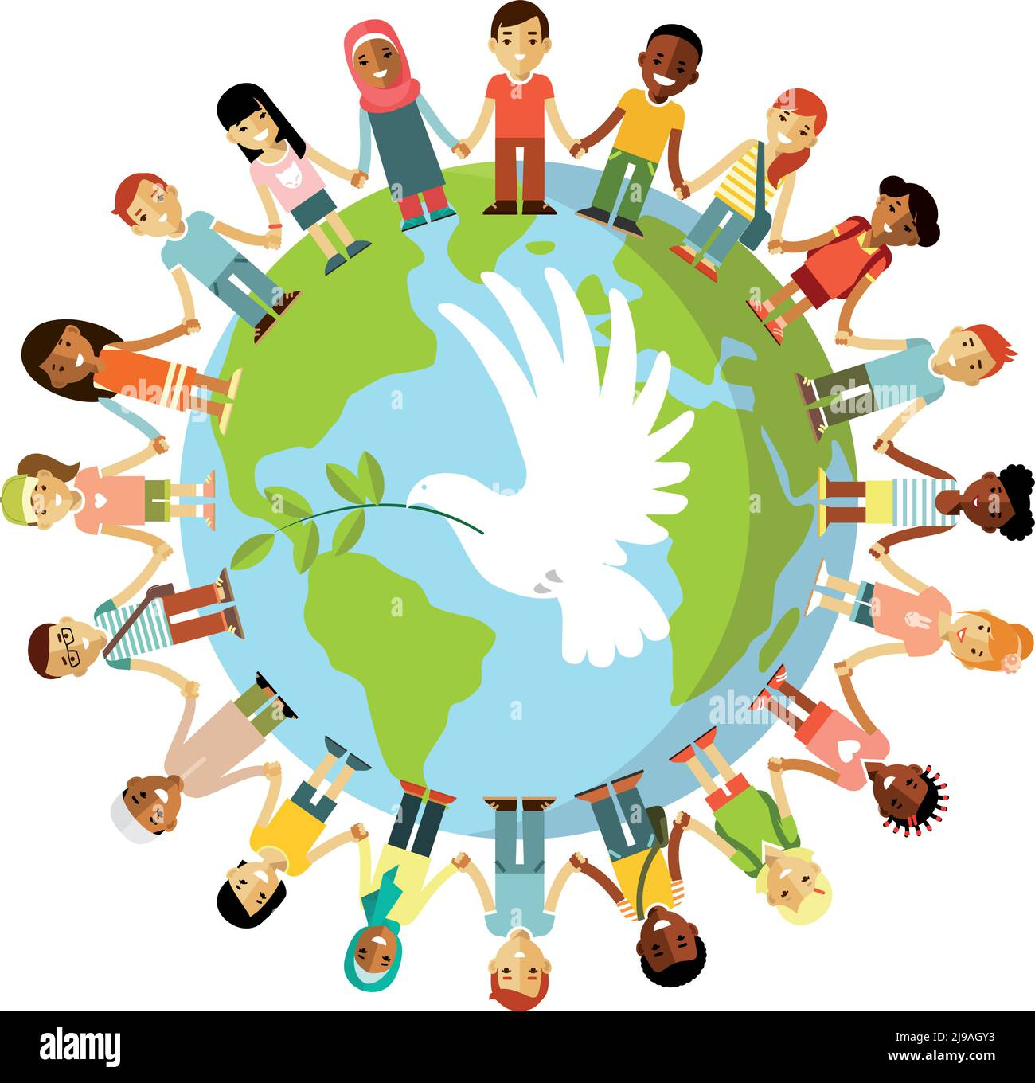
We are all the same
No matter what;
Race
Gender
Religion
Color
Disability

Slide 9


Racism is NOT ok
Show Racism the Red Card
ThePhoto by PhotoAuthor is licensed under CCYYSA.

Slide 10
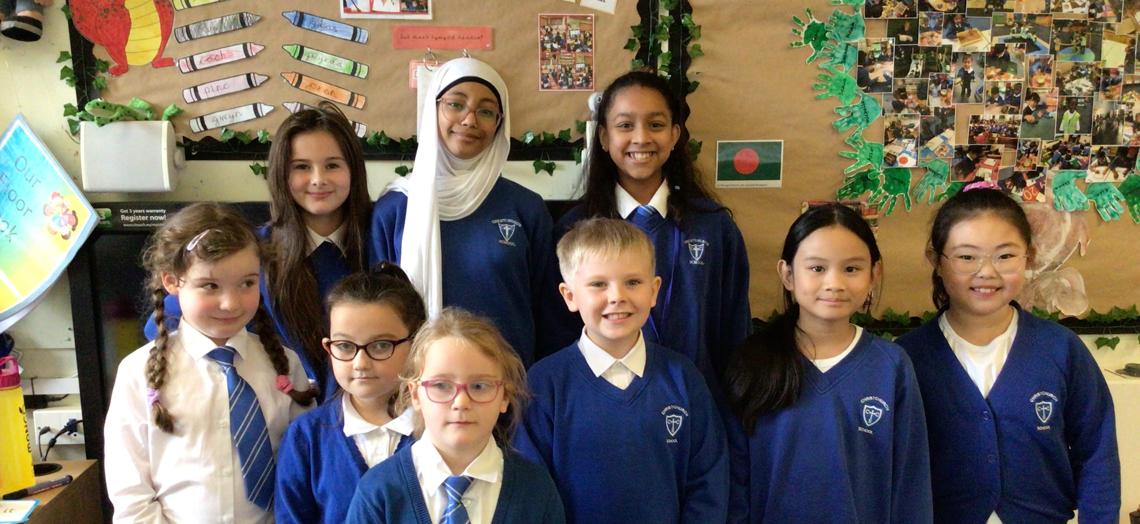
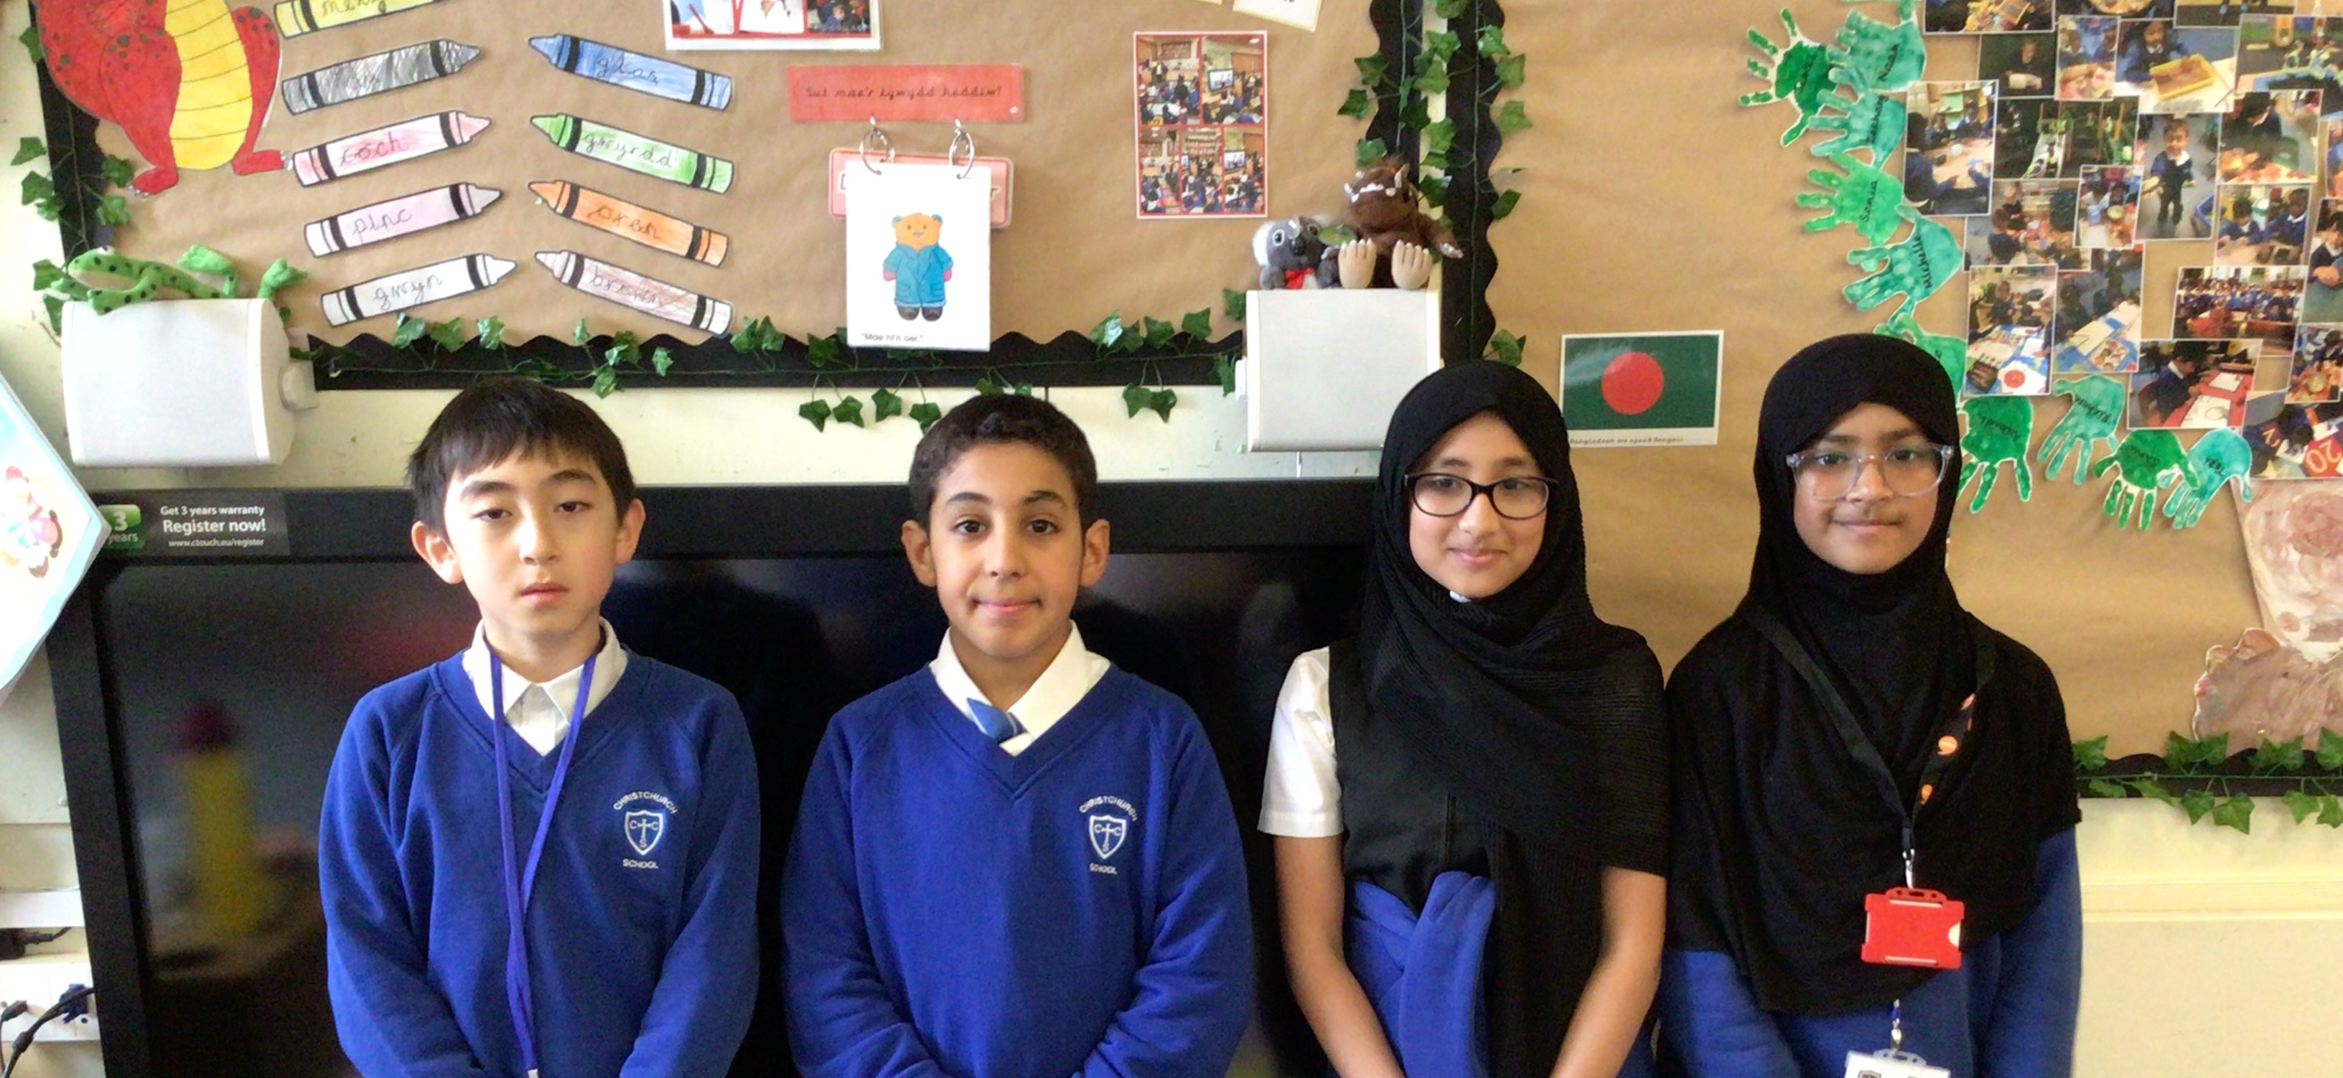
Thank you for listening
Agents of Change
and
Super Ambassadors

