Slide 1


Slide 2
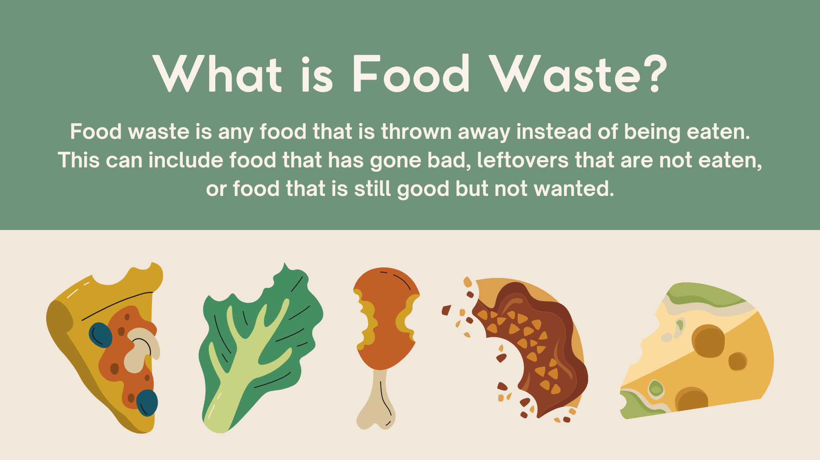

Slide 3


Slide 4
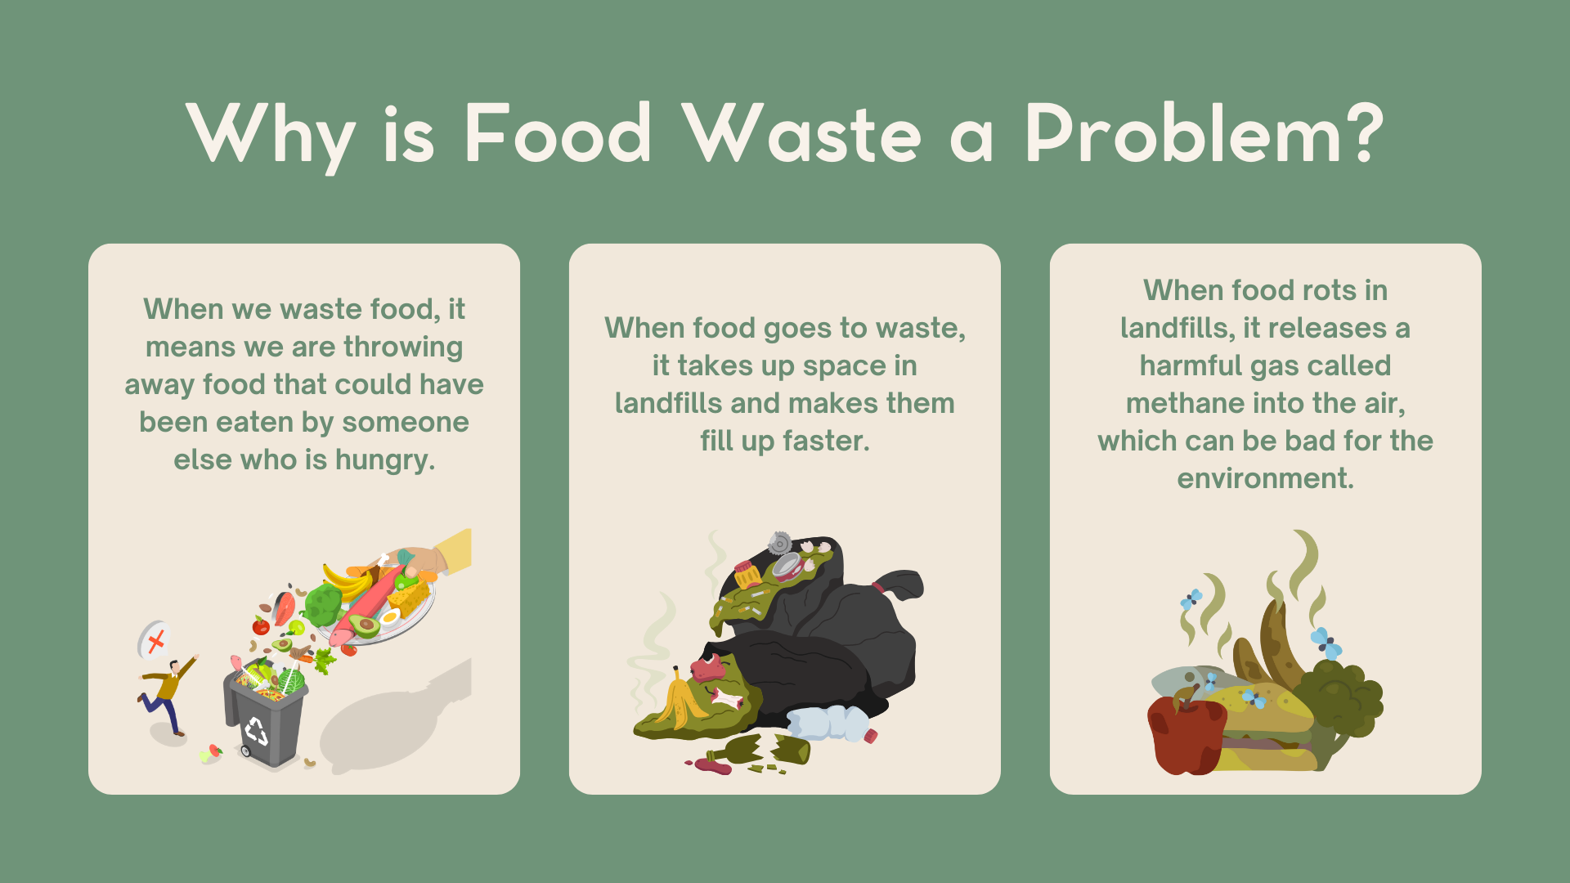

Slide 5


Slide 6

Agents of Change

