Slide 1
What Is Bullying?
Christchurch Primary
DOES NOT have Bullying.
We need to keep talking about it so it doesn’t start!

Slide 2
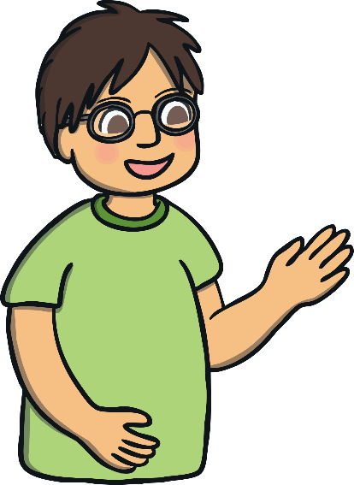
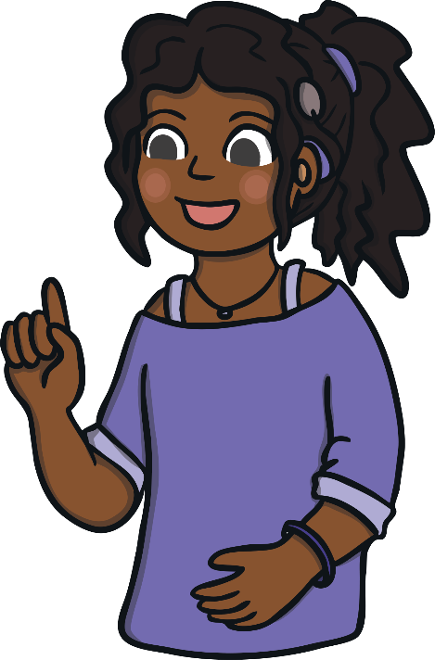
What Is Bullying?
Do you know what bullying is?
Bullying is hurting someone else on purpose. Bullying is something that happens over and over again.
Bullies can hurt people in lots of different ways. You can be hurt on your body or with nasty words.

Slide 3
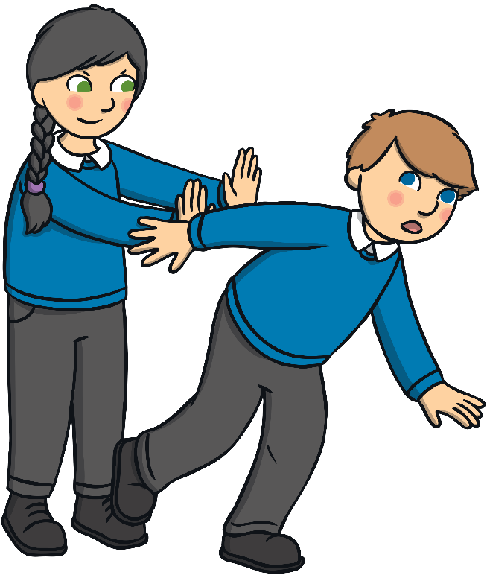
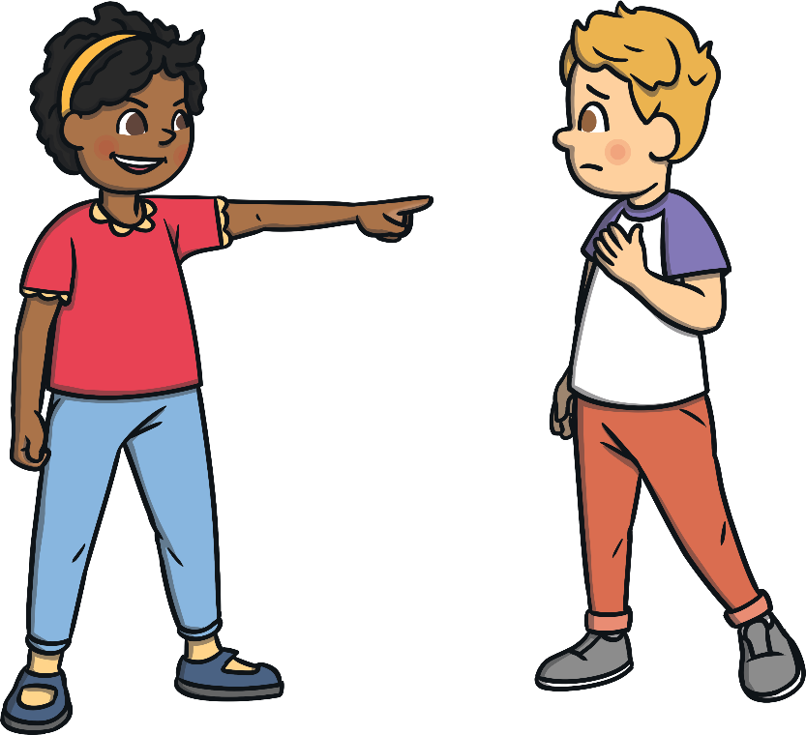
Different Kinds of Bullying
Physical bullying is pushing, hitting, pinching or kicking someone.
Verbal bullying is calling someone names, saying nasty things or even pretending you are going to hurt someone.
It can leave marks or bruises and people might see it happening, but it can be hidden underneath clothes.
Verbal bullying is not always easy to see. It can be done secretly and does not leave marks. It hurts people’s feelings and is
just as bad as physical bullying.

Slide 4
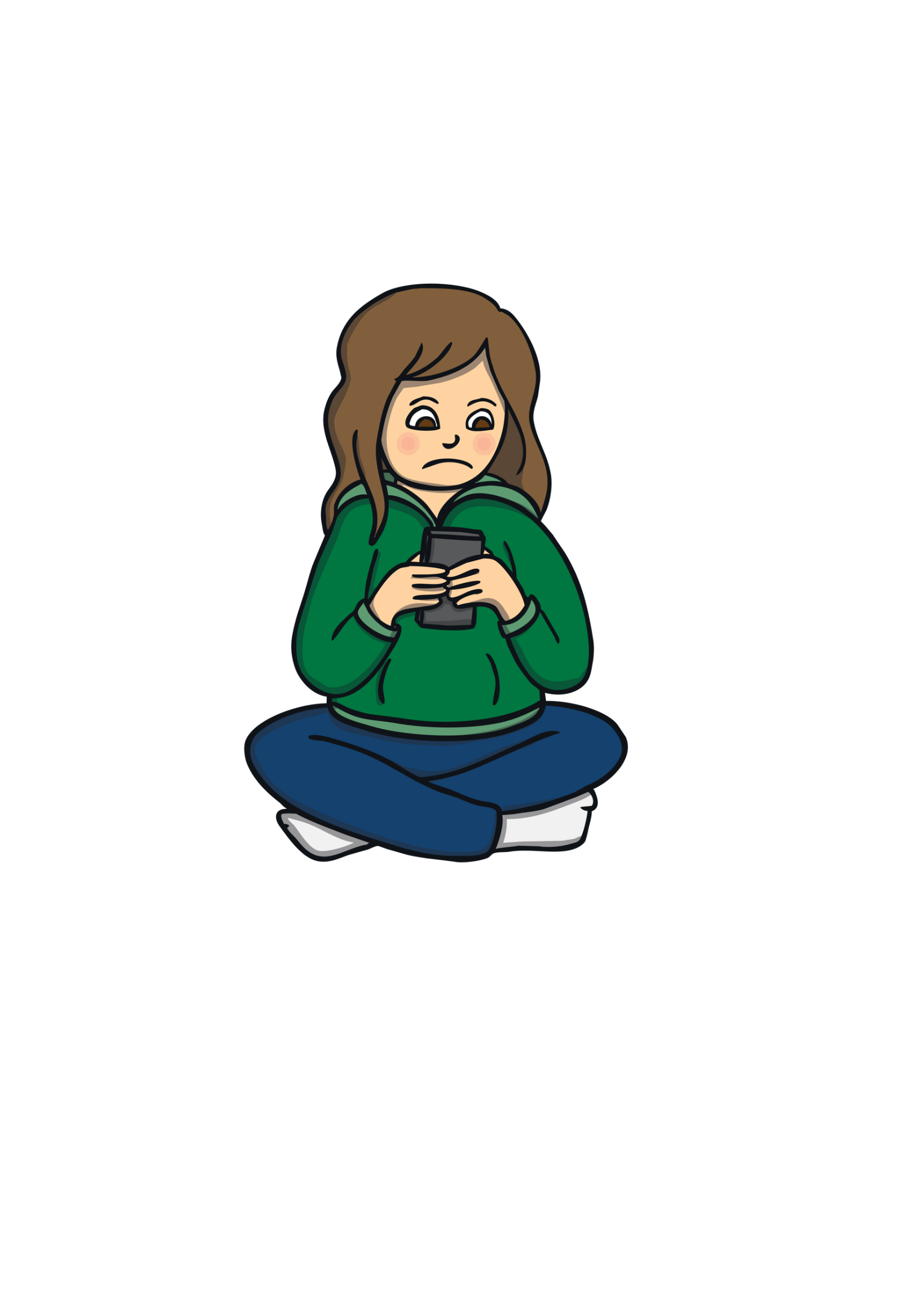
Cyberbullying
Cyberbullying is when people use email, photos, videos or text messages to make someone feel sad.
It can be one person or a group of people.
It can be scary for the person who is being bullied.
Make sure you know how to
stay safe online

Slide 5
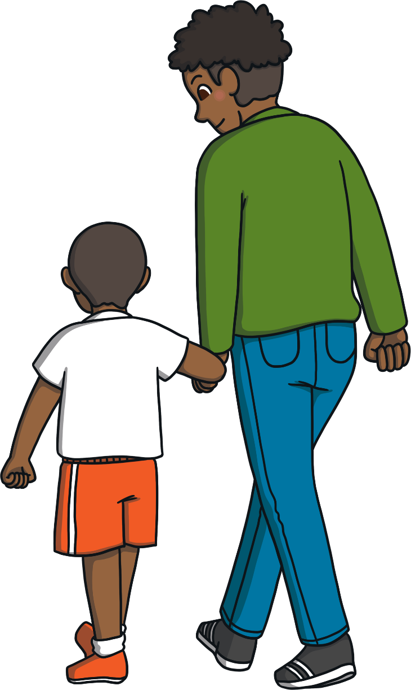
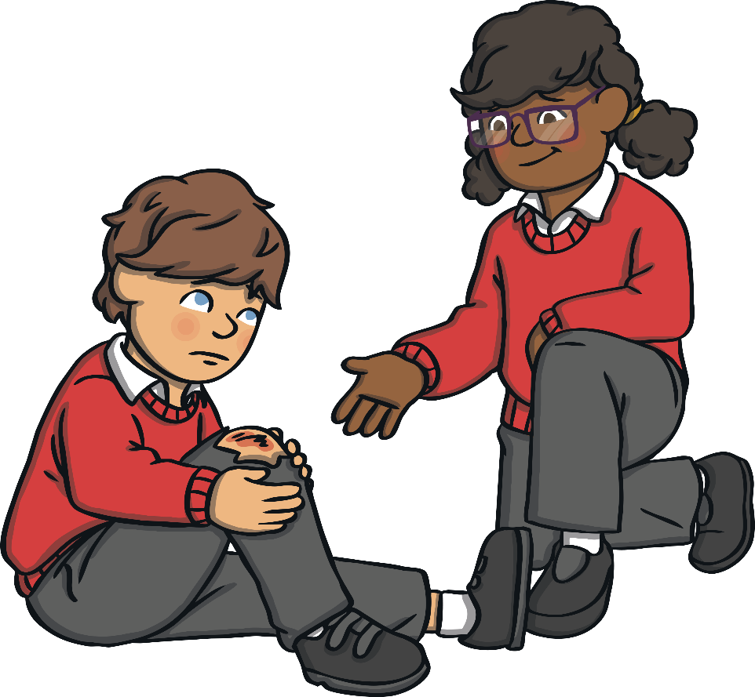
What Can You Do?
If you see bullying, you can:
Tell someone you trust - a parent, teacher, older relative. They will make sure it’s dealt with properly.
Be kind to the person being bullied. Someone who is being bullied can feel alone, sad and scared. Smile, talk to them or include them in something.
Tell your MENTOR
At CHRISTCHURCH..
Use the BUDDY BUS STOP
Use the WORRY MONSTERS

Slide 6
Thank you
We value your opinions. Is there anything you would like us to do? Any ideas?

