Slide 1

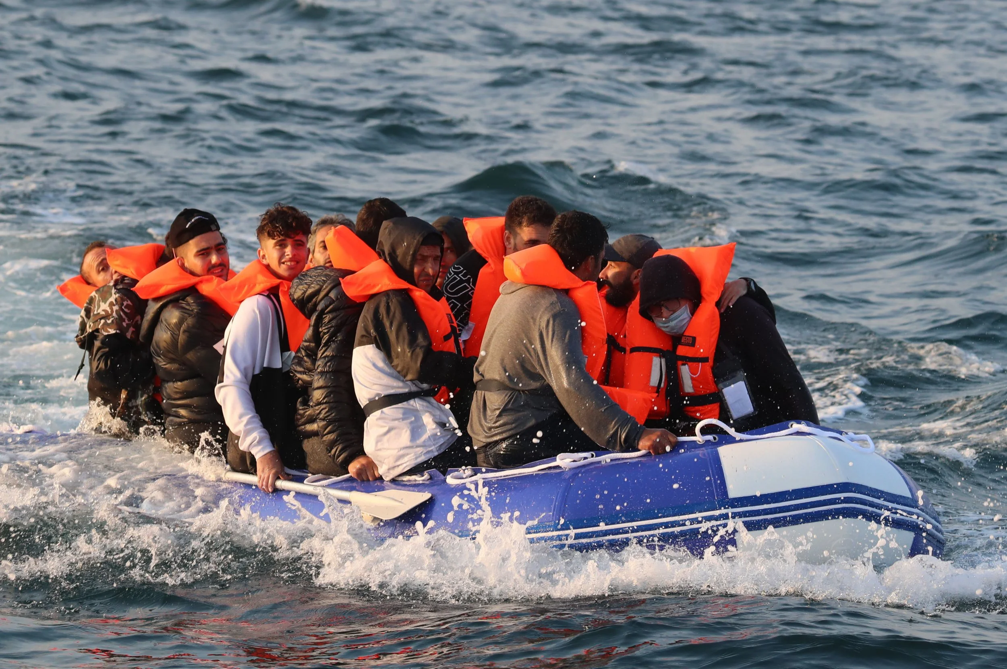
All About Refugees and orange hearts !
By Amelia .p. and Millie .h.

Slide 2

What is a refugee !
A Refugee is someone who had to leave their home because of the flee war or many other things
We have 11 Refugees in our school !
They only have a little bag to carry all their stuff, but they can only carry the stuff they can fit in the bag
What would you bring if you could only bring a few things ?
How would you feel if you had to leave your country because of the flee of war ?

Slide 3
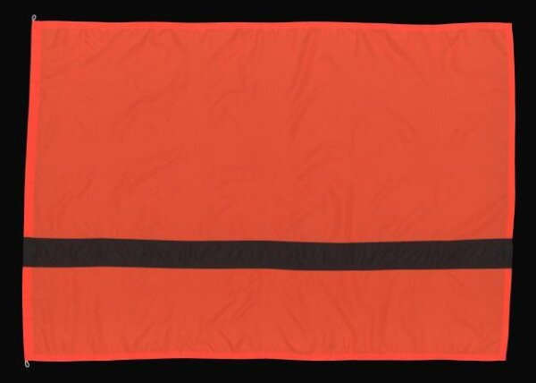
Why is the flag that represents the refuges black and orange
Picture of refugee flag !!
Answer
Because when they would go traveling sometimes, they would go on a boat because of how far their home was and the place they were going to would also be far away so they would take a boat and they would where live jackets. The life jackets would be black and orange so that’s why the colour of the flag are black and orange

Slide 4
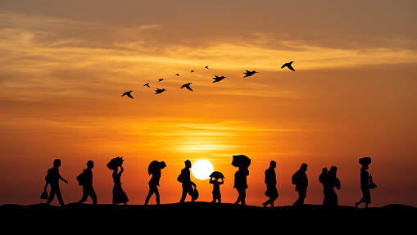
How many refugees are coming here in Wales
There are just over 10,000 people in Wales who are refugees !
Wales is community who welcomes they might have one eye a tin leg, but we still welcome them no matter what we will welcome you !
Remember don’t judge a book by their cover!

Slide 5
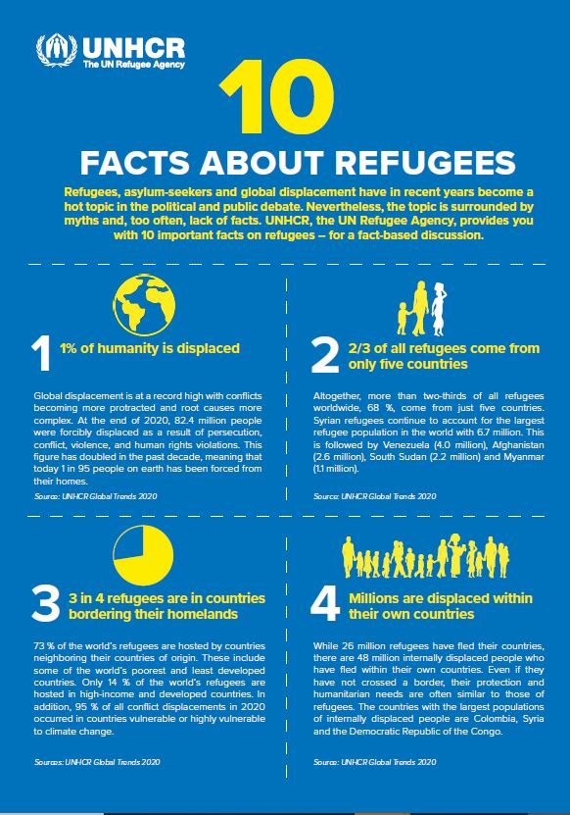
Fact
4.6 million people are asylum-seekers (seeking refugee status), and an additional 53.2 people million are displaced within their own countries. 41% of all forcibly displaced people are children. Almost 1 million children were born as refugees between 2018 and 2020.

Slide 6
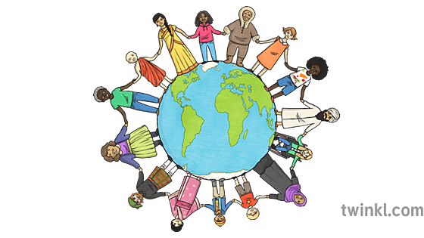
Don’t forget were all the same!
There are some different things about us but it doesn't mean you should treat people differently !

Slide 7






Don’t forget spred kindness like GLITTER
How many tickles dose it take to tickle an octopus
Ten-tickles !!

