Slide 1
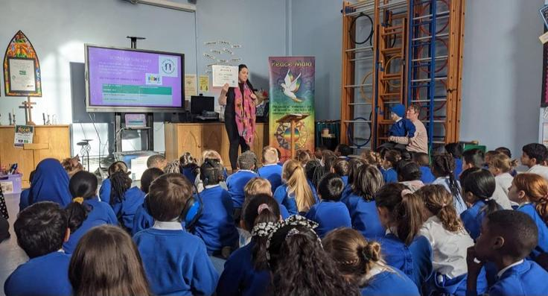

School of Sanctuary
Made by Kaya Williams : )
And Edna Omorodion

Slide 2



Contance
What is a School Of Sanctuary?
Why do we want to be a School Of Sanctuary?
What does Sanctuary mean?
About Us
We need to be a beacon of light!
How can we Help?
Remember:

Slide 3
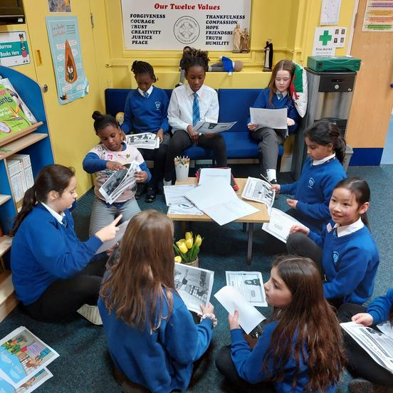
What is a school of Sanctuary?
Well, a school of Sanctuary is a school that is safe and a school that is welcoming, kind and a place for children seeking Sanctuary.
A place/school where children can go because there is a war in their country, they are having trouble in their house or just want a safe place to go.

Slide 4
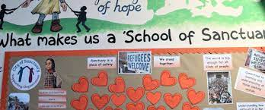
Why do we want to be a school of Sanctuary?
We want to be a school of sanctuary for many reasons:
We want to make a difference,
We are a kind school,
It is a good thing,
We want to help people,
If we were in that position, we would feel scared.

Slide 5

What does Sanctuary mean?
Sanctuary means as safe place. For example, there is something called a sanctuary for animals so animals in danger would go to a sanctuary for animals where they can be safe and have peace.
So as humans and a school we want to provide that safety!

Slide 6

About us
Christchurch school is a thriving school where children enjoy learning and spending time with their friends. In Christchurch School we encourage everyone to show respect, to reflect, take responsibility and reach their potential.
We are a busy but friendly school, with lots going on.

Slide 7
We need to be a beacon of light!
We need to be a beacon of light because:
We are a church school,
We will make that difference,
It is an AMAZING thing to be,
We spread kindness like glitter,
And millions of other things!

Slide 8



How can we help?
We can help by:
Make sure you be kind,
Be very welcoming,
Always smile
Telling them our values,
Showing them around,
Have fun with them.

Slide 9






Remember:
Make a difference
Spread kindness like glitter
Be the reason someone smiles!!!!!!!!!!!!!!!!!!!!!!!!!!!!

Slide 10
Inspection report:
Leaders have created a positive learning environment that promotes inclusion, well-being, and an ethos of mutual respect.
Teachers provide many opportunities for pupils to develop an understanding of different cultures, and this a strength of the school. The relationships between all members of the school community reflect the kind, caring and positive ethos of the school.
Nearly all pupils talk confidently about their school and take pride in their multi-cultural and diverse community.
One of the notable features is that nearly all pupils behave consistently well in lessons and around the school.
They treat adults and visitors with respect and courtesy. In nearly all cases, pupils love school and are very happy.
Nearly all pupils’ understanding of moral values and equality is developing well. They deal with topics such as racism sensitively and maturely and express their views clearly, while treating other pupils’ contributions with respect. As a result, they develop as knowledgeable and tolerant citizens who know that difference is something to be celebrated in society.
The school has pupils’ well-being and safety at its heart. There is a strong safeguarding ethos, and all staff have a clear understanding of their roles and responsibilities for keeping learners safe. All staff use effective strategies to promote and support a culture of anti-bullying and positive attitudes towards managing behaviour.

Slide 11
Staff use the school’s diverse cultural and ethnic context to provide rich opportunities for learning.
For example, during Diwali, the younger pupils make sweets, create Rangoli patterns and use Hindu stories as part of their literacy lessons.
Teachers plan a wide range of opportunities for pupils to learn about the history and experiences of Black, Asian and Minority Ethnic groups. For example, as part of a project, leaders and staff work effectively with the Arts Council to provide a range of very worthwhile learning experiences. This includes inviting local people who represent a range of roles and professions to visit the school to share their experiences with the pupils. Staff use these visits to plan beneficial learning opportunities for pupils which celebrate the diversity of the local community.
Older pupils share what they have learnt with their parents and the wider community effectively, for example, by creating films which are then posted on the school’s website for all to see.
The school provides purposeful events and visits which are effective in promoting pupils’ understanding of their diversity and the richness of their community.
Across the school, displays and presentations effectively represent pupils’ heritage and culture, for example, a map of the world shows the country of origin for each family and greetings in their languages.
Through regular assemblies and taught sessions, teachers ensure that pupils learn about the rights of the child. They provide frequent opportunities for pupils to gain a deeper understanding of important values such as honesty, fairness, and justice.

Slide 12


Thank you
Next to present - The Agents of Change
Anti bullying

