Slide 1
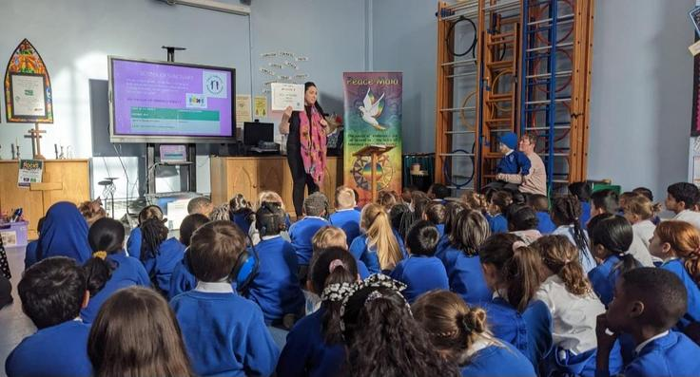

School of Sanctuary
Made by Kaya Williams : )
And Edna Omorodion

Slide 2
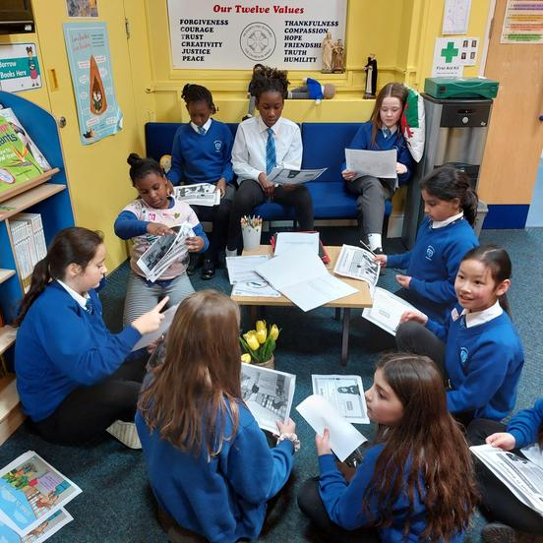
What is a school of Sanctuary?
Well, a school of Sanctuary is a school that is safe and a school that is welcoming, kind and a place for children seeking Sanctuary.
A place/school where children can go because there is a war in their country, they are having trouble in their house or just want a safe place to go.

Slide 3
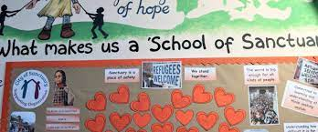
Why do we want to be a school of Sanctuary?
We want to be a school of sanctuary for many reasons:
We want to make a difference,
We are a kind school,
It is a good thing,
We want to help people,
If we were in that position, we would feel scared.

Slide 4

What does Sanctuary mean?
Sanctuary means as safe place. For example, there is something called a sanctuary for animals so animals in danger would go to a sanctuary for animals where they can be safe and have peace.
So as humans and a school we want to provide that safety!

Slide 5

About us
Christchurch school is a thriving school where children enjoy learning and spending time with their friends. In Christchurch School we encourage everyone to show respect, to reflect, take responsibility and reach their potential.
We are a busy but friendly school, with lots going on.

Slide 6
We need to be a beacon of light!
We need to be a beacon of light because:
We are a church school,
We will make that difference,
It is an AMAZING thing to be,
We spread kindness like glitter,
And millions of other things!

Slide 7



How can we help?
We can help by:
Make sure you be kind,
Be very welcoming,
Always smile
Telling them our values,
Showing them around,
Have fun with them.

Slide 8





Remember:
Make a difference
Spread kindness like glitter
Be the reason someone smiles!!!!!!!!!!!!!!!!!!!!!!!!!!!!

