Slide 1
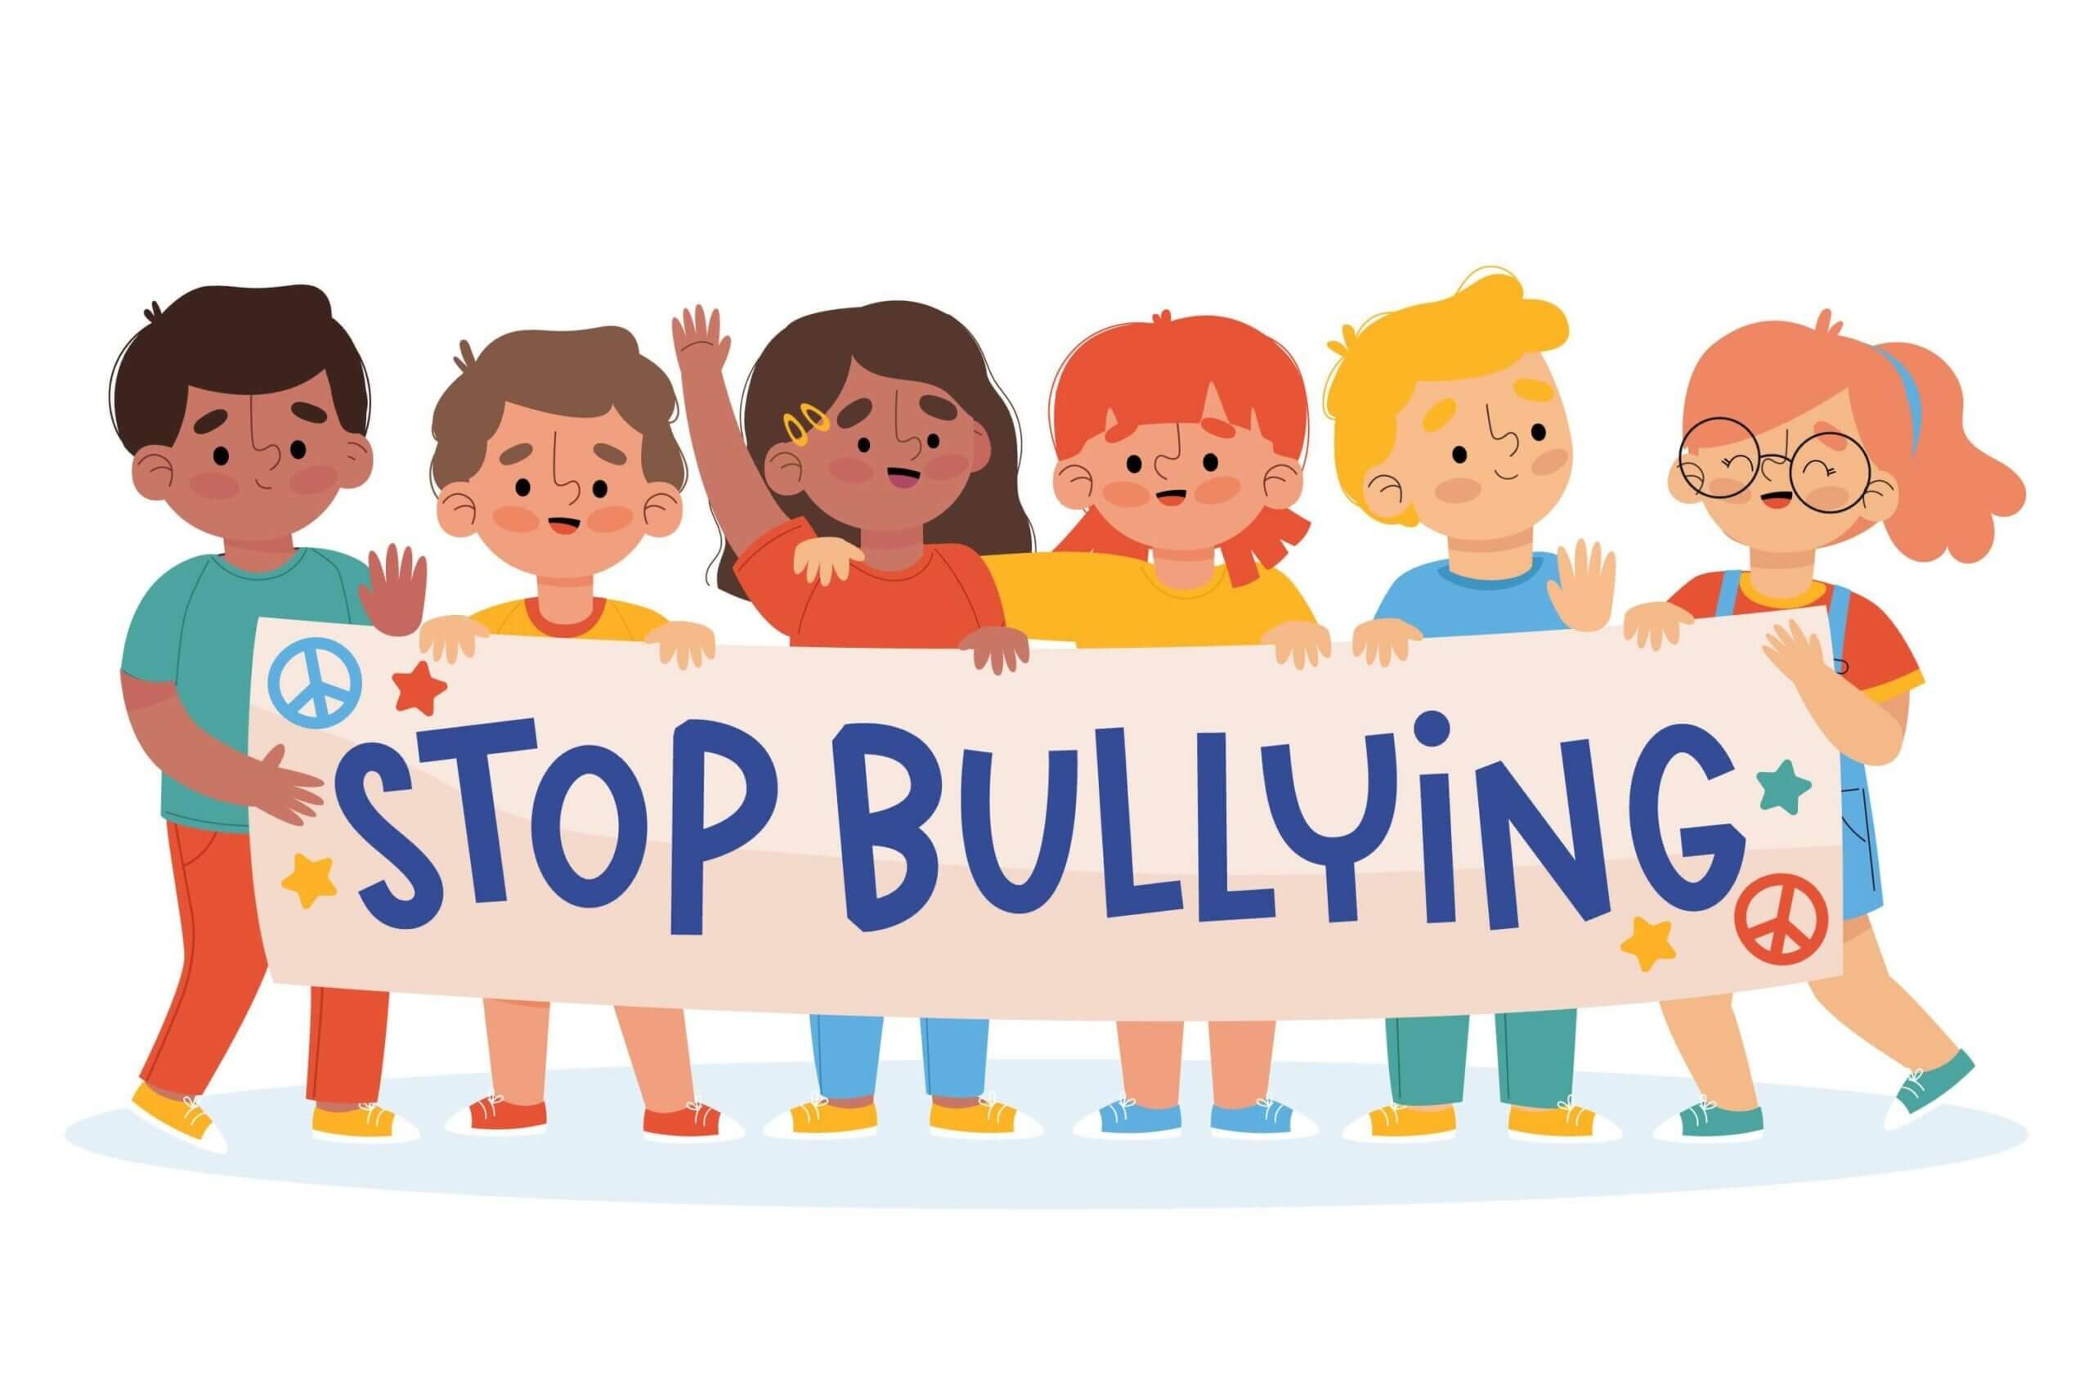
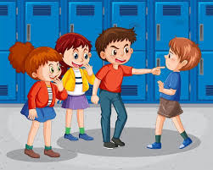
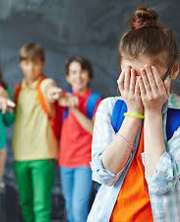
Anti-Bullying
By agents of change

Slide 2
What does bullying mean
Bullying is hurting someone in different ways like words, online or you can physically bully them.

Slide 3
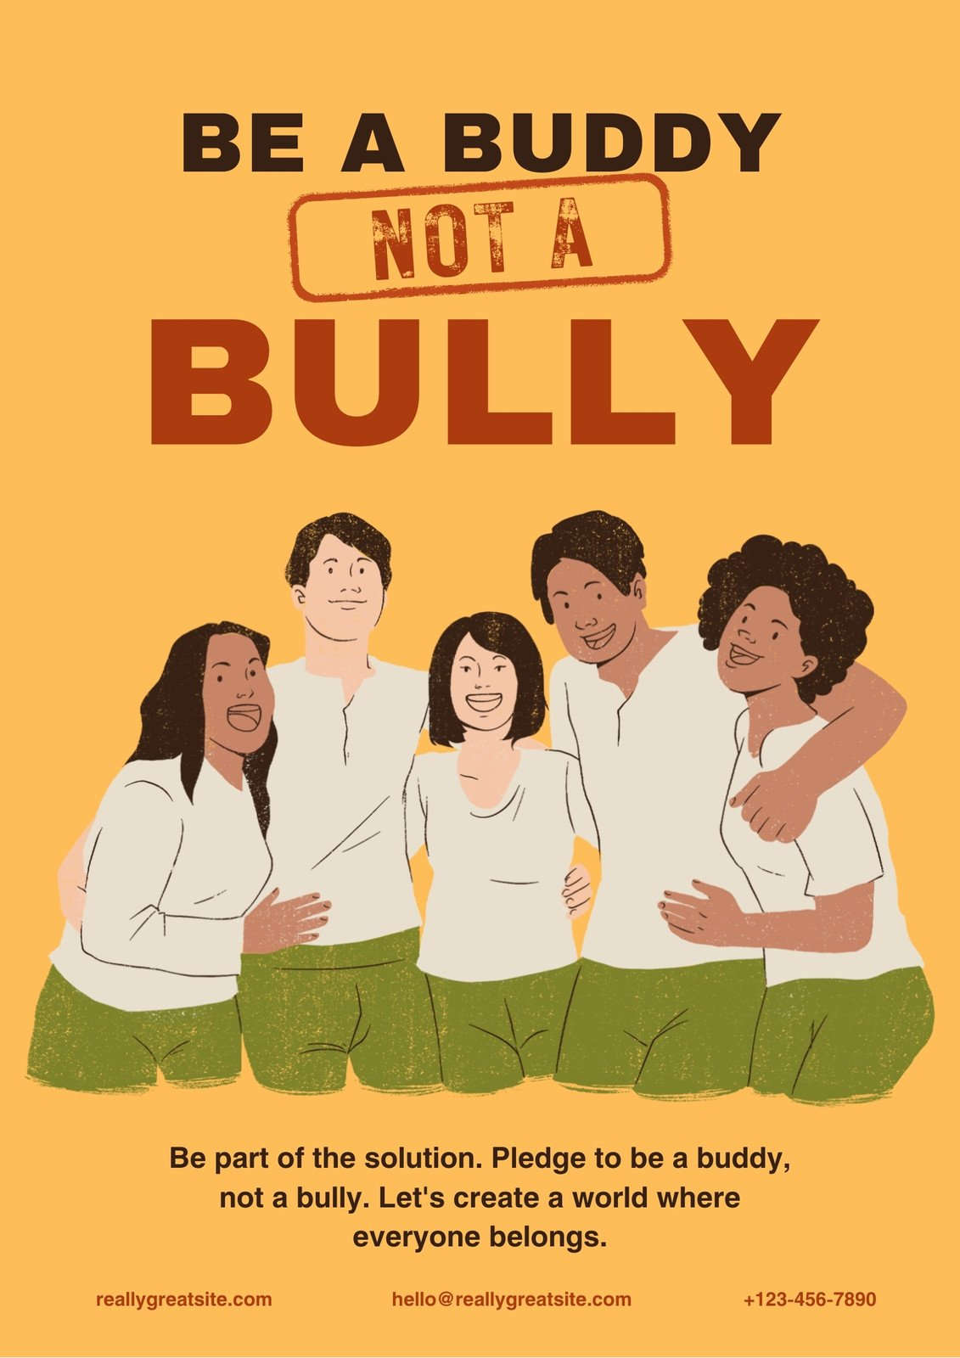
What to do if you are being bullied
If you are being bullied, tell a parent, carer or teacher, don't suffer in silence

Slide 4
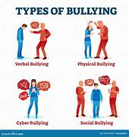
The four types of bullying
Verbal Bullying
Physical Bullying
Social Bullying
Cyber Bullying

Slide 5
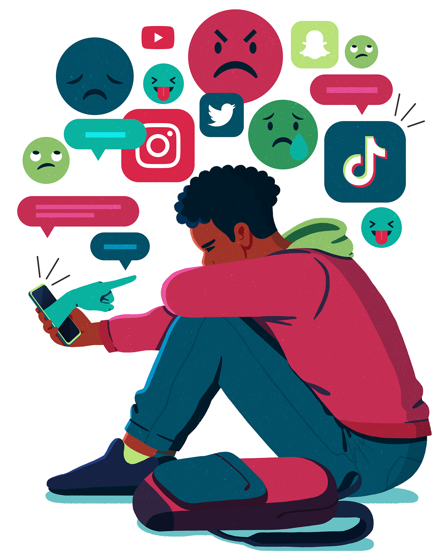
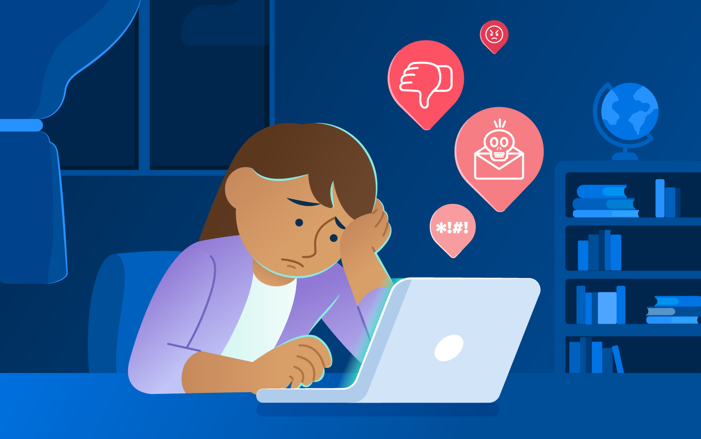
What is cyber-bullying
Cyber-bullying is bullying online where they can text you and say mean stuff.

Slide 6
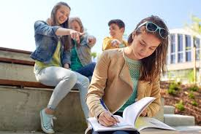
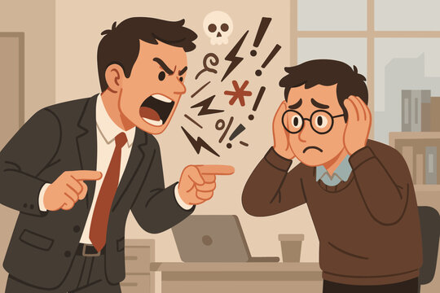
Verbal bullying
Verbal bullying is repeated rude words or slandering

Slide 7
How to not be a bully
Refuse
Refuse to be an audience for a bully
Do not laugh
Do not laugh while someone is being picked on
Do not participate in
Do not participate in bullying others
Do not use
Do not use the internet to hurt someone
Walk away
Walk away from the scene and tell an adult
Do not follow
Do not follow the wrong crowd

Slide 8
Common reasons why kids are bullied
It could be because their talented
Few or no friends
Popular or well liked
Smart or creative
Religious or cultural beliefs
. Race

Slide 9
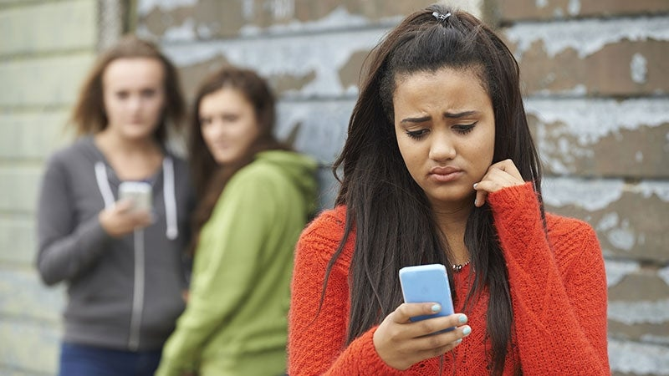
What to do when your bullied online
Report or Block
Save the evidence
Tell someone what's happening
Tell your parents about it

Slide 10


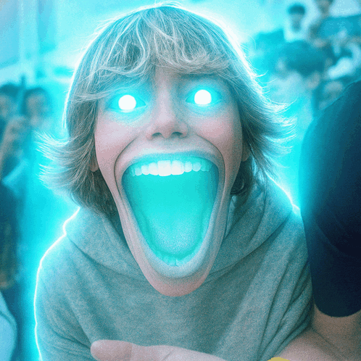
Remember don’t bully anyone and spread kindness like glitter

