Slide 1
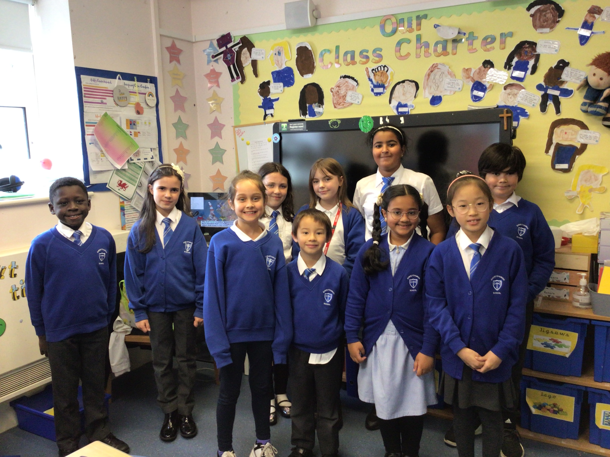
Christchurch Primary School
How we are keeping Gods world a safe place.
Agents of Change and Super Ambassadors 2023/24

Slide 2

Agents of Change and Super Ambassadors meet with Mrs Sears-Neale once a week.
We want to make the world a better place, a world we are proud of.

Slide 3
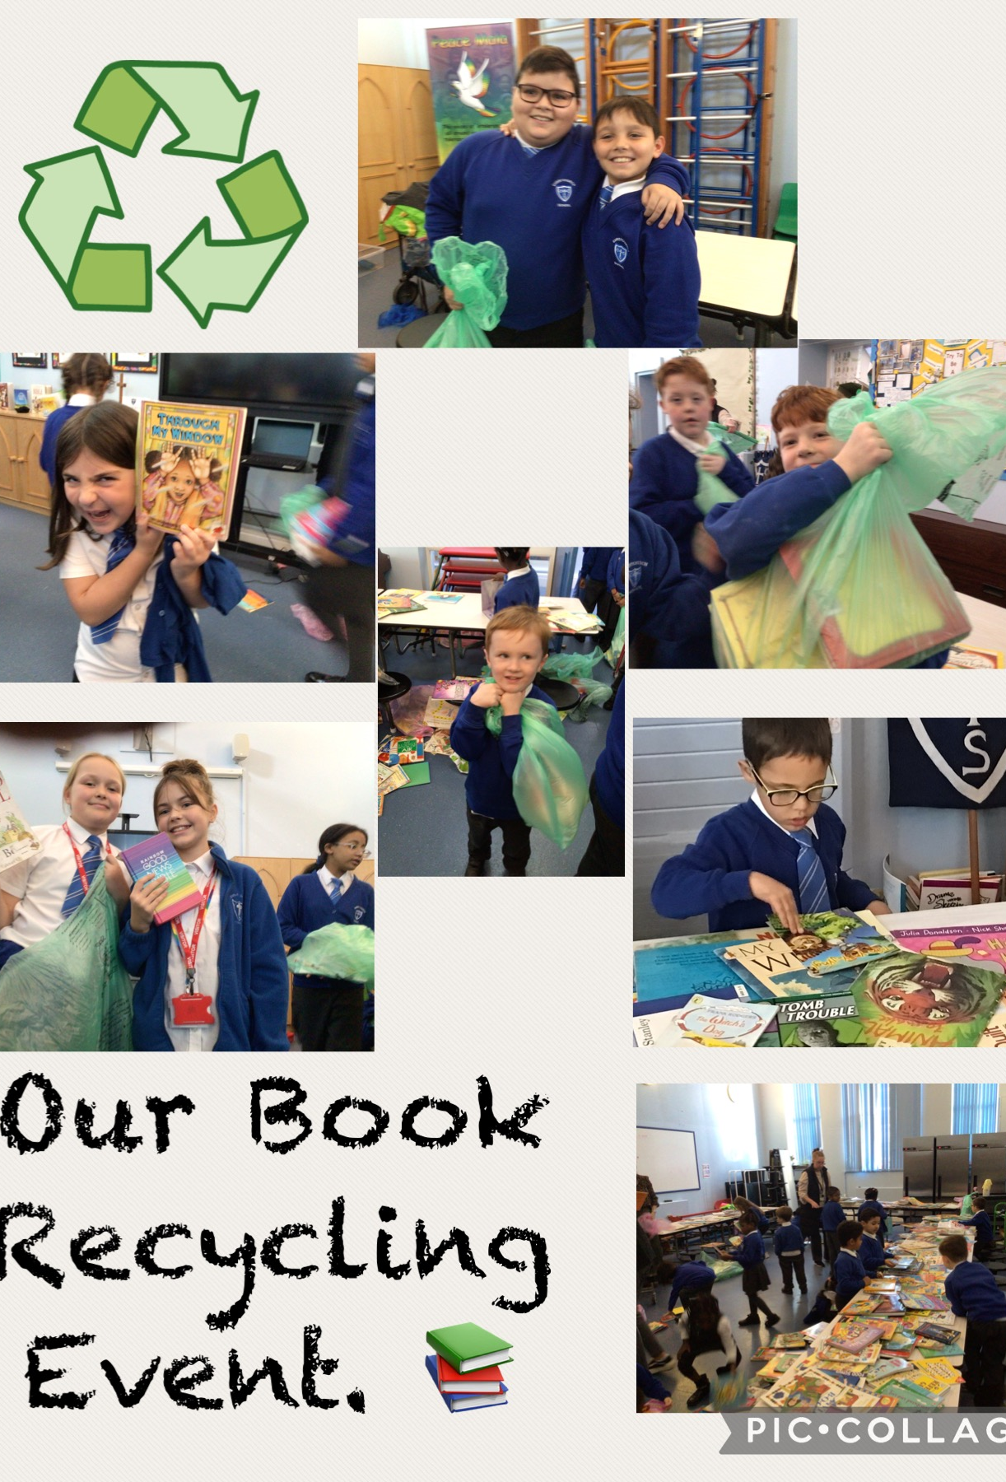
We have held a book recycling event in school. All the children had the opportunity to take home books to share with their families.

Slide 4
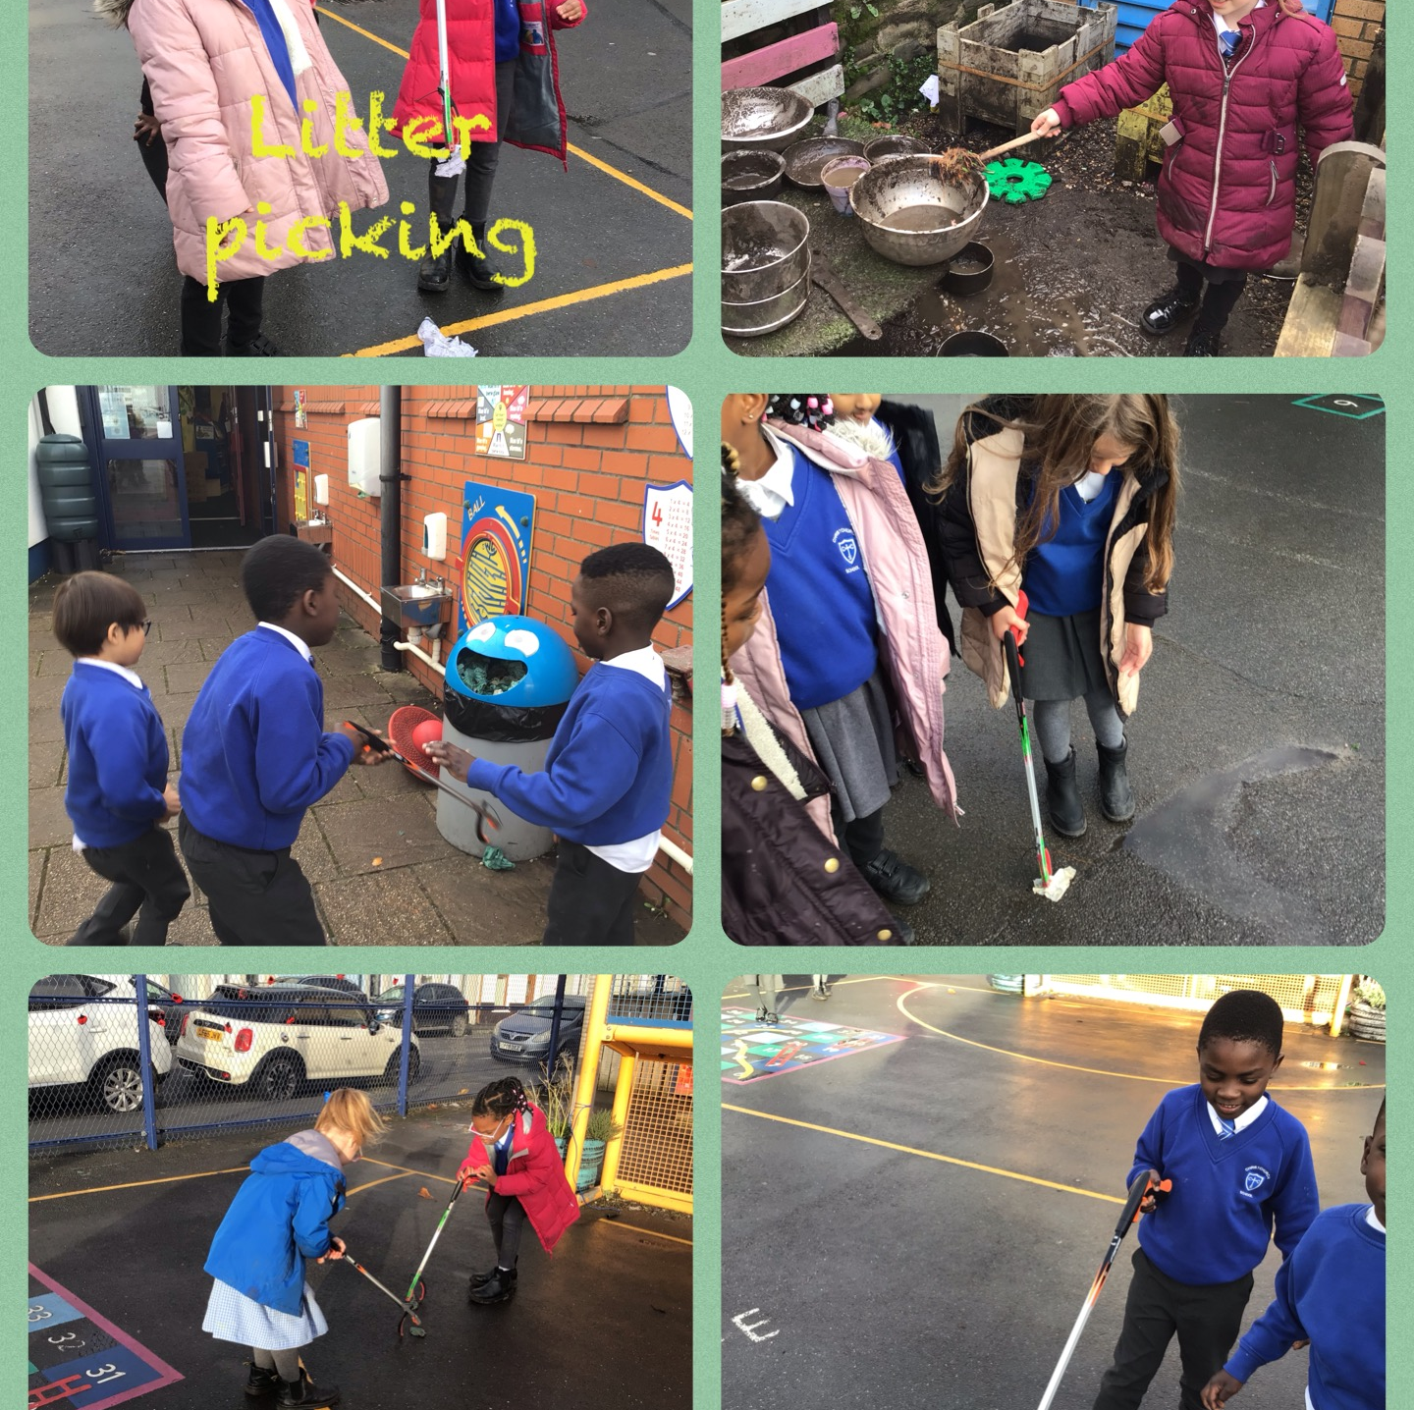
We have organised litter picking sessions to keep our yard tidy.

Slide 5
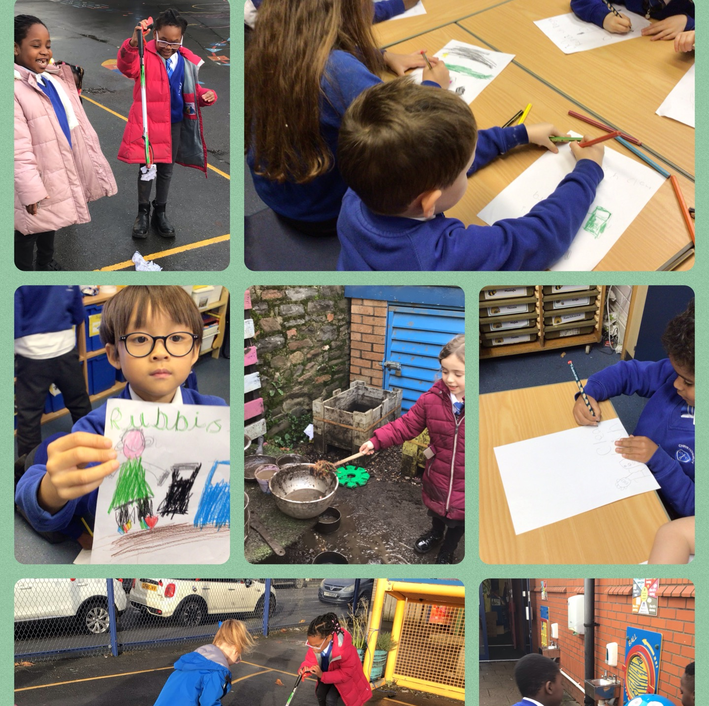
We organised a whole school recycling competition.
All children had the opportunity to submit a poster to advertise the importance of recycling.
We organised prizes for the best poster in each year group.

Slide 6
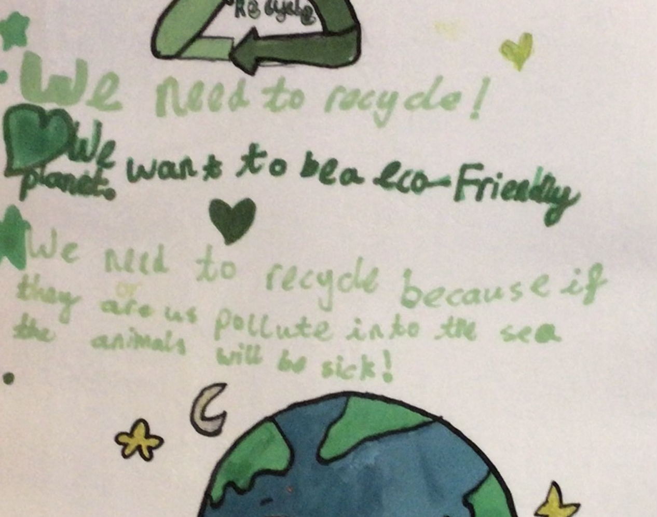
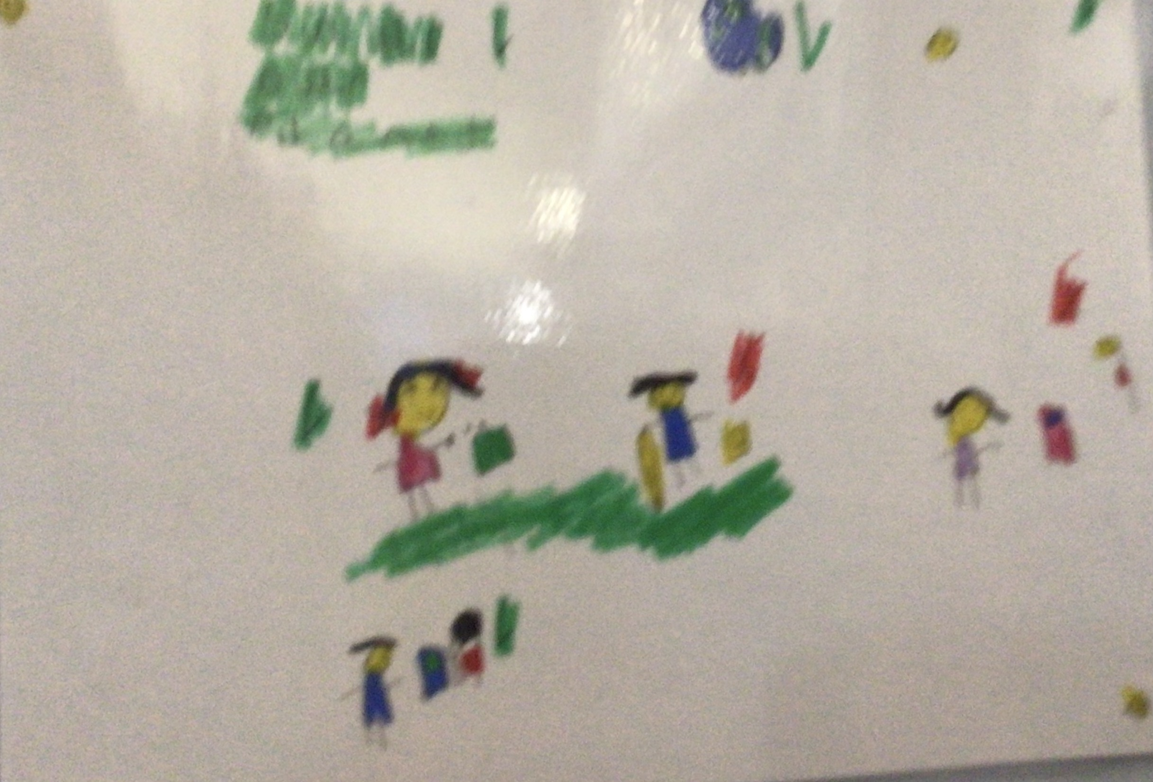
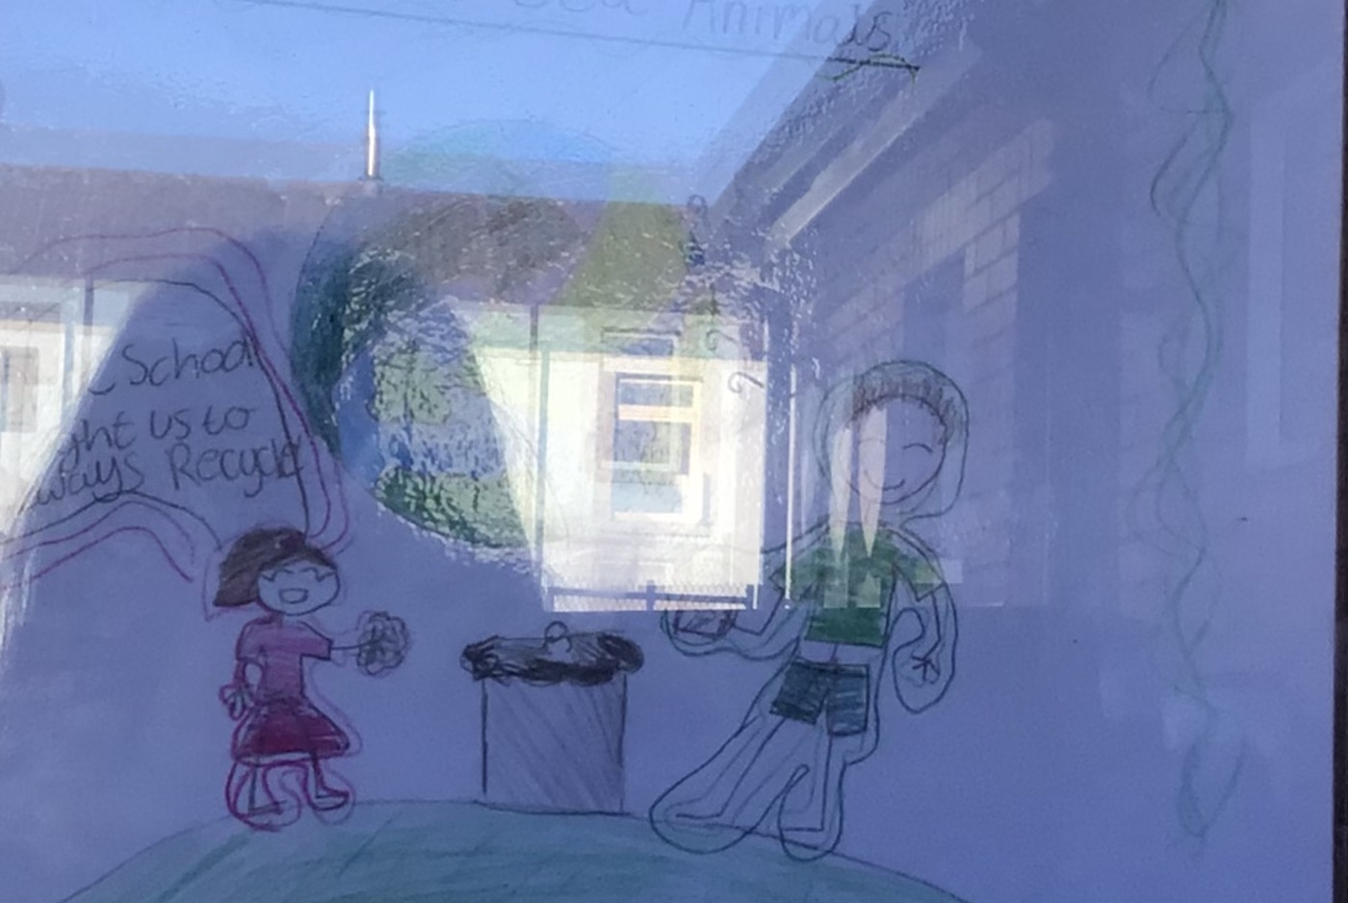
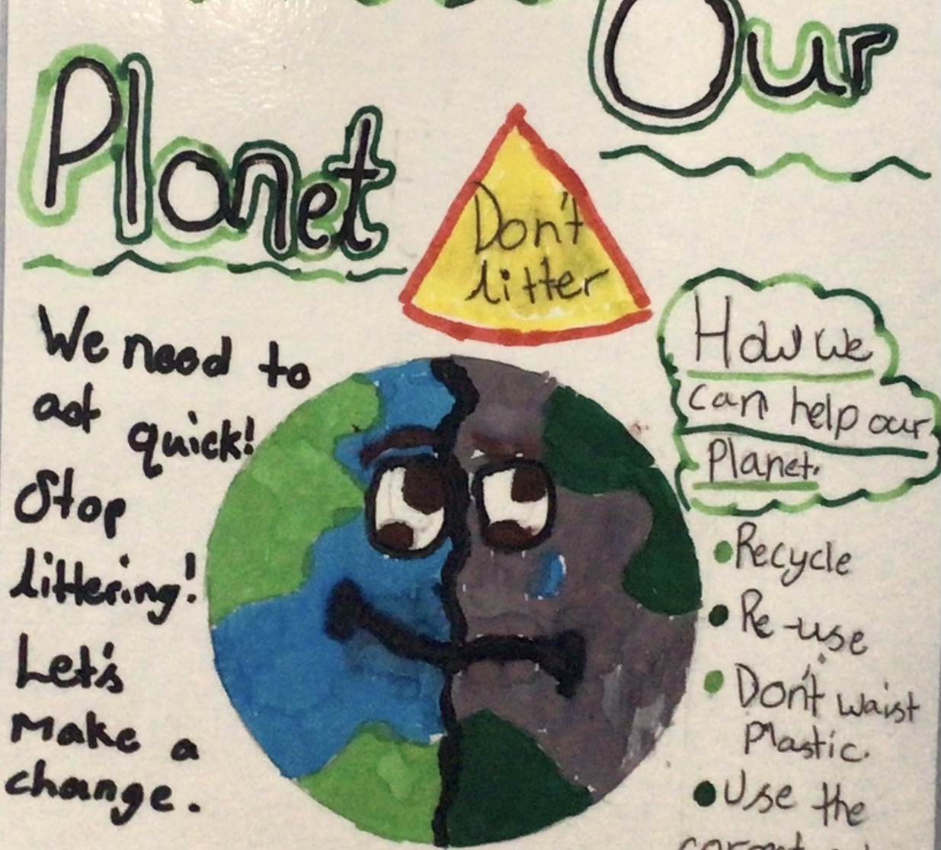
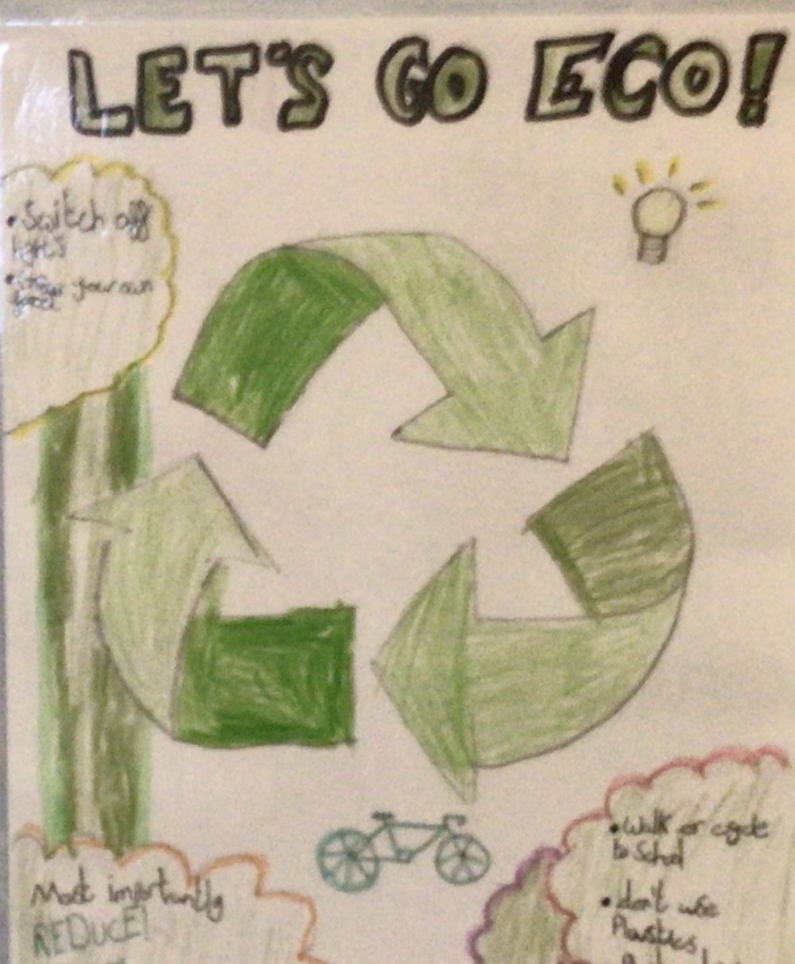
These are the winning entries.

Slide 7
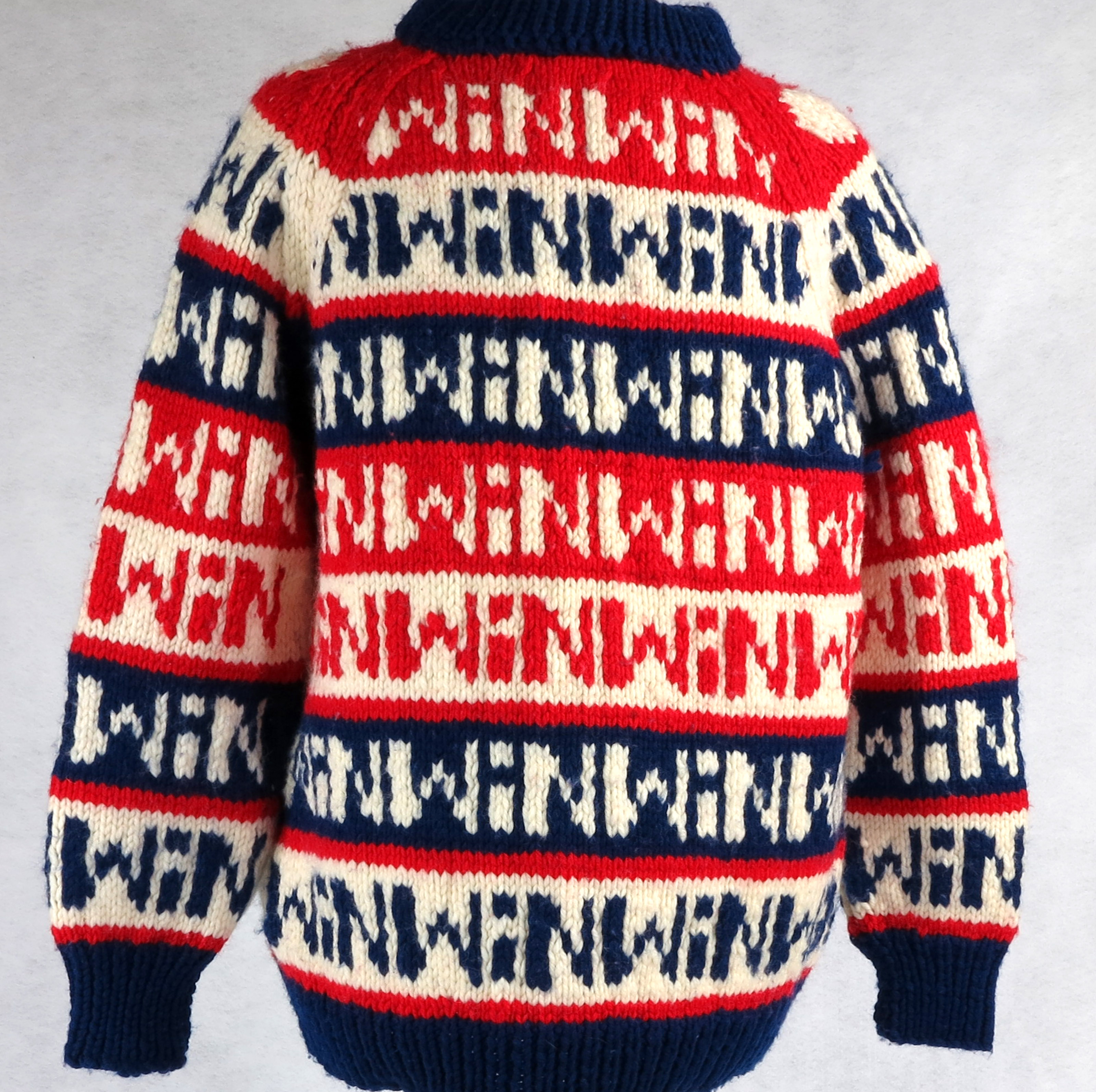
Recycling school uniform and Christmas jumpers.
Christmas time we offered our families pre-loved Christmas jumpers. This not only helps financially but it is better for the environment. We have now also started offering pre-loved school uniform.

Slide 8
What Next:
We have arranged a meeting with Nexus to discuss using their refillable glue sticks. This will save on the plastic waste of our current glue sticks.
We are planning on taking part in a litter pick on the beach.
We are delivering a whole school assembly to teach the staff and pupils how to recycle and save energy.
We are organising an assembly delivered by Sammy the Seagull, Swansea’s recycling mascot.

Slide 9

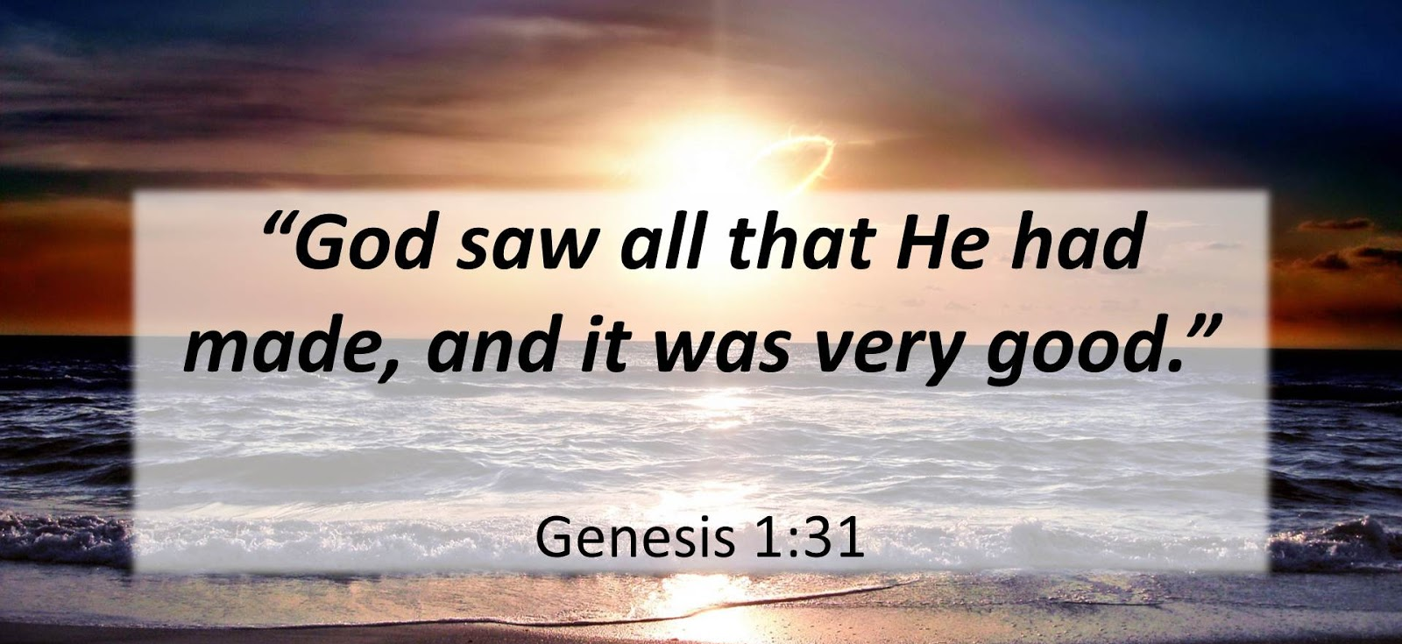
We hope you have enjoyed our presentation.
Together we can look after Gods creation.

