Slide 1

Our Journey So Far…..
Agents of change and super Ambassadors.
2023-2024

Slide 2
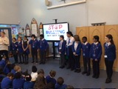
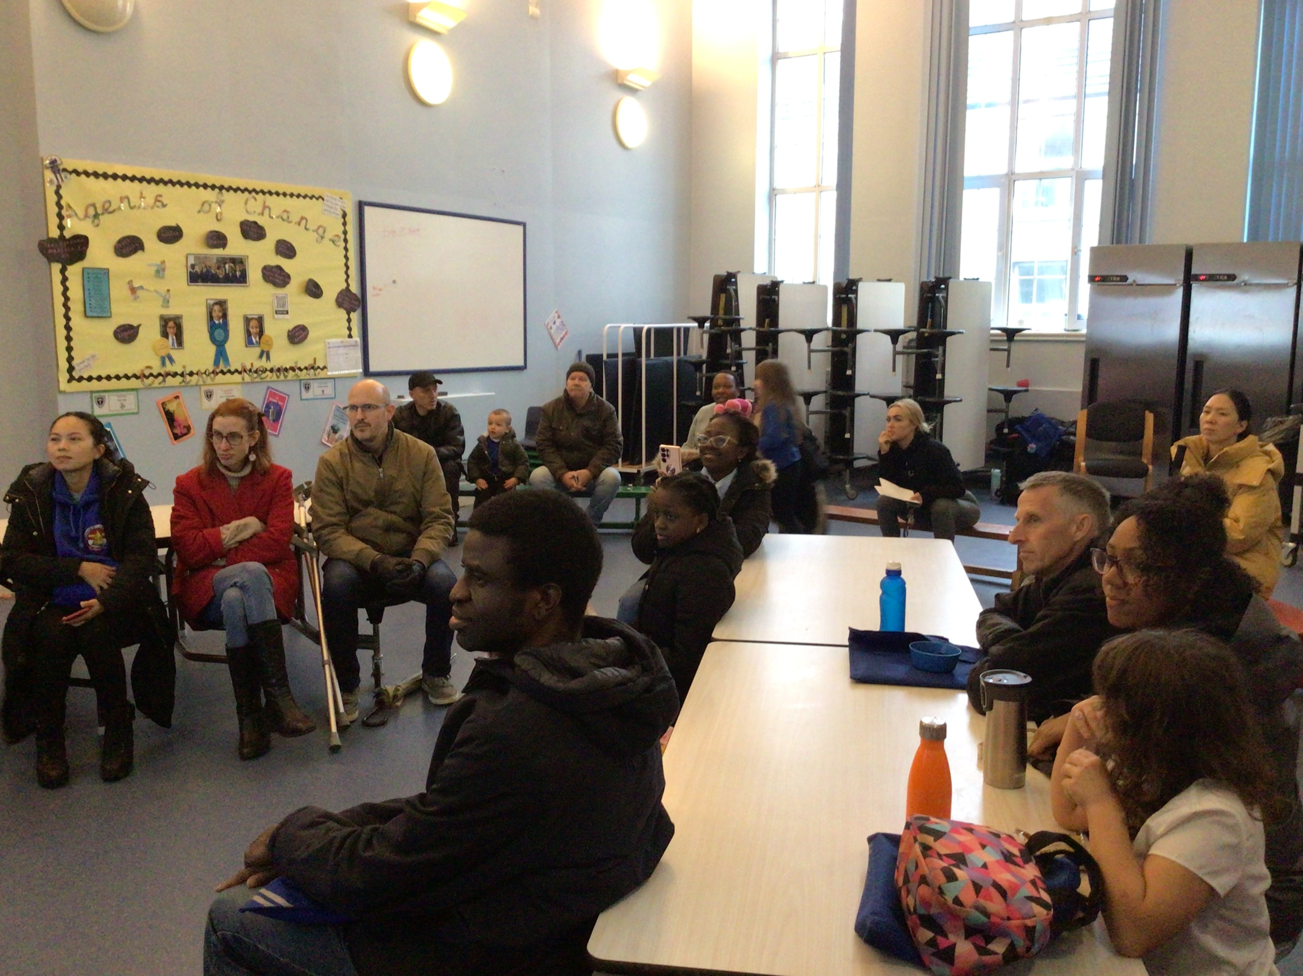
Anti Bullying Week
We presented to the whole school and to the parents. Lots of parents attended.

Slide 3
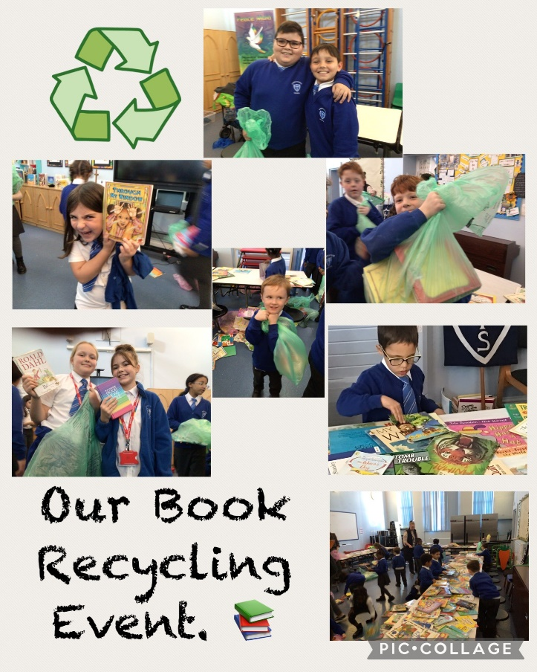
We held a Book Recycling Event.

Slide 4
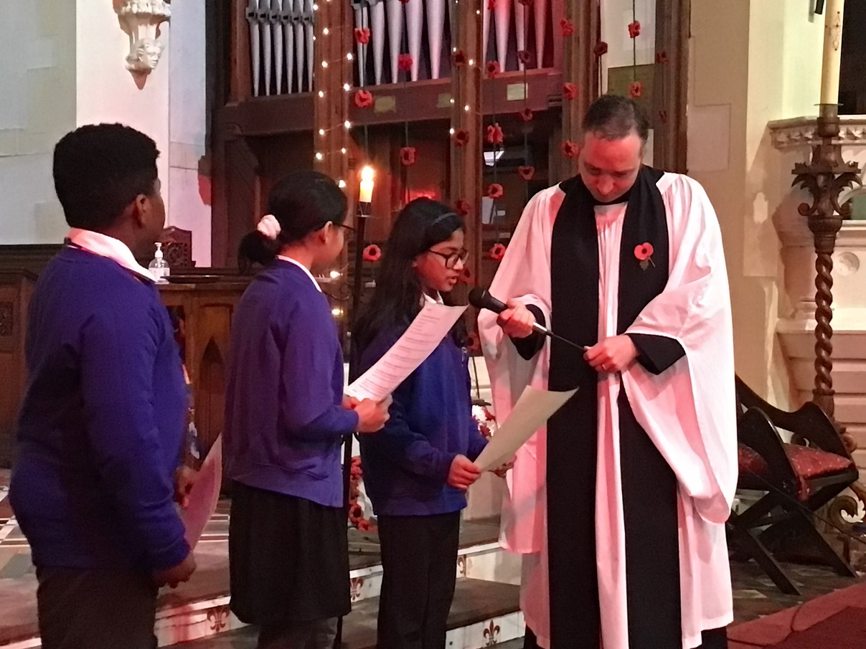
Remembrance Sunday Service.

Slide 5
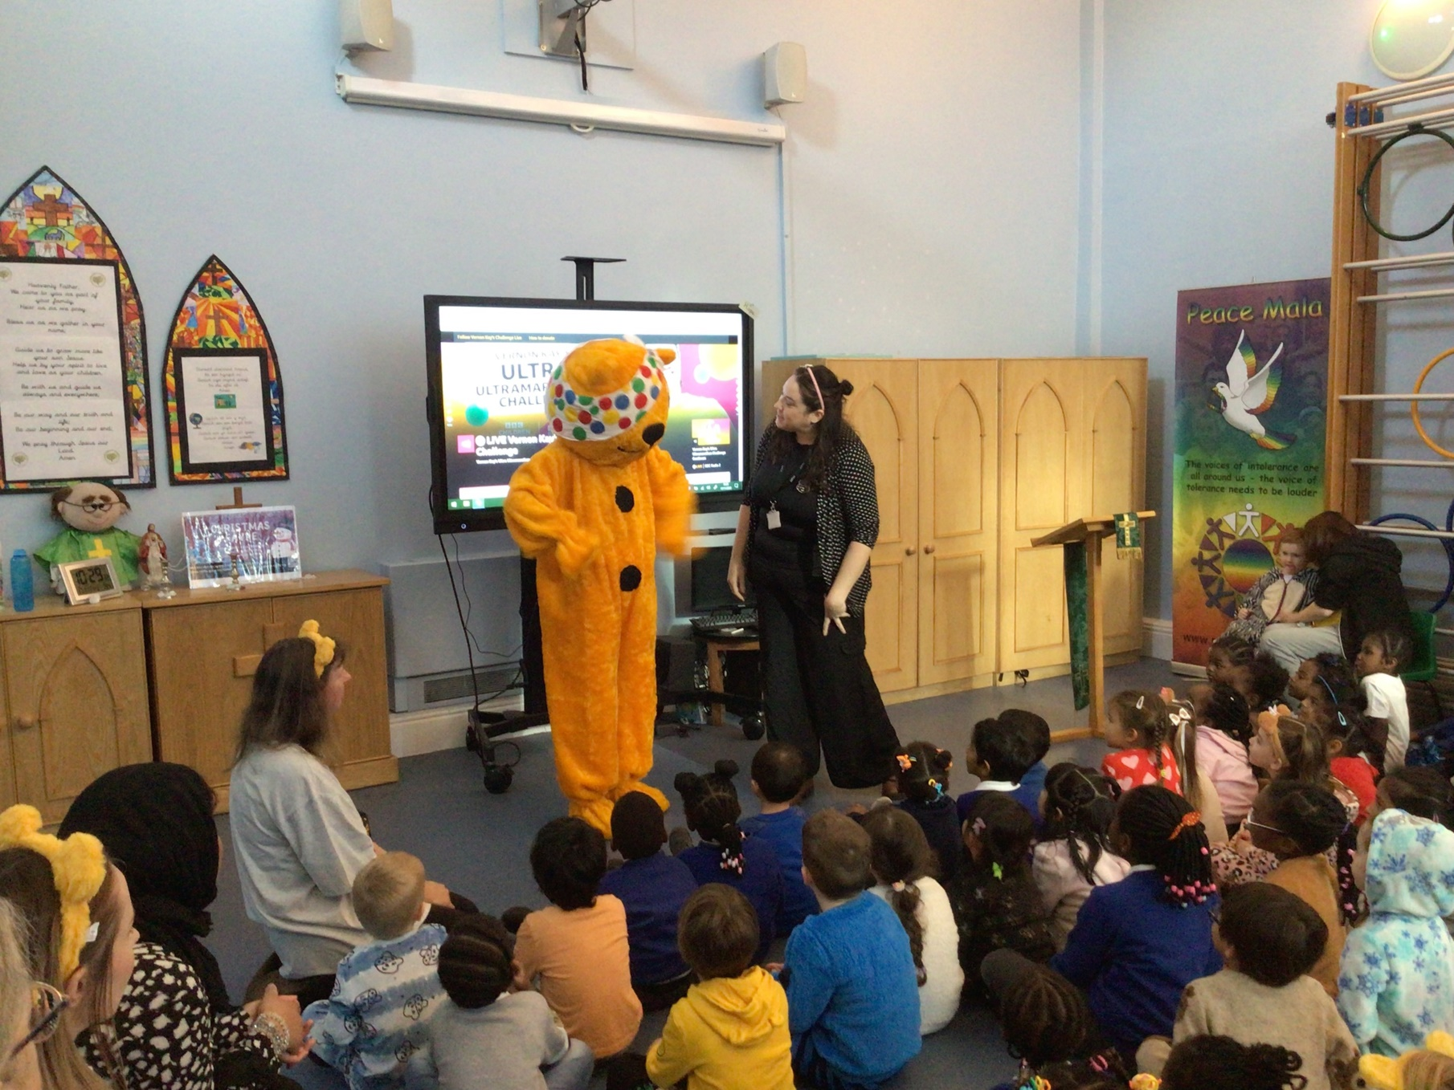
Children in Need
We raised £130.70

Slide 6
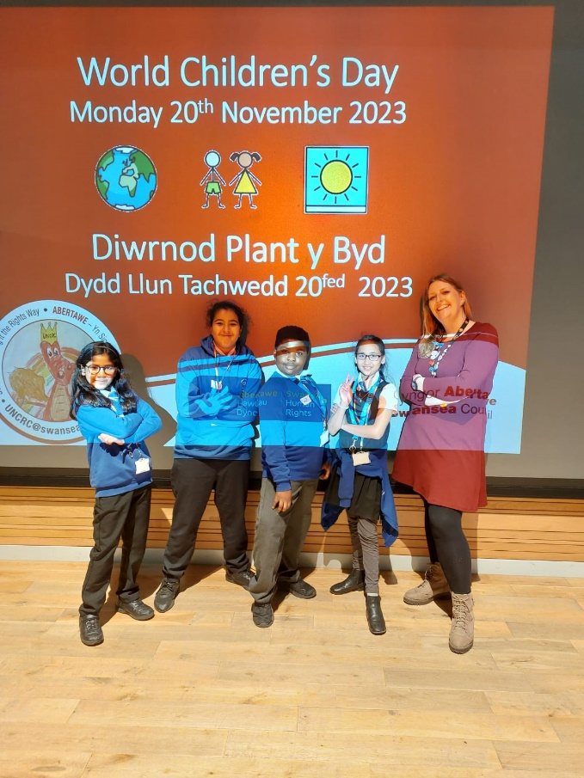
Children Rights Convention

Slide 7
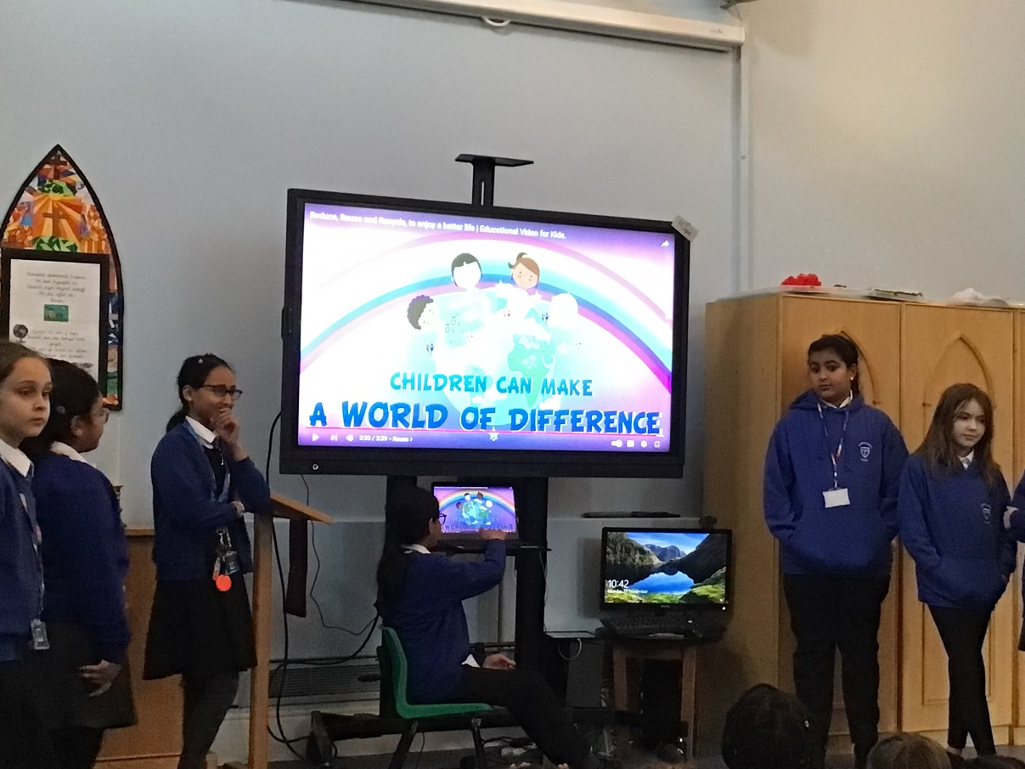
Raising Awarness of Being Enviromentally Friendly.
We are holding a competition for Reception to Y6. The best poster from each year group will win a prize. The posters will be displayed around the school.

