Slide 1

Recycle♻
By Agents Of Change and Super Ambassadors

Slide 2

What is recycle?
Recycling is the process of converting waste materials into new materials and objects. Recycling is to reduce waste and conserve resources.
Recycling takes materials instead of putting then to waste and reuses it. By recycling, we can reduce the amount of waste that ends up in landfills.

Slide 3

This is how OURS looks like

Slide 4

Why Recycle?
The Reason why we recycle is because it's good for the environment and it can lead us to a better future instead of a polluted one.
And Just because we are making the power point doesn’t mean we are not doing it!

Slide 5





Let's make the world a better place!
God gave us the world so we can look after it not to litter everywhere.
if we recycle, we can make the world a better place to live on.
If we can recycle it's like you just saved the world so let's recycle!

Slide 6
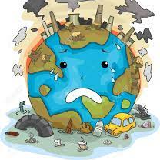
What would happen if we don’t recycle!
The world would turn into this....

Slide 7
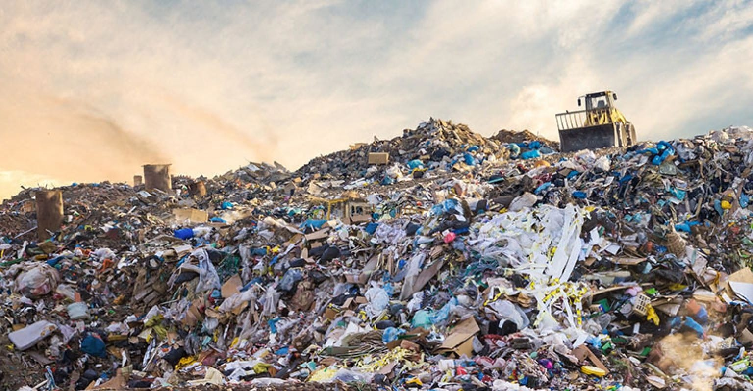
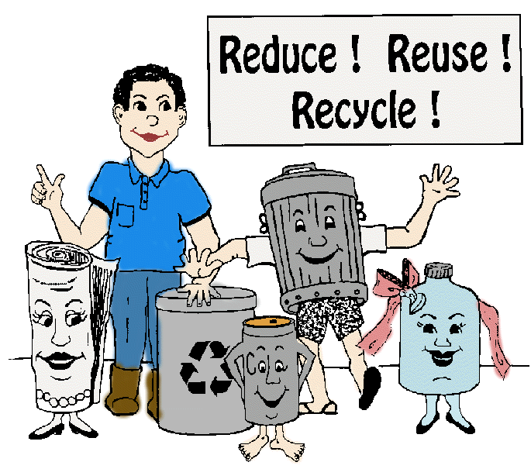
Why is recycling important
If we don't recycle than we are making the world worse ourselves. Paper and other things can be made of such better use but instead getting thrown away.

Slide 8
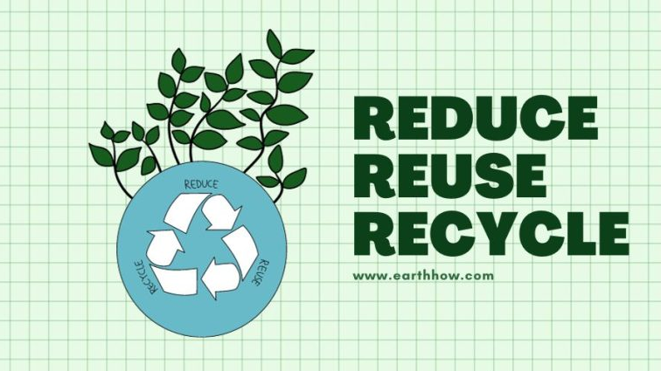
PLEASE TRY TO Reduce, Reuse and Recycle!!!

